Slide 1

179 Create Firebase Project
Peter H. Chen

Slide 2
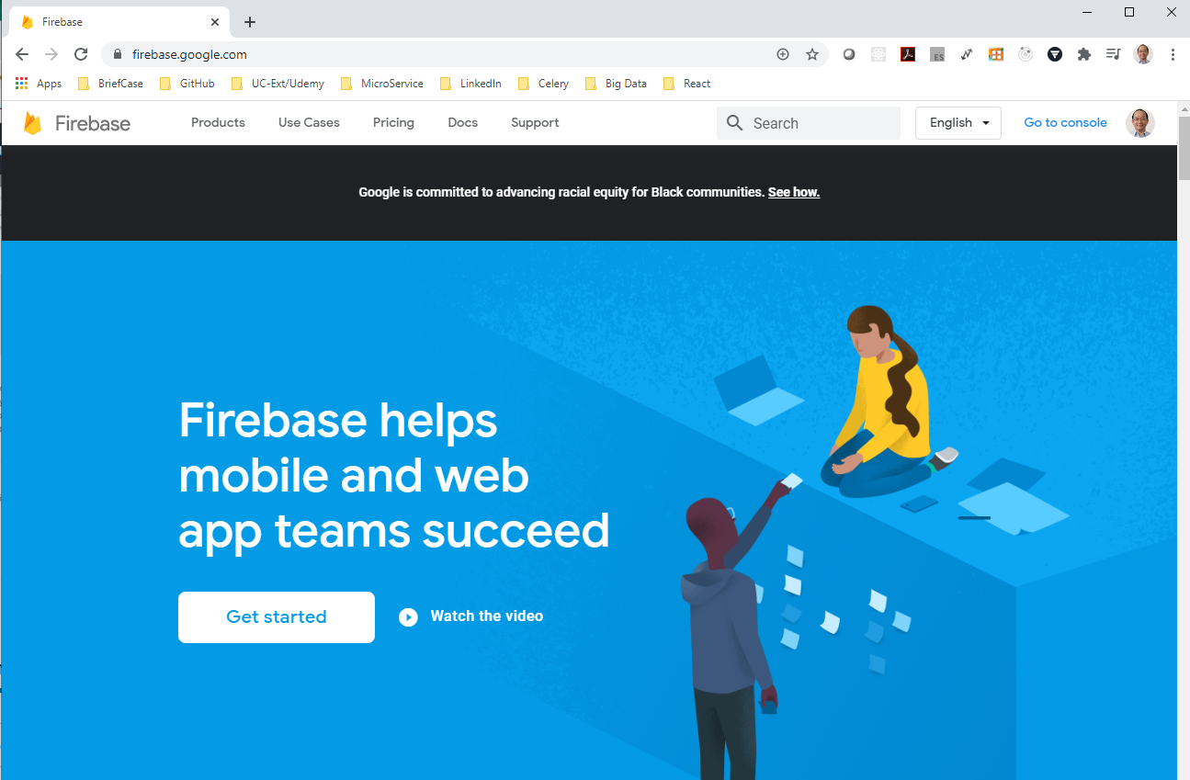
179 Create Firebase Project
https://www.udemy.com/course/react-the-complete-guide-incl-redux/learn/lecture/8138514#notes
Firebase pricing
https://firebase.google.com

Slide 3
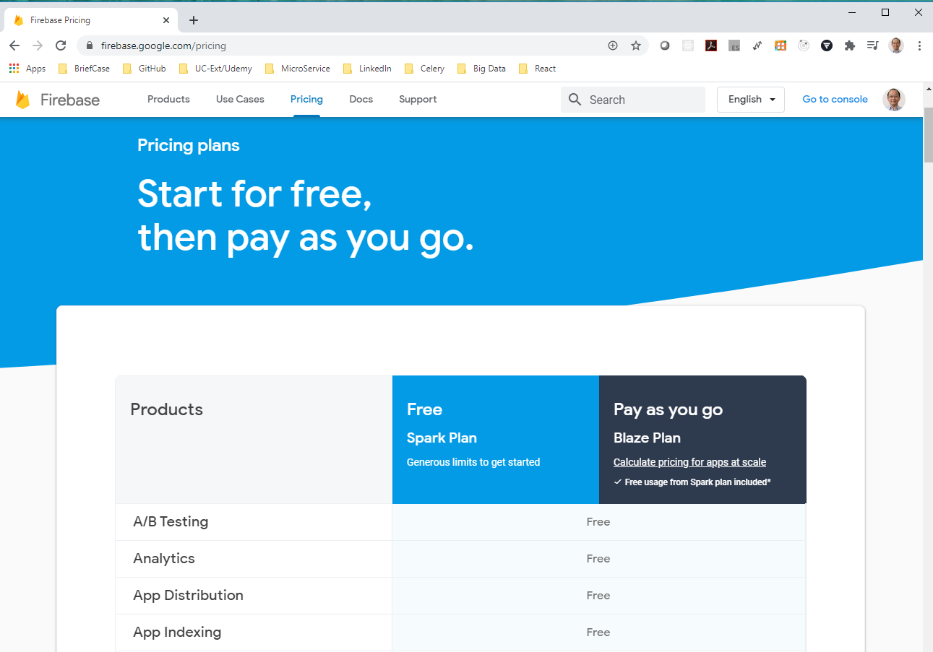
179 Create Firebase Project
https://www.udemy.com/course/react-the-complete-guide-incl-redux/learn/lecture/8138514#notes
Firebase pricing
https://firebase.google.com/pricing
It is very important if you plan on using this in production environment for our real application. If you stay in free plan, do not worry.

Slide 4
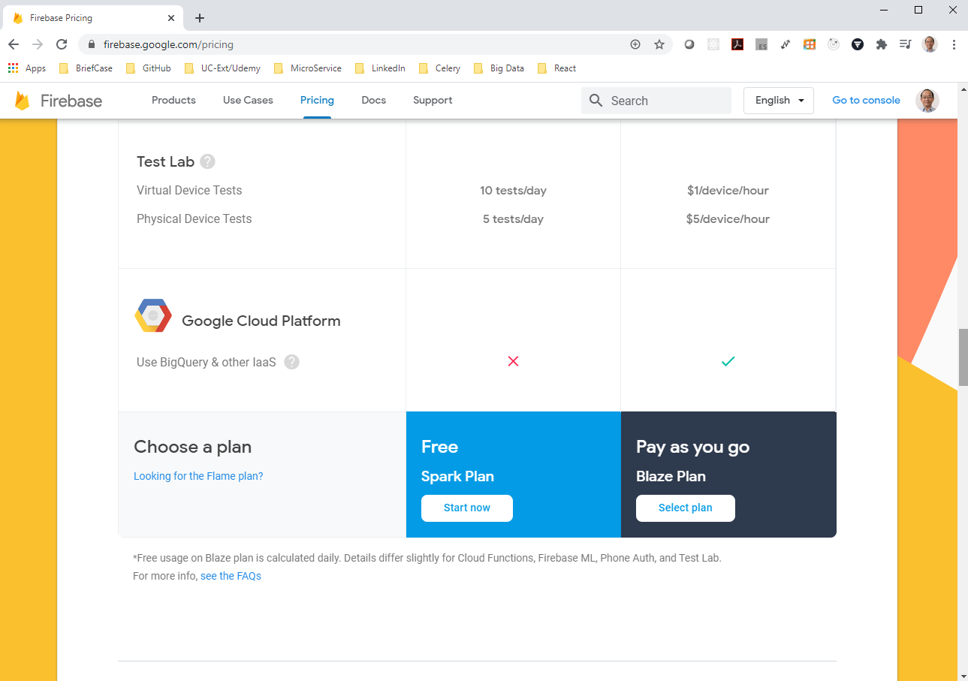
179 Create Firebase Project
https://www.udemy.com/course/react-the-complete-guide-incl-redux/learn/lecture/8138514#notes
Firebase pricing
https://firebase.google.com/pricing
You just have limited service in your production ready application.

Slide 5
179.1 Get Started

Slide 6
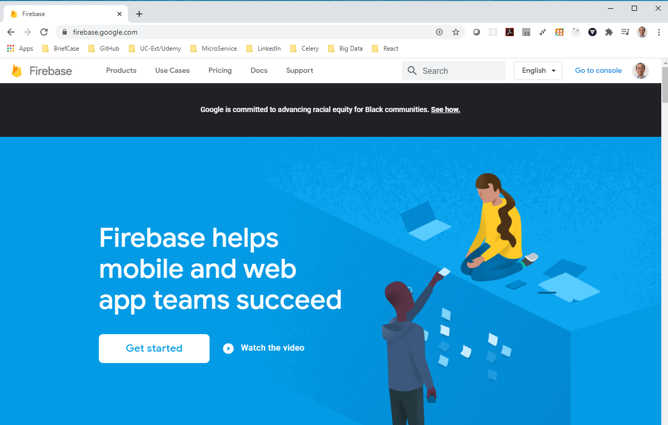
179.1 Firebase
https://www.udemy.com/course/react-the-complete-guide-incl-redux/learn/lecture/8138514#notes
Create Firebase Project
> Click “Get started”

Slide 7
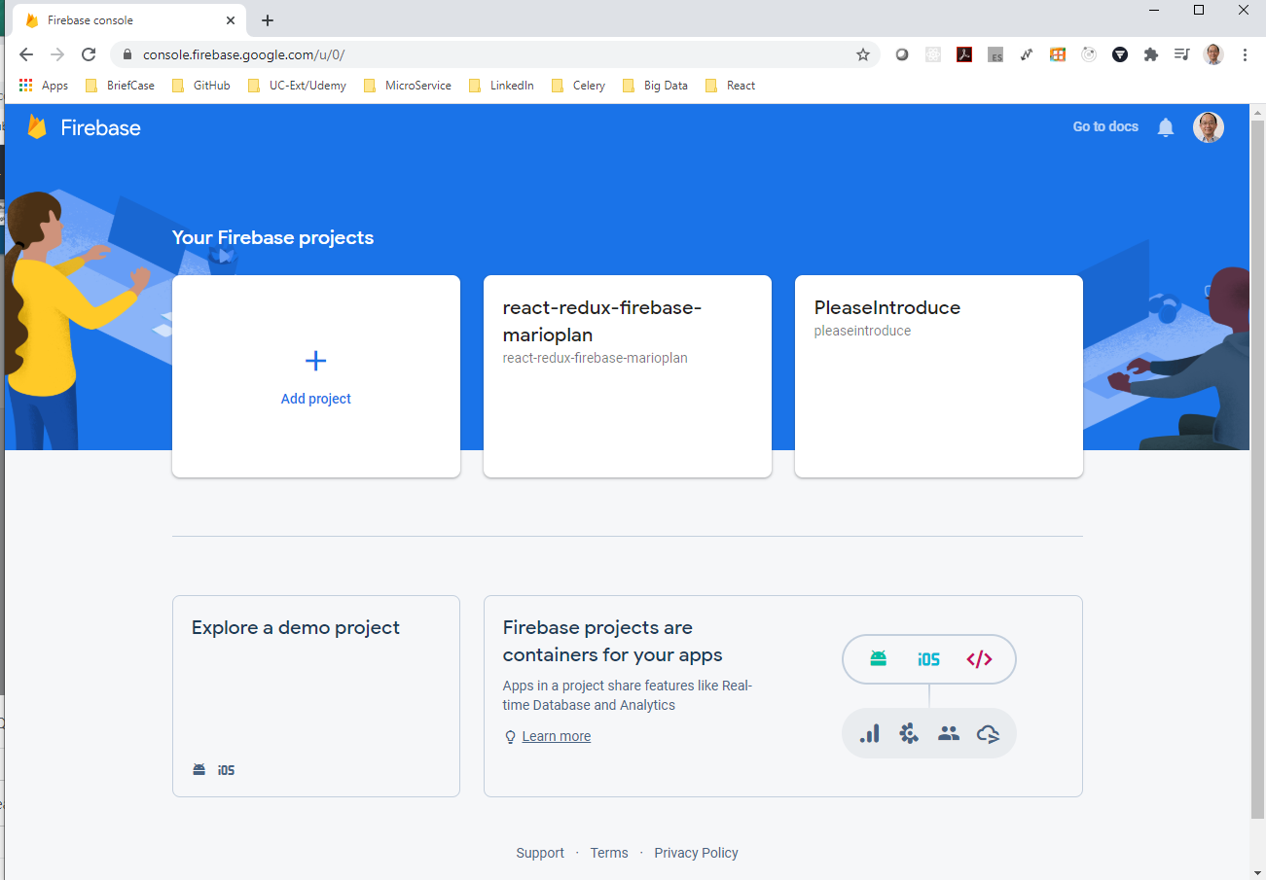
179.1 Firebase
https://www.udemy.com/course/react-the-complete-guide-incl-redux/learn/lecture/8138514#notes
Create Firebase Project
> Click “Add project”

Slide 8
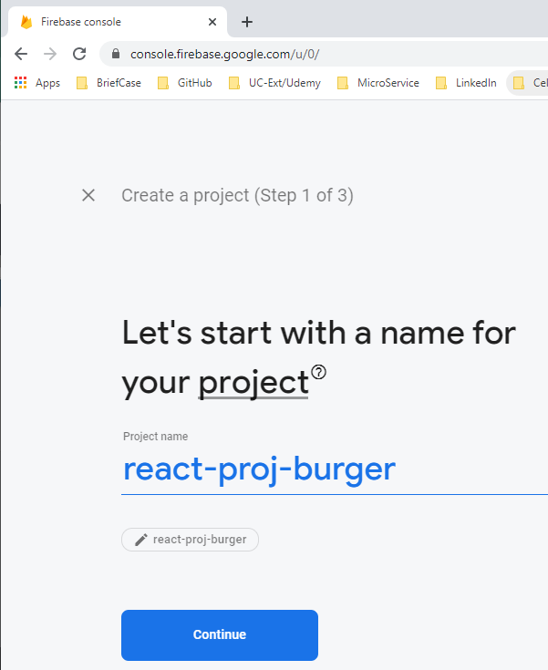
179.1 Firebase
https://www.udemy.com/course/react-the-complete-guide-incl-redux/learn/lecture/8138514#notes
Create Firebase Project
> Give the Project Name: react-proj-burger

Slide 9
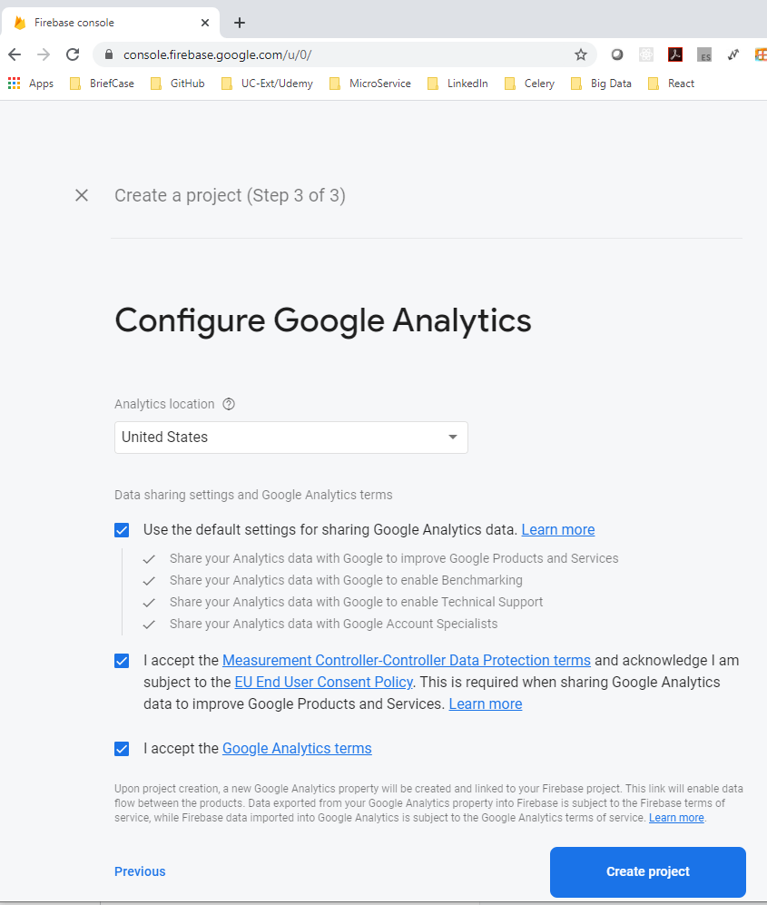
179.1 Firebase
https://www.udemy.com/course/react-the-complete-guide-incl-redux/learn/lecture/8138514#notes
Create Firebase Project
> Configure Google Analytics

Slide 10
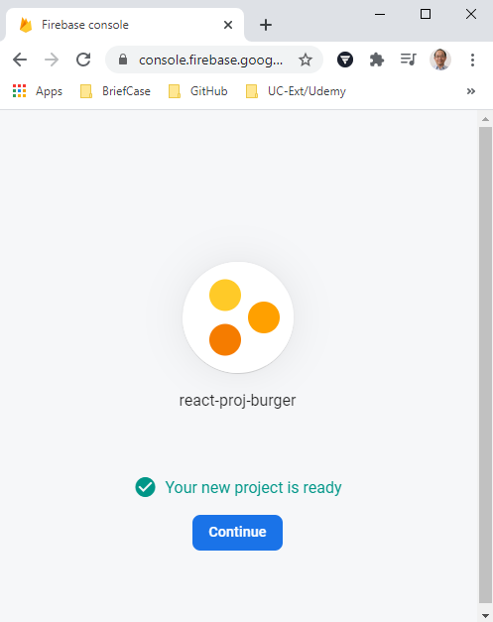
179.1 Firebase
https://www.udemy.com/course/react-the-complete-guide-incl-redux/learn/lecture/8138514#notes
Create Firebase Project
The configuration automatically give you some REST API endpoint and MongoDB like database store data so that we do not have to write any server side code.

Slide 11
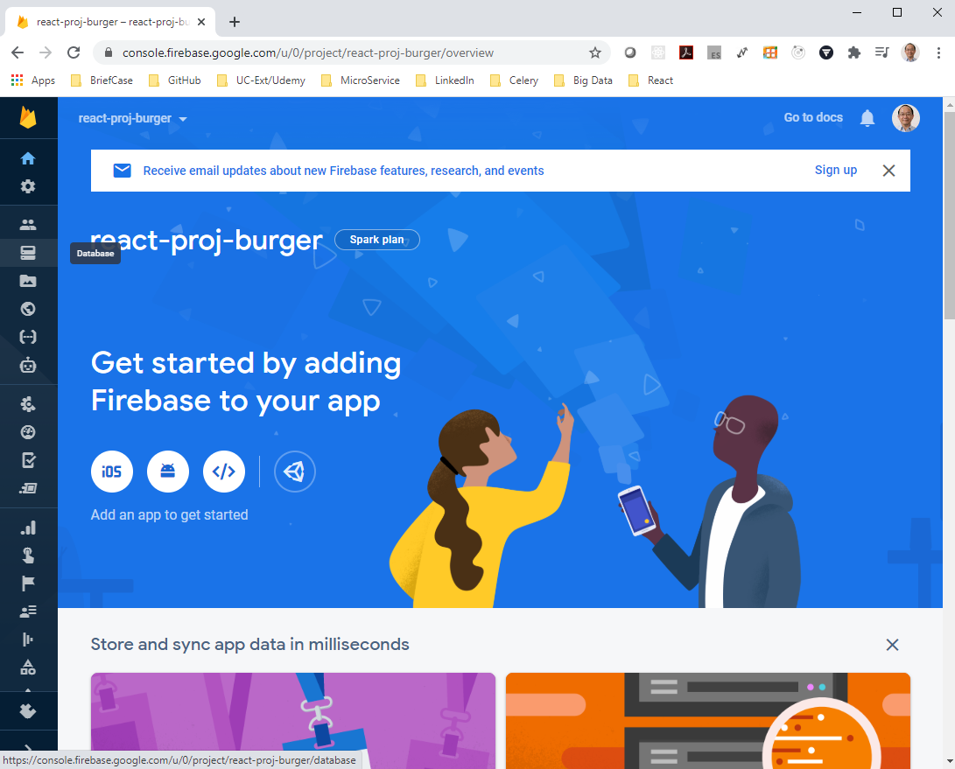
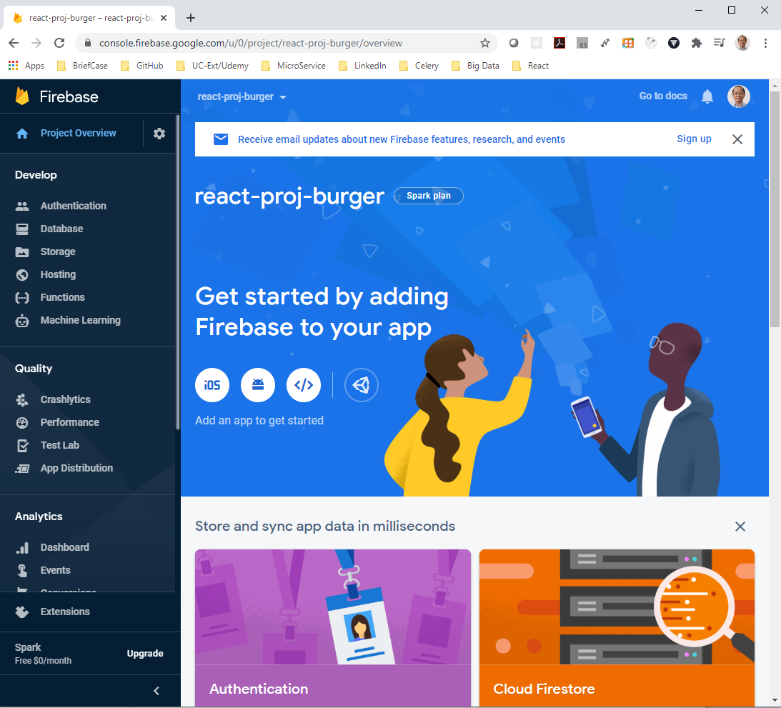
179.1 Firebase
https://www.udemy.com/course/react-the-complete-guide-incl-redux/learn/lecture/8138514#notes
Create Firebase Project
The console looks like this.
On the left hand side, select the “Database”.

Slide 12
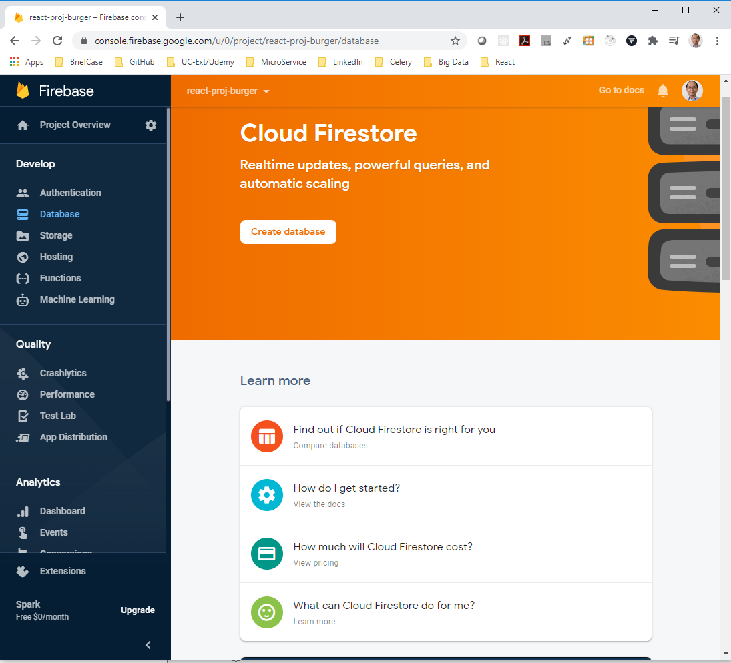
179.1 Firebase
https://www.udemy.com/course/react-the-complete-guide-incl-redux/learn/lecture/8138514#notes
Create Firebase Project
Firebase has the API endpoint and directly mapped to endpoints or to tables in our database.
It is very easy to get started and store data.
Click “Create Database”

Slide 13
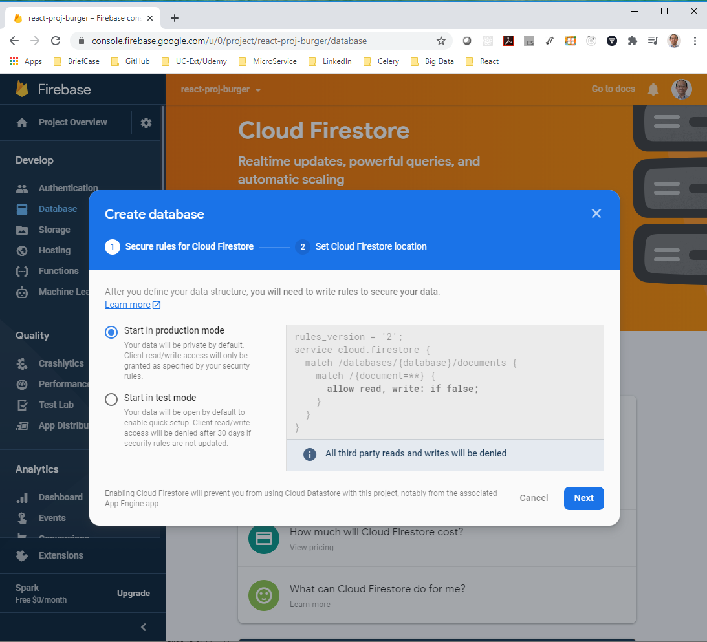
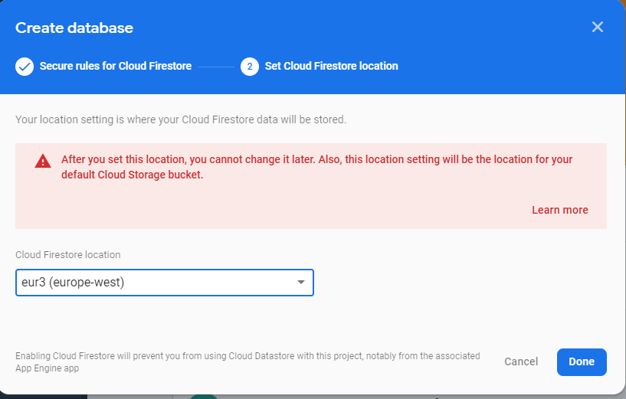
179.1 Firebase
https://www.udemy.com/course/react-the-complete-guide-incl-redux/learn/lecture/8138514#notes
Create Firebase Project
Create Production Mode. Select Location: US West

Slide 14
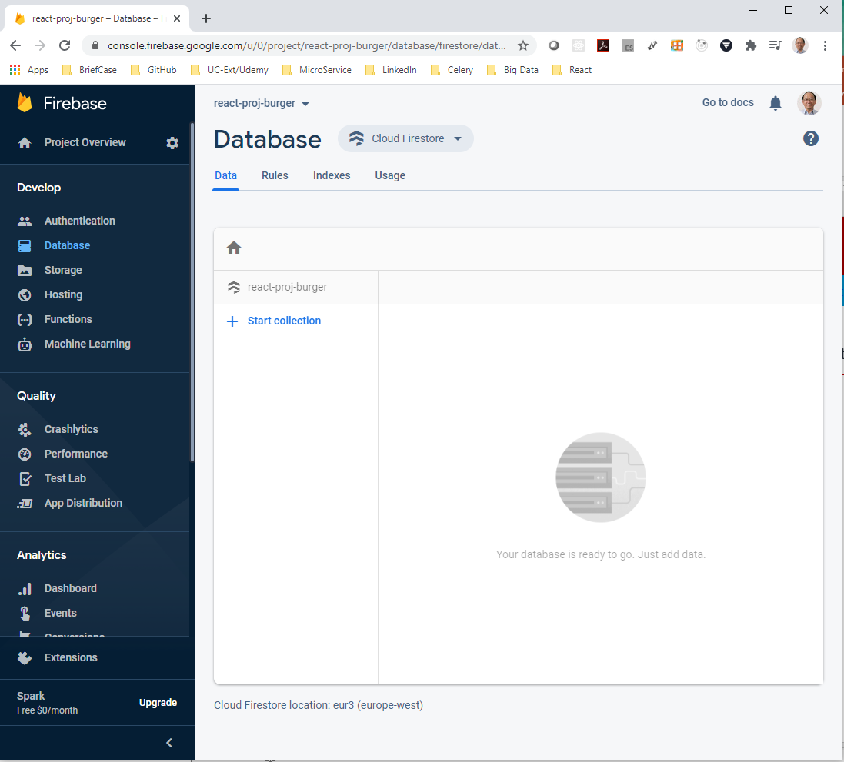

179.1 Firebase
https://www.udemy.com/course/react-the-complete-guide-incl-redux/learn/lecture/8138514#notes
Create Firebase Project
Change the Database from “Cloud Firestore” to “Realtime Database”

Slide 15
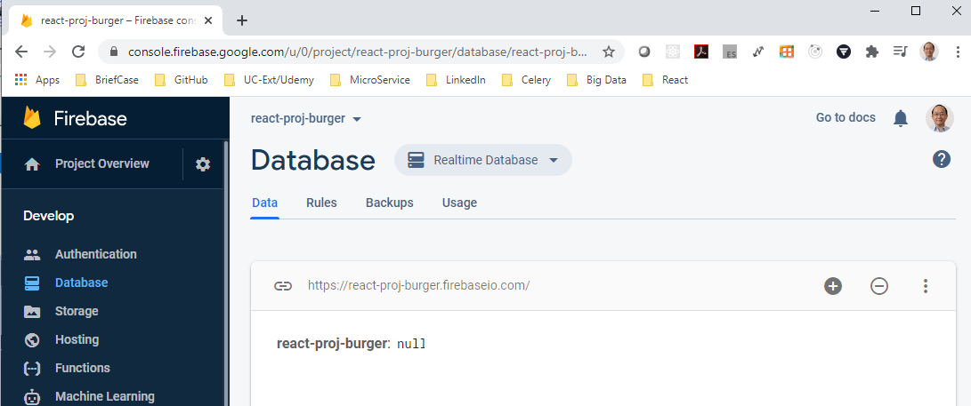
179.1 Firebase
https://www.udemy.com/course/react-the-complete-guide-incl-redux/learn/lecture/8138514#notes
Create Firebase Project
“Realtime Database” location: https://react-proj-burger.firebaseio.com
This is the endpoint where we send data and it will automatically be stored in this database.

Slide 16
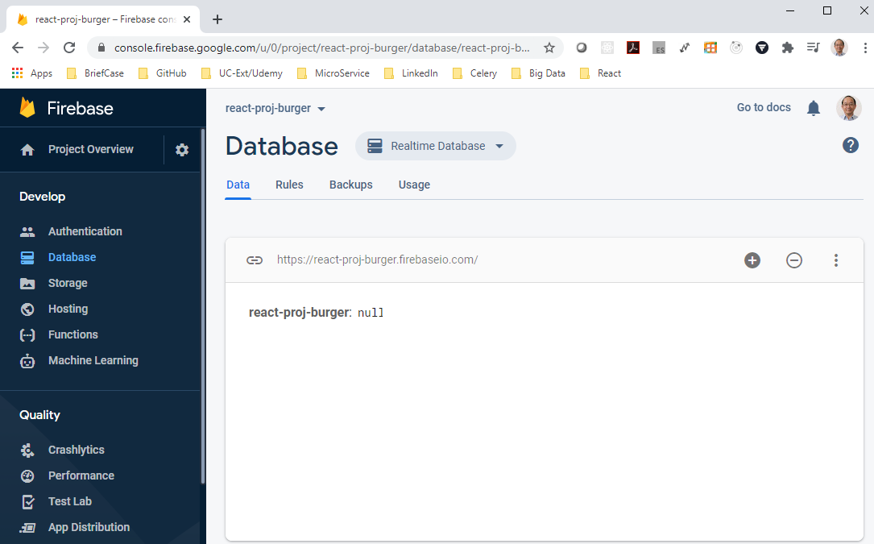
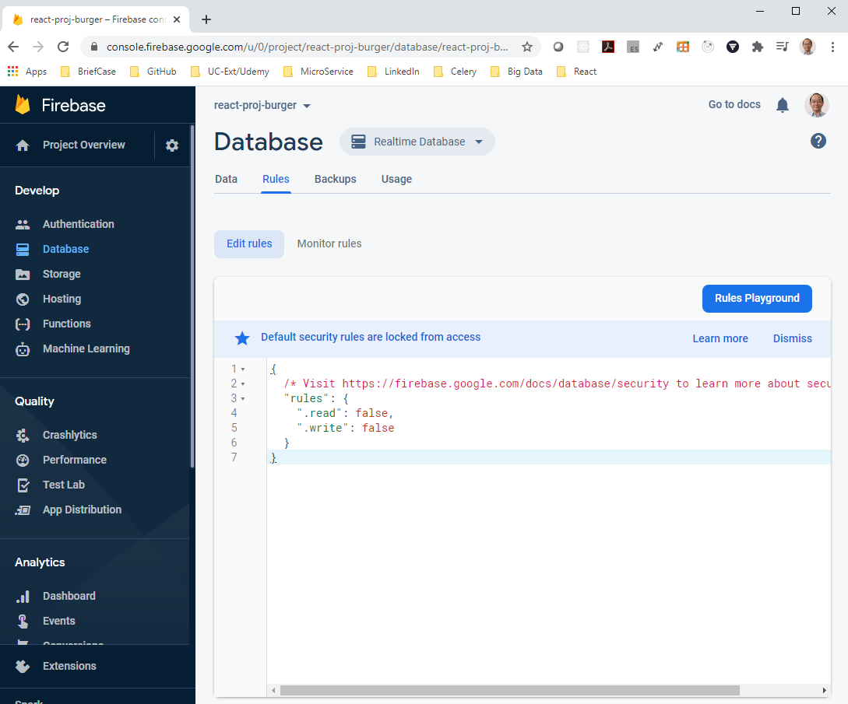
179.1 Firebase
https://www.udemy.com/course/react-the-complete-guide-incl-redux/learn/lecture/8138514#notes
Create Firebase Project
We just HTTP Request to endpoint. The firebase will map the HTTP endpoints to the database.
This is the cool thing that firebase setup for us.
Click the “Rules” Tab.

Slide 17
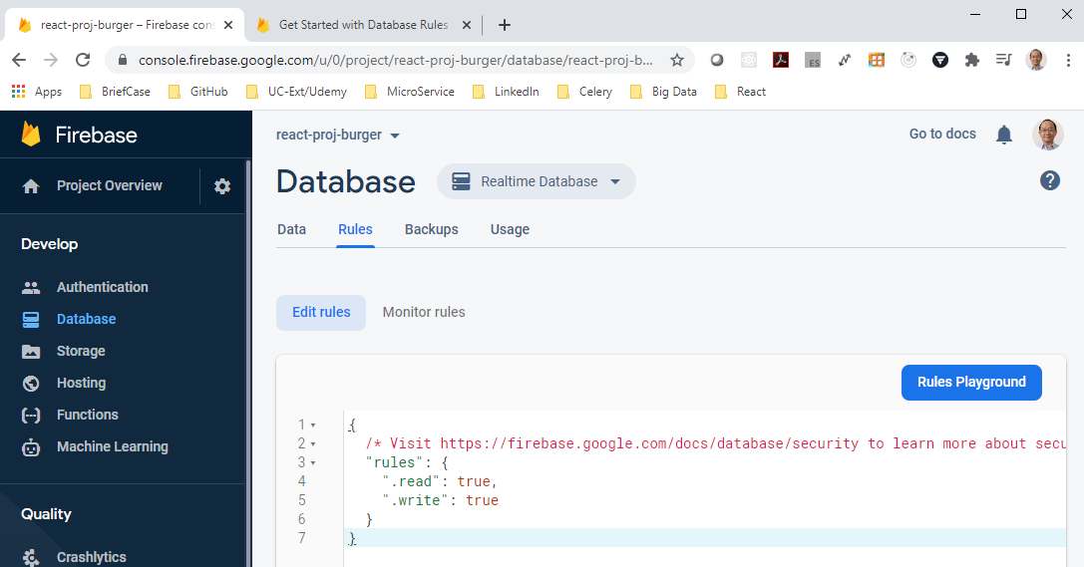
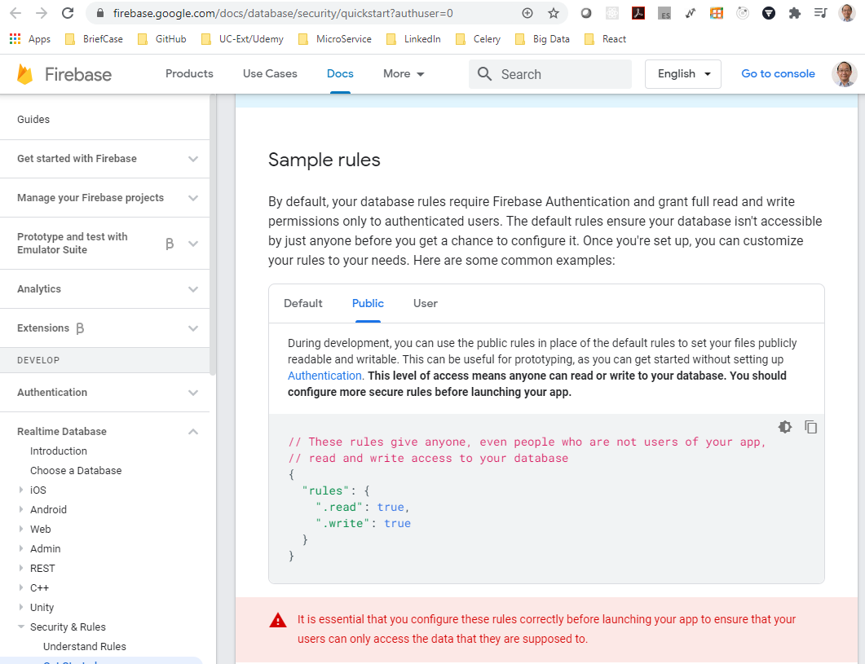
179.1 Firebase
https://www.udemy.com/course/react-the-complete-guide-incl-redux/learn/lecture/8138514#notes
Create Firebase Project
Set the read and write to true for you test.
“rules”: {
“.read”: true, “.write”: true}
This true is for authentication users and the production ready application.

Slide 18
179.1 Firebase
https://www.udemy.com/course/react-the-complete-guide-incl-redux/learn/lecture/8138514#notes
Create Firebase Project
We have not implemented the authenticated users yet.
For this moment, we set to true. Everyone can read and write.
Of course, this mode is not for our real application.
We need read and write for authenticated users only.
The global read write permission cannot be used in real production mode.

Slide 19
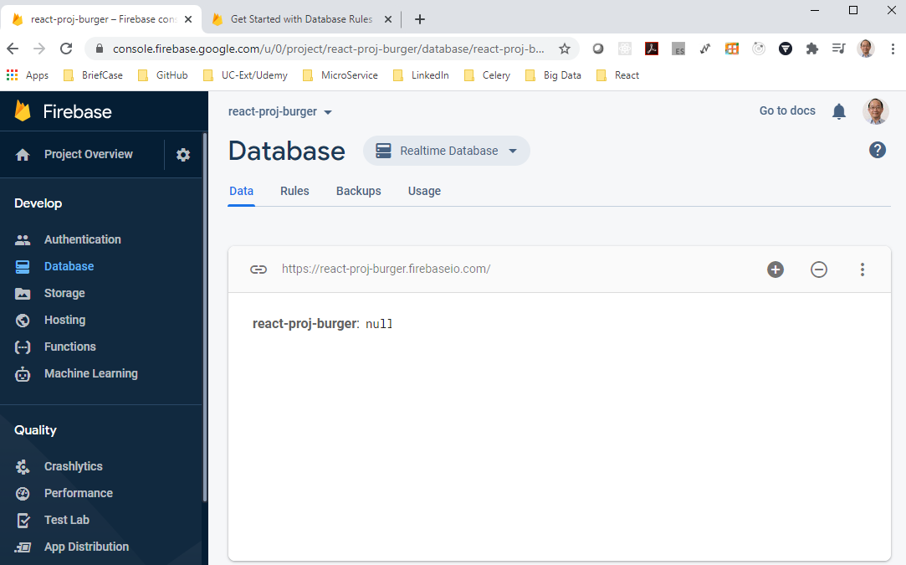
179.1 Firebase
https://www.udemy.com/course/react-the-complete-guide-incl-redux/learn/lecture/8138514#notes
Create Firebase Project
We can start any HTTP request now.
We can make request to this http endpoint or some nested endpoints..

Slide 20
End of Chapter

