Slide 1

180 Create Axios Instance
Peter H. Chen

Slide 2
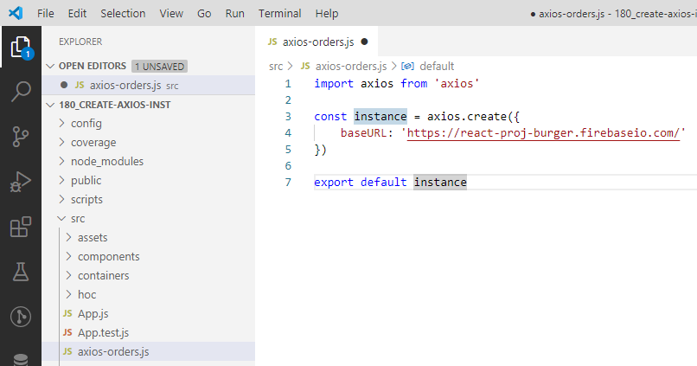
180 Create Axios Instance
https://www.udemy.com/course/react-the-complete-guide-incl-redux/learn/lecture/8138518#notes
Create Axios Instance
Create axios-orders.js
> axios.create({
> baseURL: ‘firebaseURL’
>})

Slide 3
End of Chapter

