Slide 1

181 Send Post Request
Peter H. Chen

Slide 2
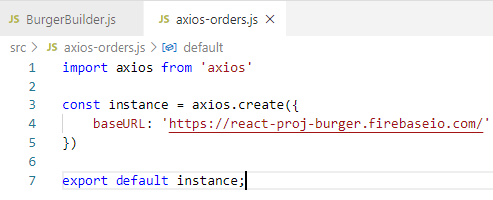
181 Send Post Request
https://www.udemy.com/course/react-the-complete-guide-incl-redux/learn/lecture/8138520#notes
Send Post Request
Create axios-orders.js
> axios.create({
> baseURL: ‘firebaseURL’
>})

Slide 3
181.1 Send Post Request

Slide 4
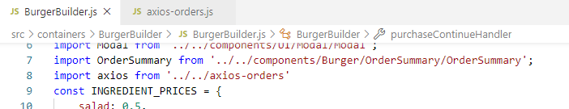
181.1 Send Post Request
https://www.udemy.com/course/react-the-complete-guide-incl-redux/learn/lecture/8138520#notes
Send Post Request
In BurgerBuilder.js, import alias from ‘../../axios-orders’

Slide 5
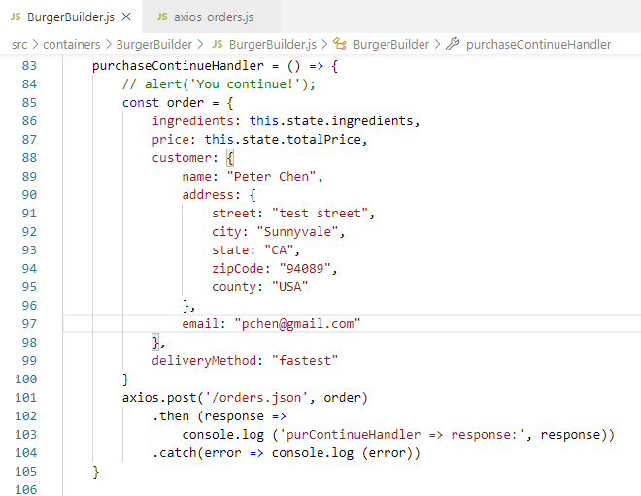
181.1 Send Post Request
https://www.udemy.com/course/react-the-complete-guide-incl-redux/learn/lecture/8138520#notes
Send Post Request
Set up data
Send to firebase: Axis.post (‘/table.json’, data)

Slide 6
181.2 Verify

Slide 7
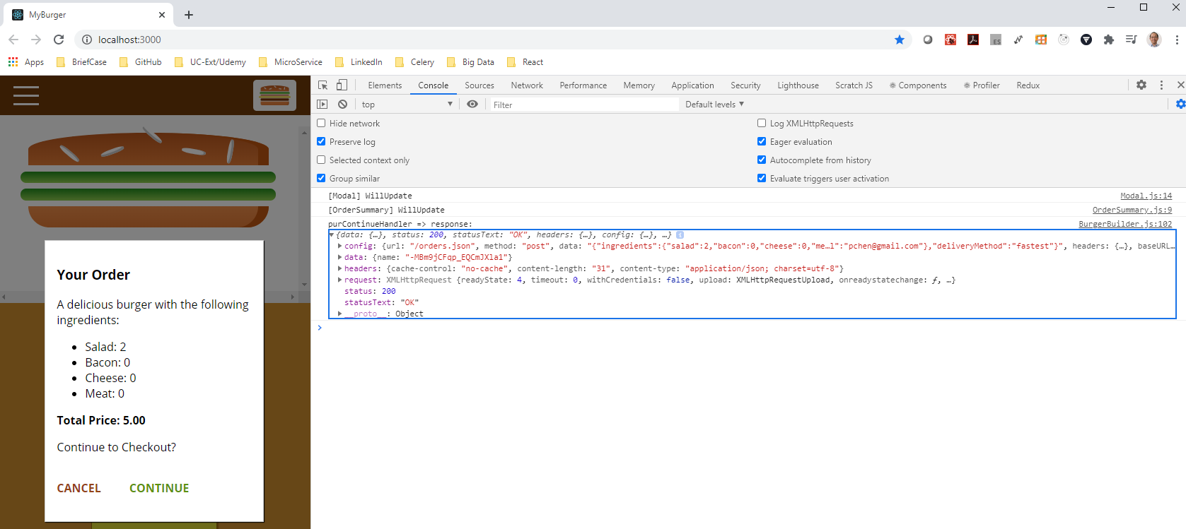
181.2 Verify
https://www.udemy.com/course/react-the-complete-guide-incl-redux/learn/lecture/8138520#notes
Verify response data

Slide 8
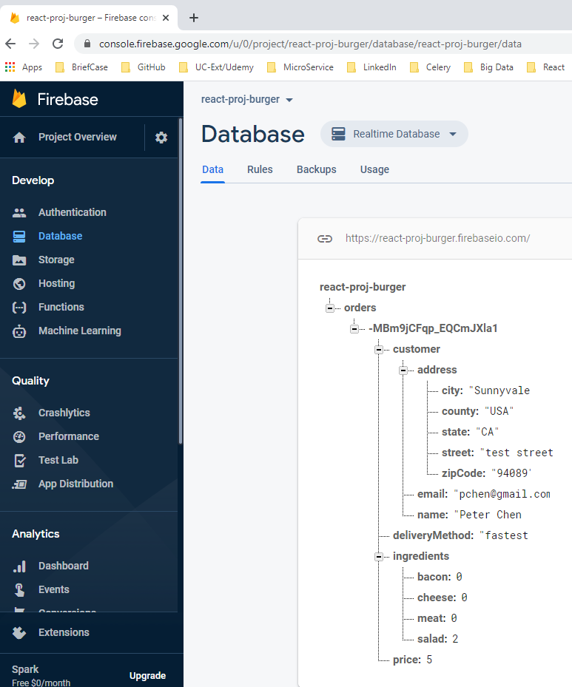
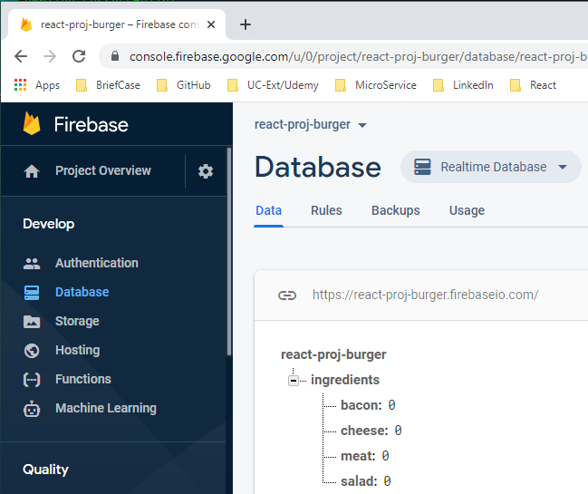
181.2 Verify
https://www.udemy.com/course/react-the-complete-guide-incl-redux/learn/lecture/8138520#notes
Verify response data

Slide 9
End of Chapter

