Slide 1

182 Spinner
Peter H. Chen

Slide 2
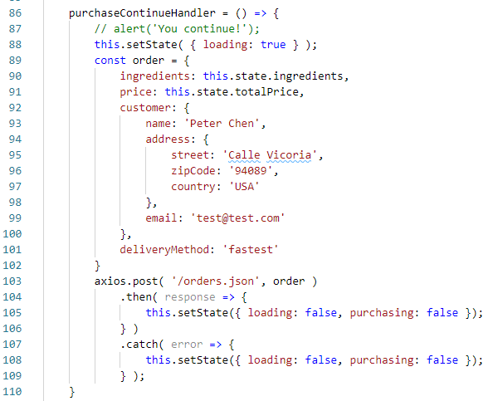
182 Spinner
https://www.udemy.com/course/react-the-complete-guide-incl-redux/learn/lecture/8125796#notes
Spinner
In the last discussion, we add a POST request. We want to add the spinner when saving the database.

Slide 3
182.1 Add Spinner

Slide 4
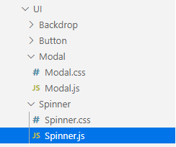
182.1 Add Spinner
https://www.udemy.com/course/react-the-complete-guide-incl-redux/learn/lecture/8125796#notes
Spinner
Add components\UI\Spinner\Spinner.js and Spinner.css.

Slide 5
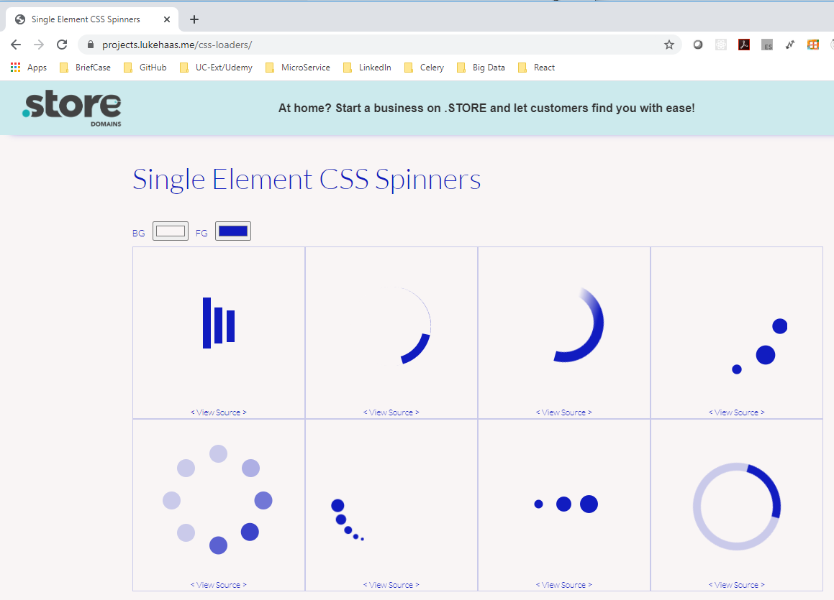
182.1 Add Spinner
https://www.udemy.com/course/react-the-complete-guide-incl-redux/learn/lecture/8125796#notes
Spinner/Loader
https://projects.lukehaas.me/css-loaders/
Use “BG” and “FG” to select the color you want.

Slide 6
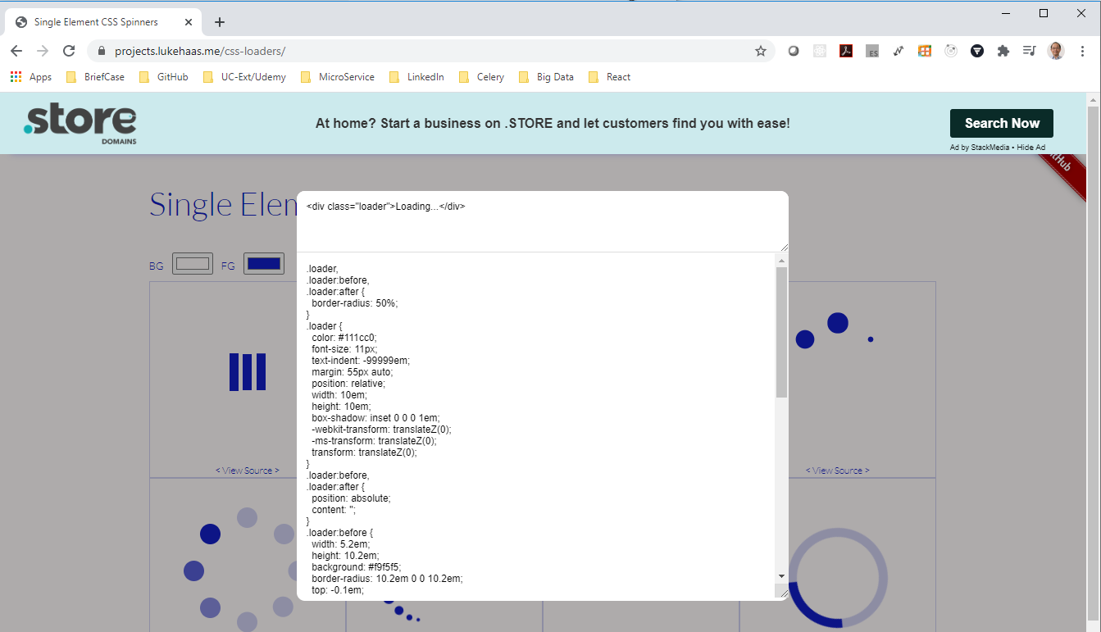
182.1 Add Spinner
https://www.udemy.com/course/react-the-complete-guide-incl-redux/learn/lecture/8125796#notes
Spinner/Loader
https://projects.lukehaas.me/css-loaders/
Click the spinner you want and select <View Source>.
Copy the source code and put in “./Spinner.css”

Slide 7
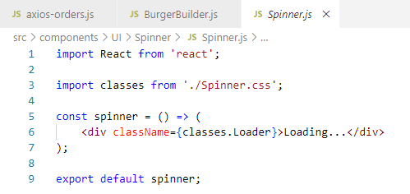
182.1 Add Spinner
https://www.udemy.com/course/react-the-complete-guide-incl-redux/learn/lecture/8125796#notes
Spinner
Add components\UI\Spinner\Spinner.js

Slide 8
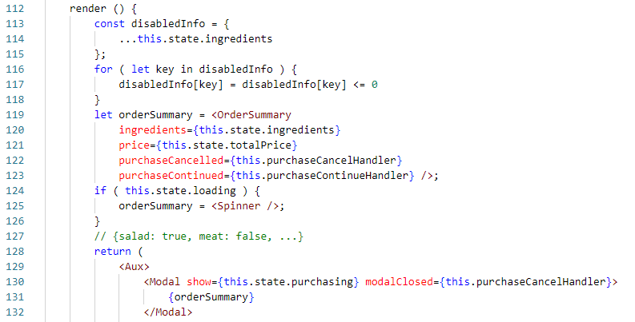
182.1 Add Spinner
https://www.udemy.com/course/react-the-complete-guide-incl-redux/learn/lecture/8125796#notes
Spinner
We need to render “Order Summary” in the Modal for the Spinner.

Slide 9
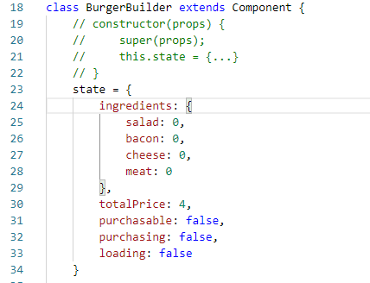
182.1 Add Spinner
https://www.udemy.com/course/react-the-complete-guide-incl-redux/learn/lecture/8125796#notes
Spinner
We need a state “loading” for database and Spinner.
When loading is true, then display the Spinner in the Modal.
When loading is false, then we want to show the order summary in the Modal.

Slide 10
182.1 Add Spinner
https://www.udemy.com/course/react-the-complete-guide-incl-redux/learn/lecture/8125796#notes
Spinner
Let the orderSummary variable for <OrderSummary …>
When the loading is true, then overwrite the orderSummary to Spinner component.

Slide 11
182.1 Add Spinner
https://www.udemy.com/course/react-the-complete-guide-incl-redux/learn/lecture/8125796#notes
Spinner
We show the orderSummary in the Modal component.

Slide 12
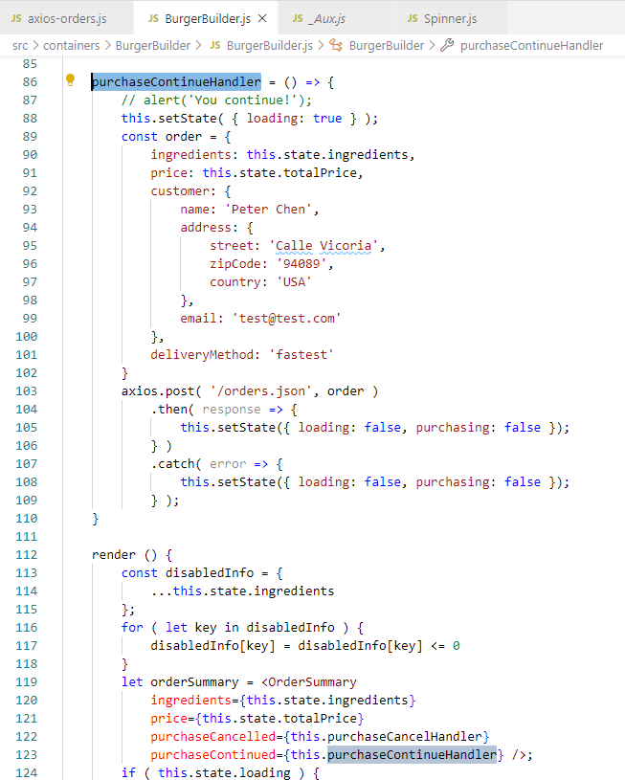
182.1 Add Spinner
https://www.udemy.com/course/react-the-complete-guide-incl-redux/learn/lecture/8125796#notes
Spinner
We need to set the loading to true when we call axios.

Slide 13
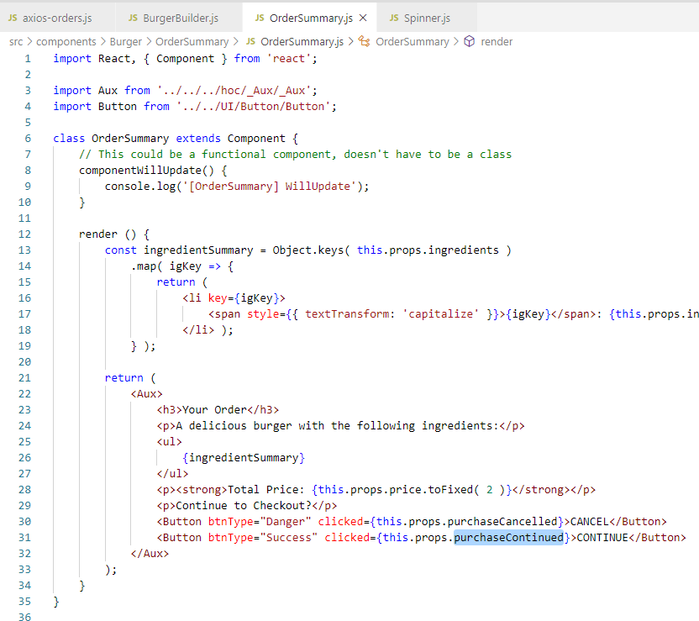
182.1 Add Spinner
https://www.udemy.com/course/react-the-complete-guide-incl-redux/learn/lecture/8125796#notes
Spinner
“props.purchasedContinued” is a reference of “perchaseContinuedHandler”
When click in the child, the parent handler will be called.

Slide 14
182.1 Add Spinner
https://www.udemy.com/course/react-the-complete-guide-incl-redux/learn/lecture/8125796#notes
Spinner
Note:
React props is called by reference.
https://www.google.com/search?q=react+property+is+called+by+reference&rlz=1C1KDEC_enUS826US826&oq=react+property+is+called+by+reference&aqs=chrome..69i57.8908j0j7&sourceid=chrome&ie=UTF-8
When click in the child, the parent handler will be called.

Slide 15
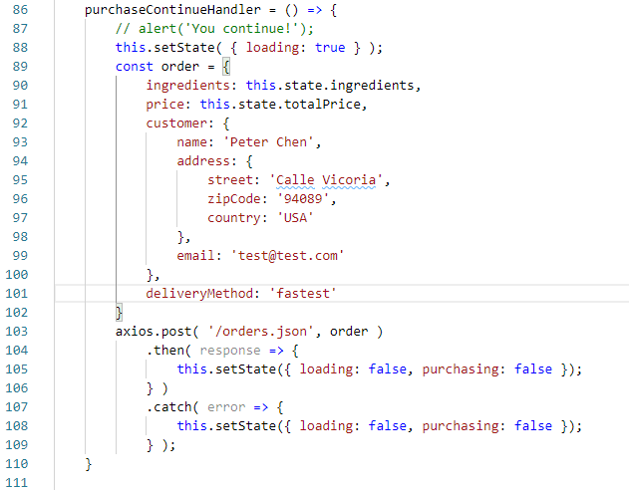
182.1 Add Spinner
https://www.udemy.com/course/react-the-complete-guide-incl-redux/learn/lecture/8125796#notes
Spinner
Once the response is there, the data is saved to database, we no longer want to display the spinner. We need to stop the spinner. We set the loading to false.
We also set the purchasing to false to close the Modal.

Slide 16
182.2 Verify

Slide 17
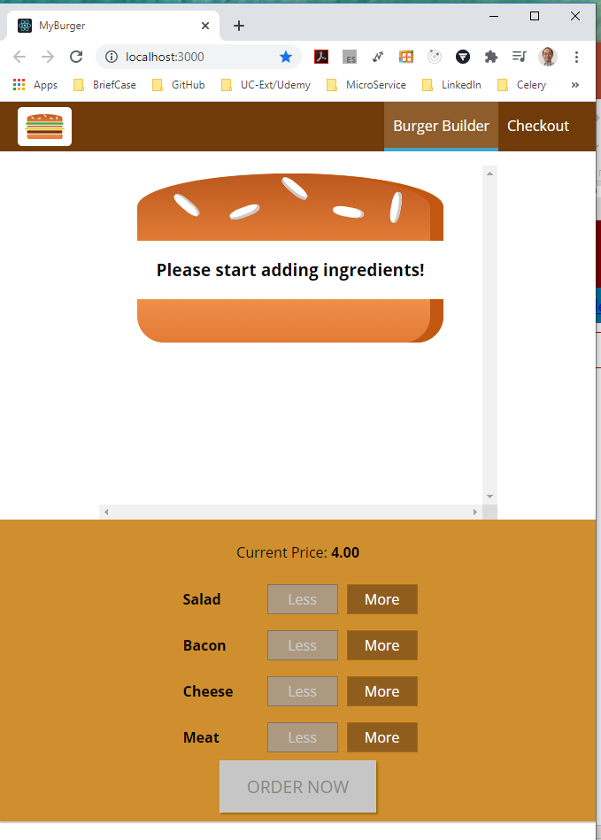
182.2 Verify
https://www.udemy.com/course/react-the-complete-guide-incl-redux/learn/lecture/8125796#notes
Verify Spinner

Slide 18
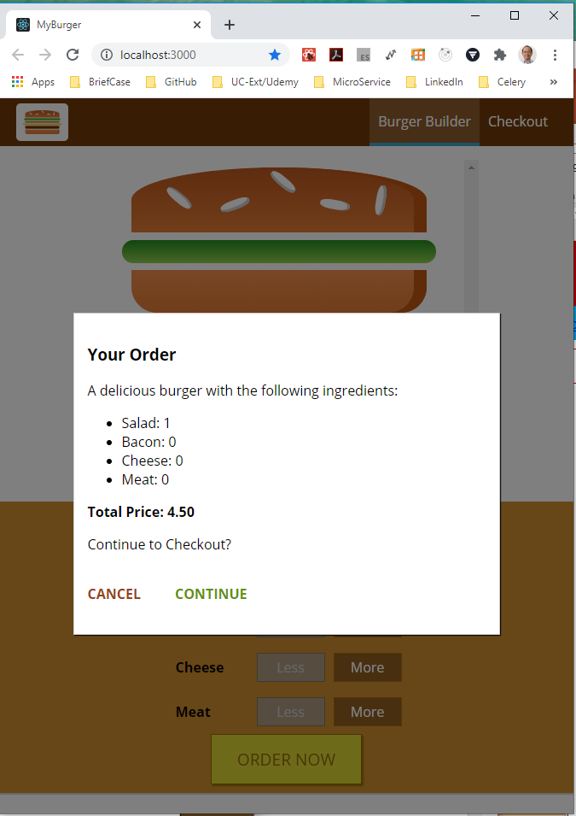
182.2 Verify
https://www.udemy.com/course/react-the-complete-guide-incl-redux/learn/lecture/8125796#notes
Verify Spinner

Slide 19
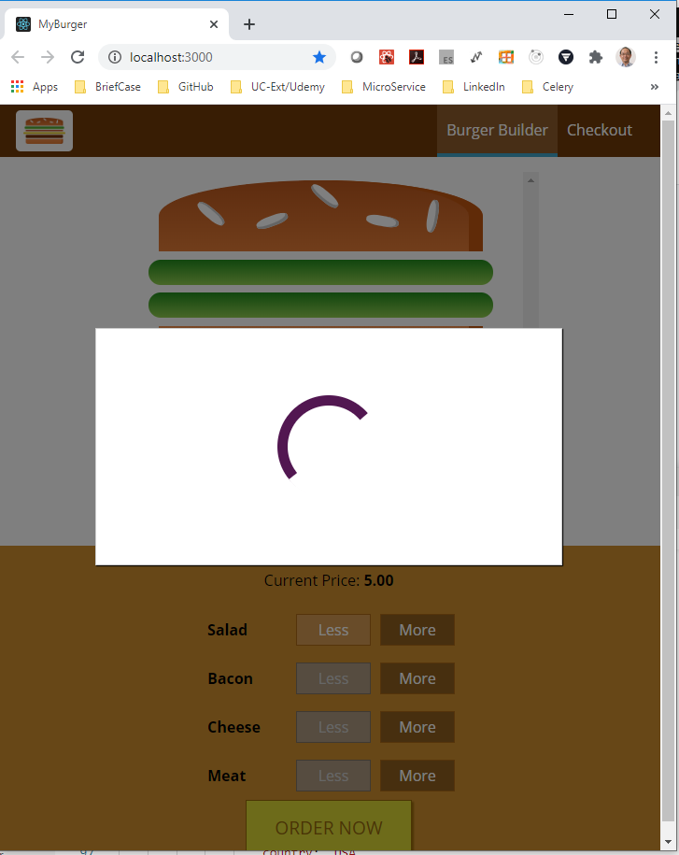
182.2 Verify
https://www.udemy.com/course/react-the-complete-guide-incl-redux/learn/lecture/8125796#notes
Verify Spinner

Slide 20
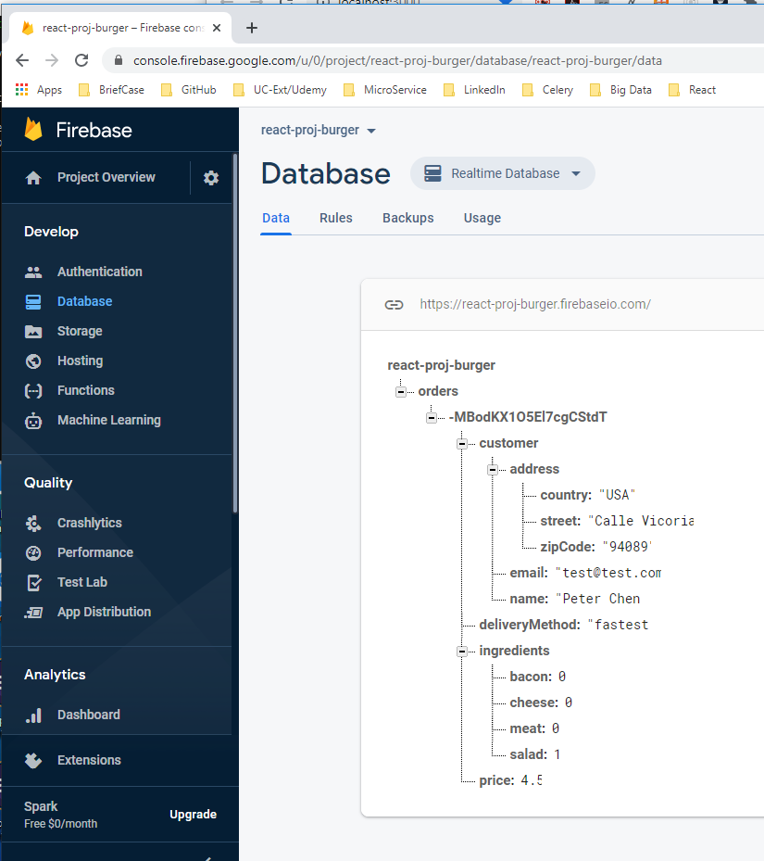
182.2 Verify
https://www.udemy.com/course/react-the-complete-guide-incl-redux/learn/lecture/8125796#notes
Verify Spinner
Open firebase and check:
https://console.firebase.google.com/u/0/project/react-proj-burger/database/react-proj-burger/data

Slide 21
End of Chapter

