Slide 1

183 Global Handle Error
Peter H. Chen

Slide 2
183 Global Handle Error
https://www.udemy.com/course/react-the-complete-guide-incl-redux/learn/lecture/13556518#notes
Global Handle Error
We discuss the Handle Error Globally.
We want to setup the global error handler.

Slide 3
183.1 Global Handle Error

Slide 4
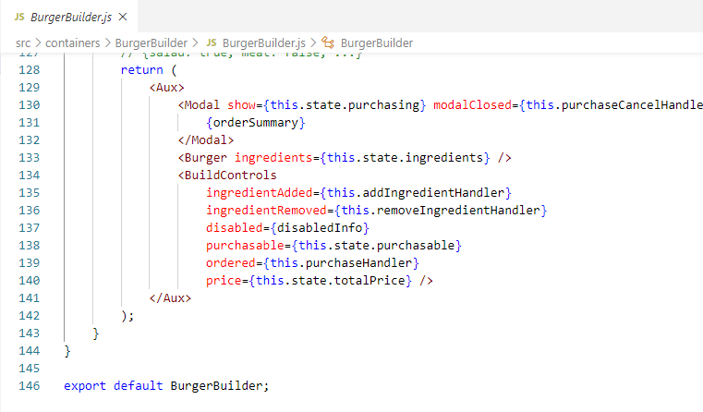
183.1 Global Handle Error
https://www.udemy.com/course/react-the-complete-guide-incl-redux/learn/lecture/13556518#notes
We need some higher order component to handle for burger builder container where I catch errors and where then make sure that my error model is displayed.
Where can we set this up? How can we control this?

Slide 5
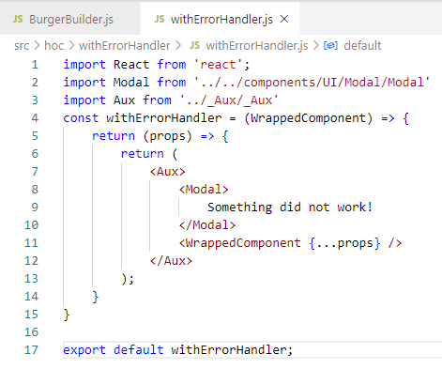
183.1 Global Handle Error
https://www.udemy.com/course/react-the-complete-guide-incl-redux/learn/lecture/13556518#notes
We simply want to create a higher order component with which we can wrap the burger builder.
We will use higher order components to do that.
We can wrap any component which should have this error modal.
We create an HOC withErrorHandler/withErrorHandler.js.

Slide 6
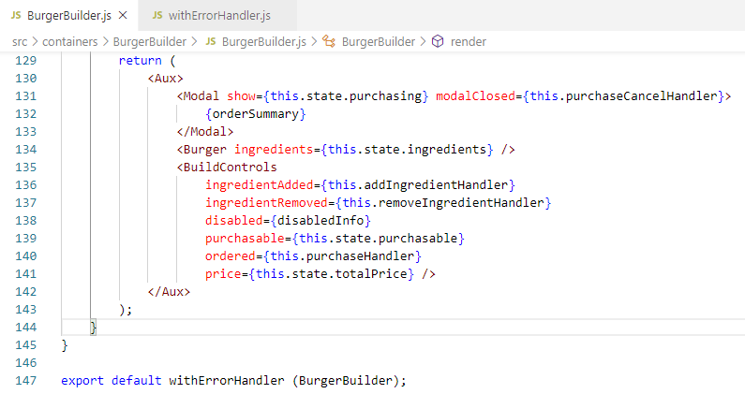
183.1 Global Handle Error
https://www.udemy.com/course/react-the-complete-guide-incl-redux/learn/lecture/13556518#notes
Now, we have the HOC withErrorHandler().
withErrorHandler (BurgerBuilder)

Slide 7
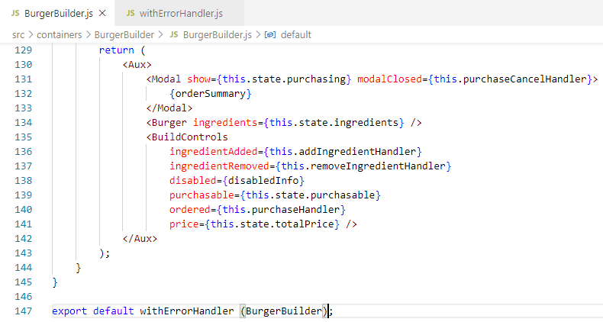
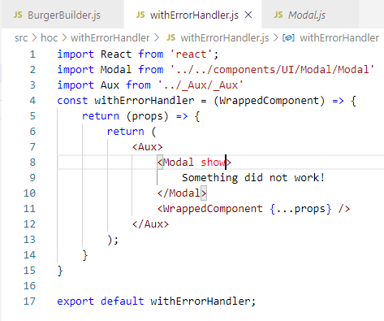
183.1 Global Handle Error
https://www.udemy.com/course/react-the-complete-guide-incl-redux/learn/lecture/13556518#notes
Now, we have the HOC withErrorHandler().
withErrorHandler (BurgerBuilder)
<Modal show>: show is used to display the error message

Slide 8
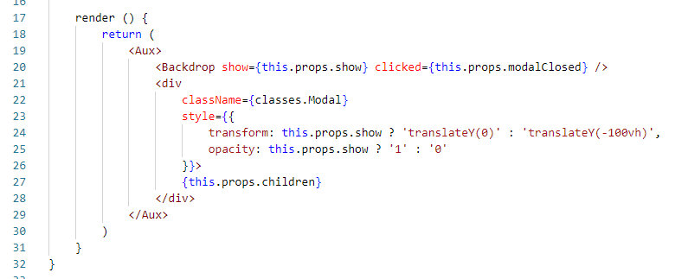
183.1 Global Handle Error
https://www.udemy.com/course/react-the-complete-guide-incl-redux/learn/lecture/13556518#notes
<Modal show>: show is used to display the error message

Slide 9
183.2 Verify

Slide 10
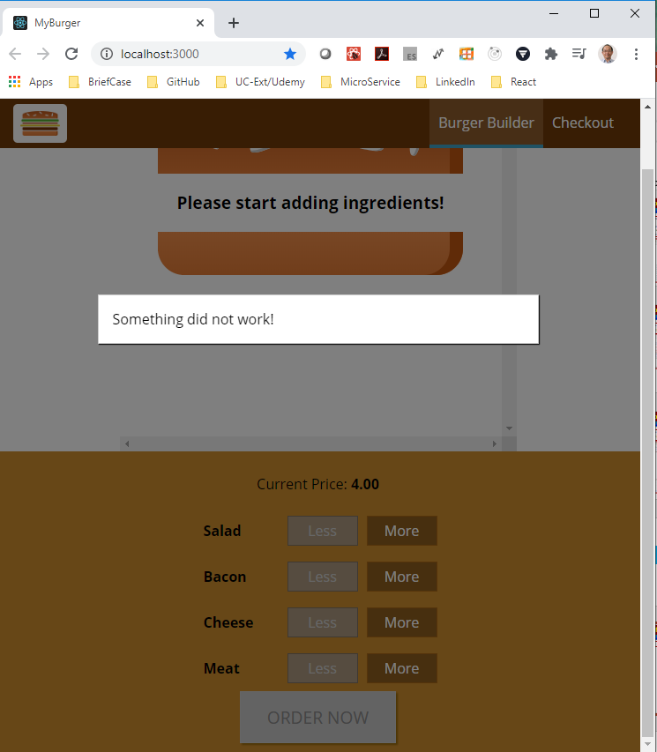
183.2 Verify
https://www.udemy.com/course/react-the-complete-guide-incl-redux/learn/lecture/8125796#notes
Verify Spinner

Slide 11
183.3 Pass Message

Slide 12
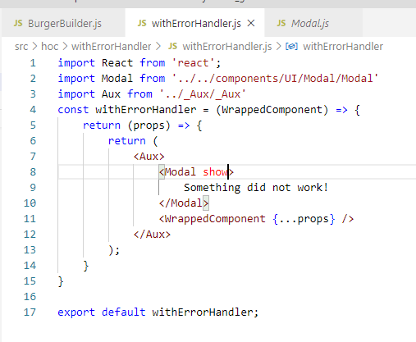
183.3 Pass Message
https://www.udemy.com/course/react-the-complete-guide-incl-redux/learn/lecture/8125796#notes
The withErrorHandler() cannot get the message.
We need that information as the second argument of HOC to make it a global Error Handler.

Slide 13
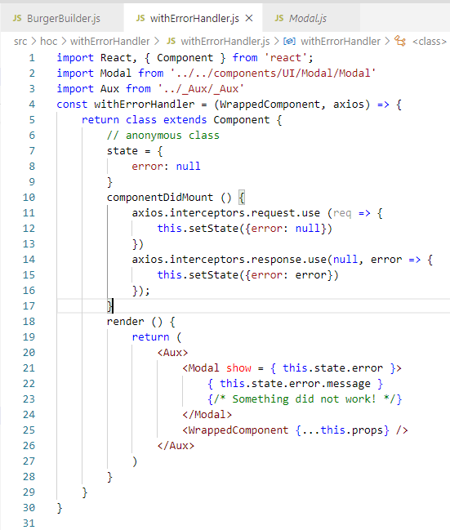
183.3 Pass Message
https://www.udemy.com/course/react-the-complete-guide-incl-redux/learn/lecture/8125796#notes
We will change functional component to class component.
We want to add componentDidMount() for class component. We will change componentDidMount() into useEffect() latter on.
We add the anonymous class.

Slide 14
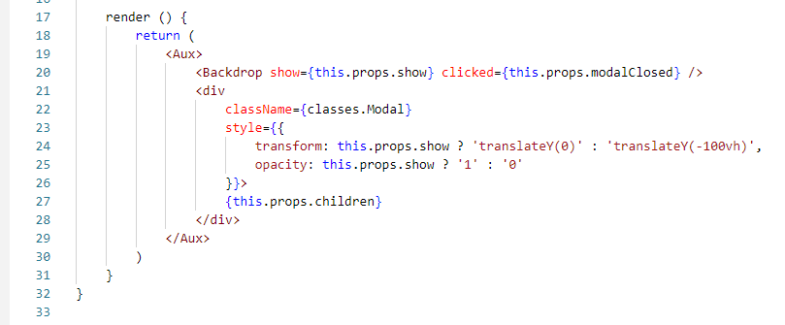
183.3 Pass Message
https://www.udemy.com/course/react-the-complete-guide-incl-redux/learn/lecture/8125796#notes
In the Modal component, we also exposes the clicked property which occurs when we click the backdrop.
This also clear the error because we click the Modal.

Slide 15
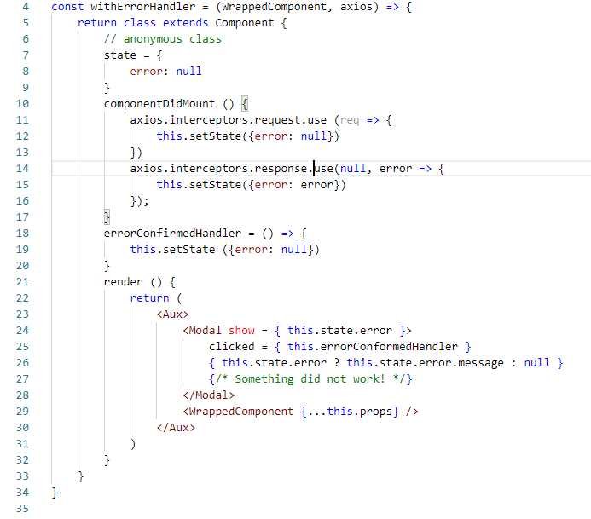
183.3 Pass Message
https://www.udemy.com/course/react-the-complete-guide-incl-redux/learn/lecture/8125796#notes
In the withErrorHandler.js, we have to pass the handler reference and set the error to null.

Slide 16
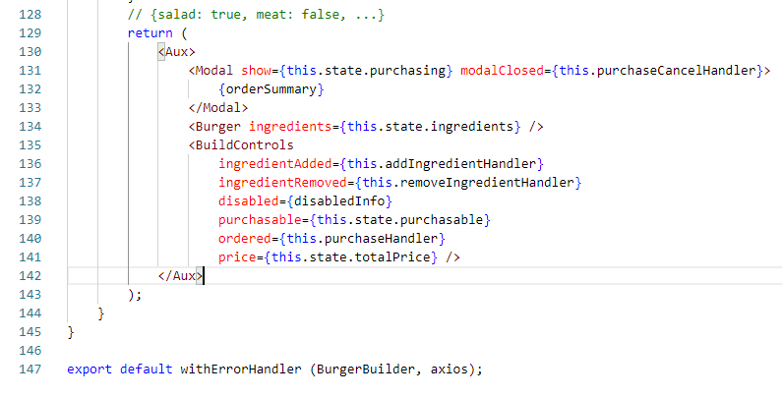
183.3 Pass Message
https://www.udemy.com/course/react-the-complete-guide-incl-redux/learn/lecture/8125796#notes
We also need to pass axios with withErrorHandler ()

Slide 17
183.4 Verify Pass Message

Slide 18
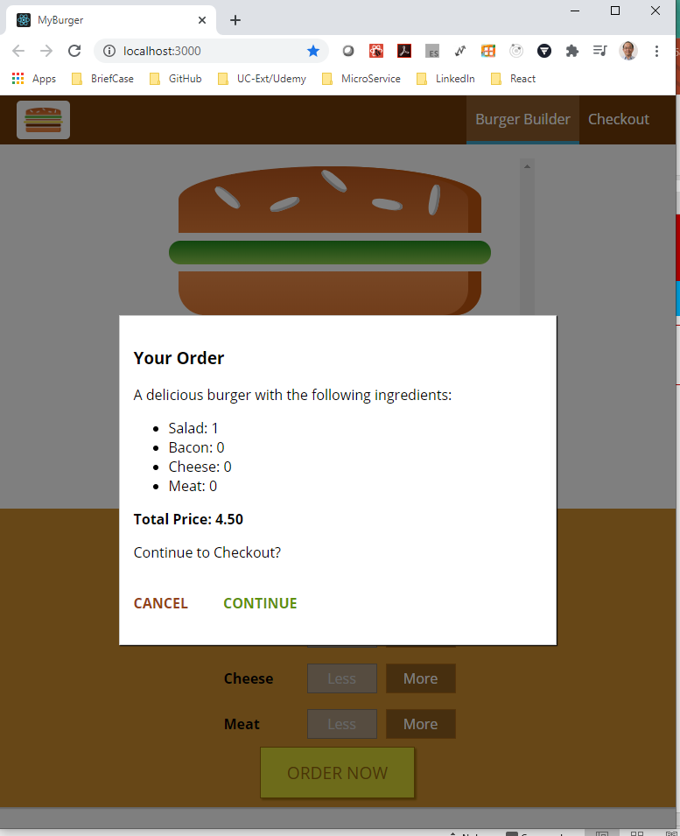
183.4 Verify Pass Message
https://www.udemy.com/course/react-the-complete-guide-incl-redux/learn/lecture/8125796#notes
Verify the Pass Message again.

Slide 19
183.5 Interceptor Return

Slide 20
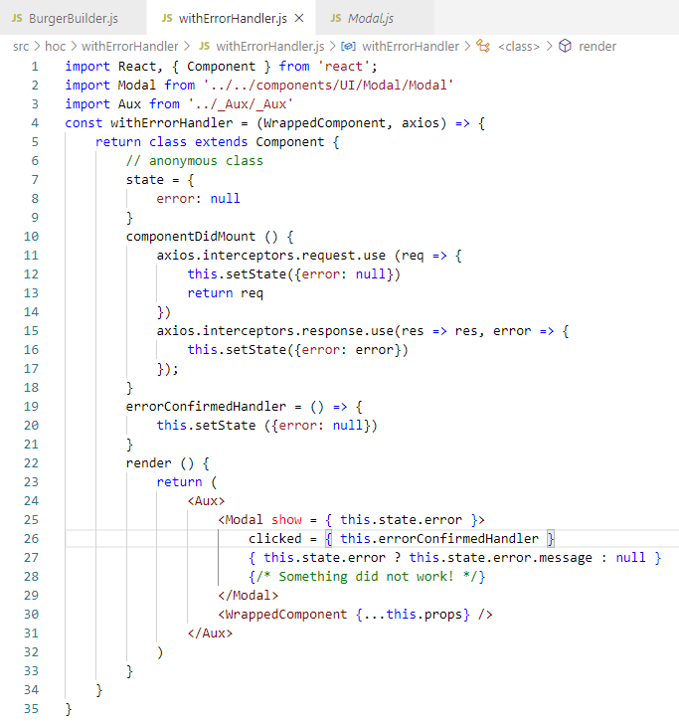
183.5 Interceptor Return
https://www.udemy.com/course/react-the-complete-guide-incl-redux/learn/lecture/8125796#notes
Add the return request message.

Slide 21
183.6 Verify Request Message

Slide 22
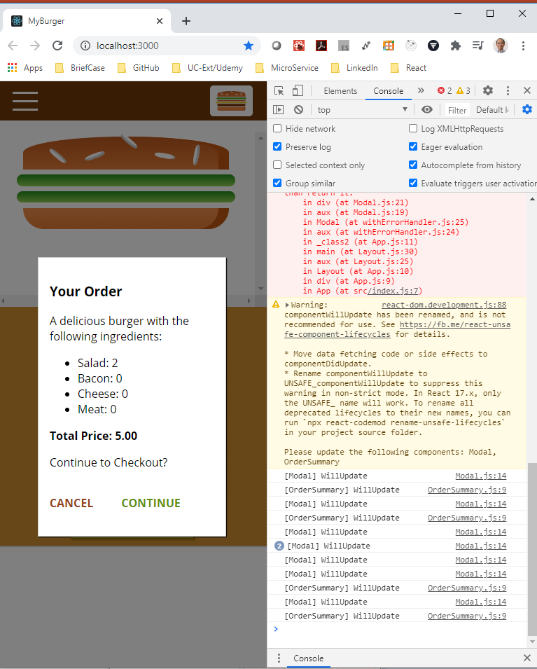
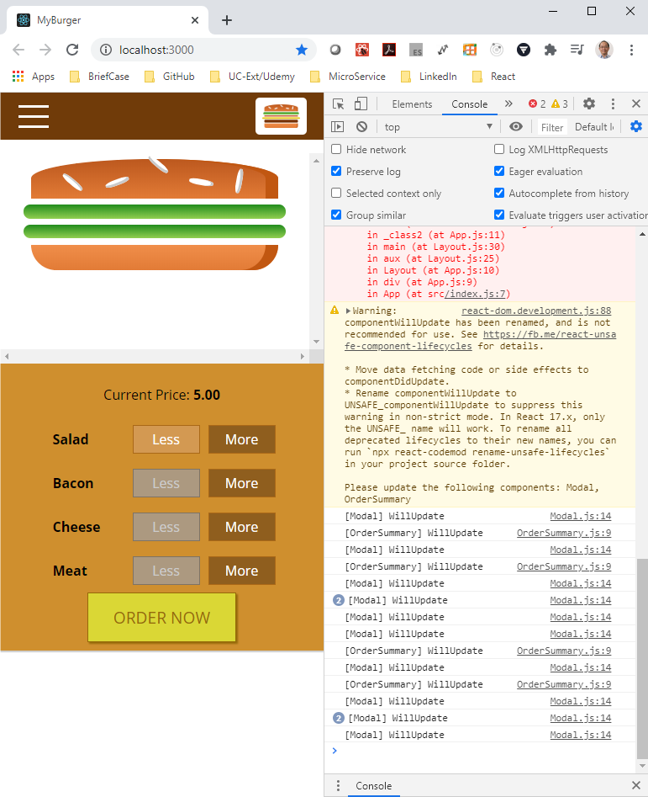
183.6 Verify Request Message
https://www.udemy.com/course/react-the-complete-guide-incl-redux/learn/lecture/8125796#notes
Verify return request message.

Slide 23
End of Chapter

