Slide 1

184 Get Data From Backend
Peter H. Chen

Slide 2
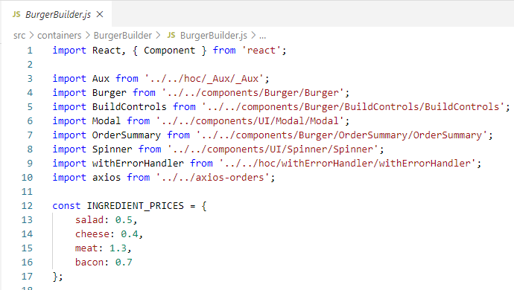
184 Get Data From Backend
https://www.udemy.com/course/react-the-complete-guide-incl-redux/learn/lecture/13556520#notes
Get Data from Backend
We discussed the global error handling error.
With that we can post our orders to backend.
Now, we want to get the data from backend.
Right now, we hard-coded the initial data in the application.

Slide 3
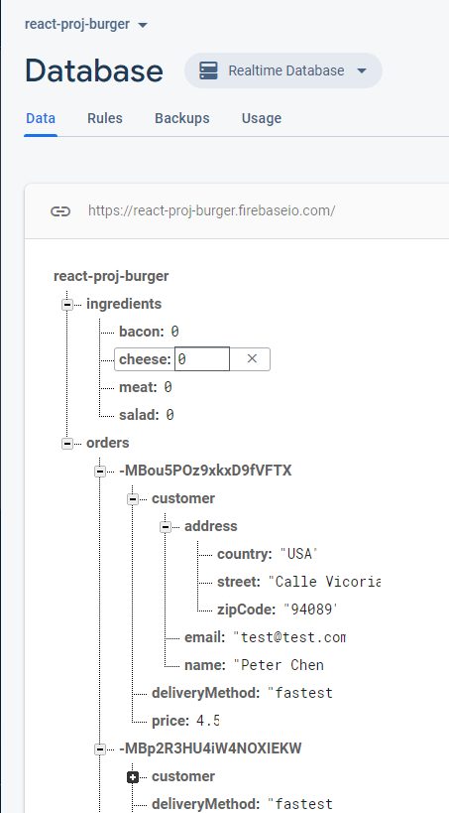
184 Get Data From Backend
https://www.udemy.com/course/react-the-complete-guide-incl-redux/learn/lecture/13556520#notes
Get Data from Backend
First, we go the firebase database.
We use + to add the key and value.
Add the ingredients
Under the ingredients, we add salad, cheese, meat, and bacon.
Note:
1. After the value = 0 and then enter.
2. Make sure the ingredients and orders are in separated table.
3. If you put them in the same table, then the setState () will have error.

Slide 4
184 Get Data From Backend
https://www.udemy.com/course/react-the-complete-guide-incl-redux/learn/lecture/13556520#notes
Get Data from Backend
https://firebase.google.com/docs/database/ios/structure-data#avoid_nesting_data
In Firebase, each data is stored as JSON Object.
The database is a cloud-based JSON tree.
Unlike a SQL database, there are no tables or records.
When we add data to the JSON tree, it becomes a node in the existing JSON structure with an associated key.

Slide 5
184.1 Get Data from Backend

Slide 6
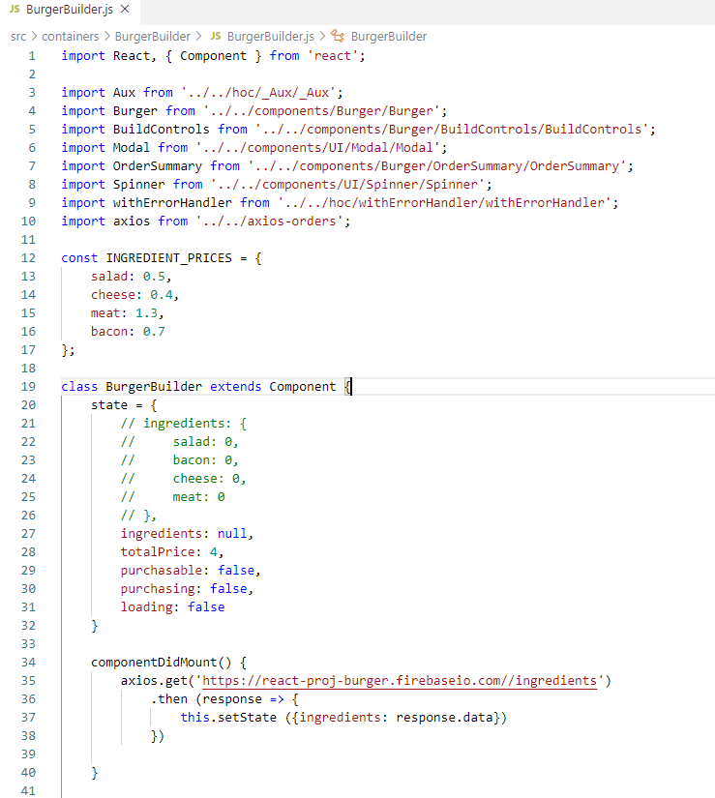
184.1 Get Data from Backend
https://www.udemy.com/course/react-the-complete-guide-incl-redux/learn/lecture/13556520#notes
In the BurgerBuilder component, we add the componentDidMount()
We get the data from the backend

Slide 7
184.2 Verify

Slide 8
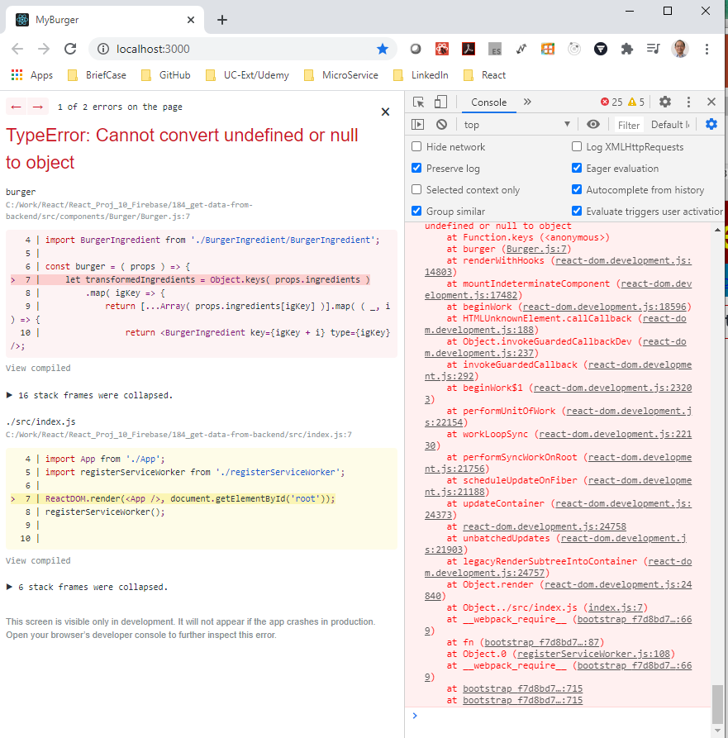
184.2 verify
https://www.udemy.com/course/react-the-complete-guide-incl-redux/learn/lecture/13556520#notes
Verify.
We get the error message.
When rendering, we have error message due to ingredients = null.

Slide 9
184.3 Take Care the Ingredient

Slide 10
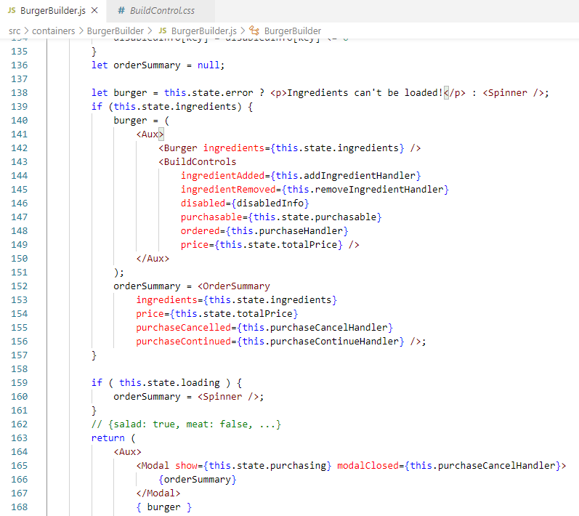
184.3 Take Care the Ingredient
https://www.udemy.com/course/react-the-complete-guide-incl-redux/learn/lecture/13556520#notes
We need to take care of the ingredients = null to prevent render error.

Slide 11
184.4 Verify Null Ingredient

Slide 12
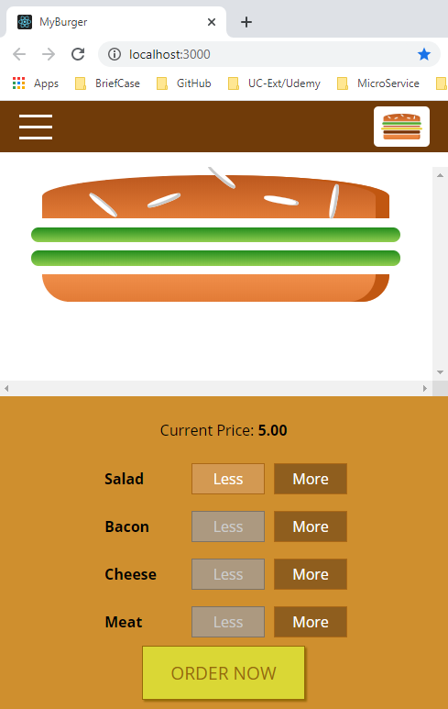
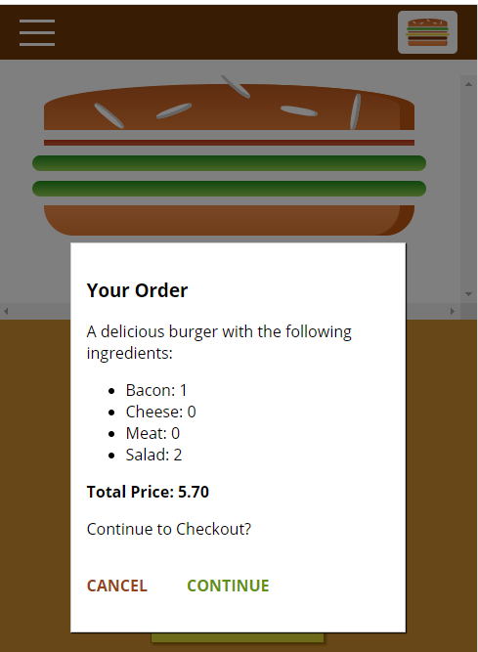
184.4 Verify Null Ingredient
https://www.udemy.com/course/react-the-complete-guide-incl-redux/learn/lecture/13556520#notes
Verify.

Slide 13
184.5 Handle Specific Error

Slide 14
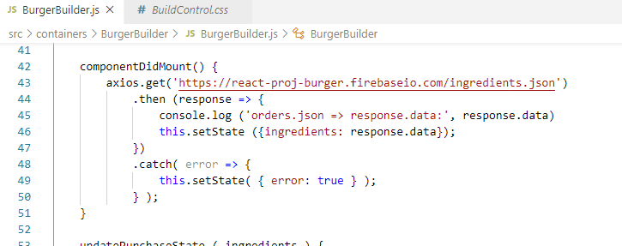

184.5 Handle Specific Error
https://www.udemy.com/course/react-the-complete-guide-incl-redux/learn/lecture/13556520#notes
Set Specific Error

Slide 15
End of Chapter

