Slide 1

185 Remove Old Interceptor
Peter H. Chen

Slide 2
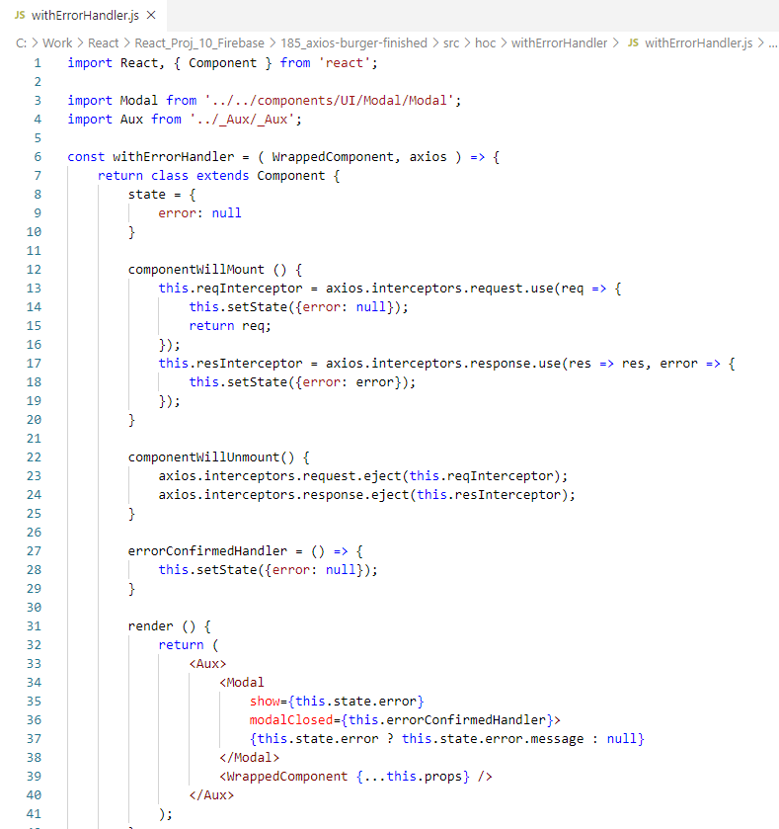
185 Remove Old Interceptor
https://www.udemy.com/course/react-the-complete-guide-incl-redux/learn/lecture/13556520#notes
Remove Old Interceptor
We completed HTTP/Ajax by Axios library and Burger GUI integration.
Removed the interceptor when unmount.

Slide 3
End of Chapter

