Slide 1

91 Life Cycle
Peter H. Chen

Slide 2
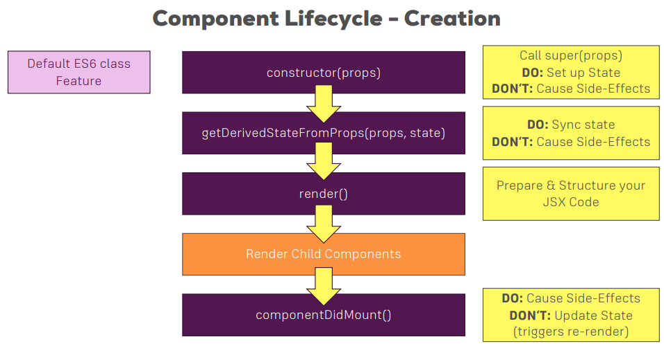
91 Life Cycle
https://www.udemy.com/course/react-the-complete-guide-incl-redux/learn/lecture/13556268#overview
Life Cycle

Slide 3
End of Chapter

