Slide 1

92 Life Cycle: Component Update
Peter H. Chen

Slide 2
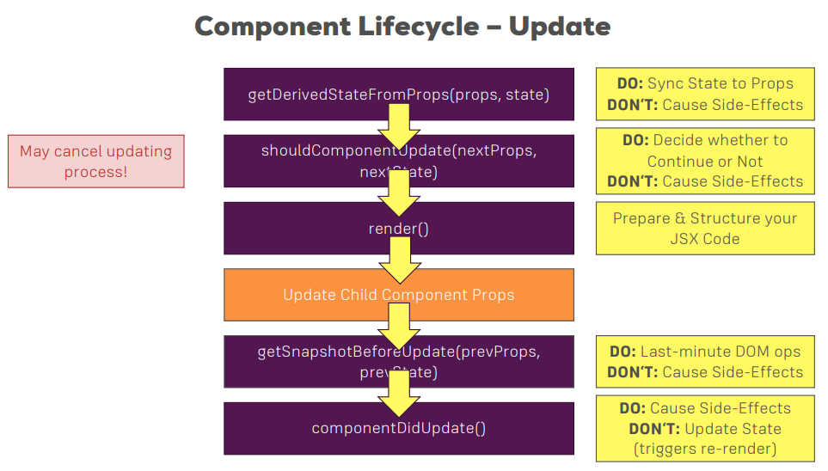
92 Life Cycle: Component Update
https://www.udemy.com/course/react-the-complete-guide-incl-redux/learn/lecture/13556268#overview
Life Cycle: Component Update

Slide 3
End of Chapter

