Slide 1

97 useEffect
Peter H. Chen

Slide 2
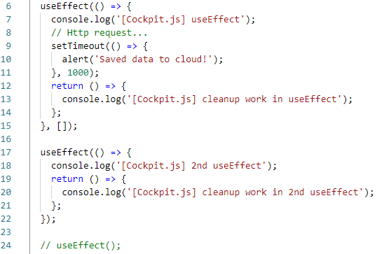
97 useEffect
https://www.udemy.com/course/react-the-complete-guide-incl-redux/learn/lecture/13556268#overview
useEffect
There is a timer here. The userEffect() will be called every second when DOM refresh or popup the warining message. The second argument is used to control “if nothing change, do not call “useEffect” again. This prevent each timer called and repeat the display warning or etc.
No timer inside useEffect(). Do not need the second argument.

Slide 3
End of Chapter

