Slide 1

103 Adjacent JSX
Peter H. Chen

Slide 2
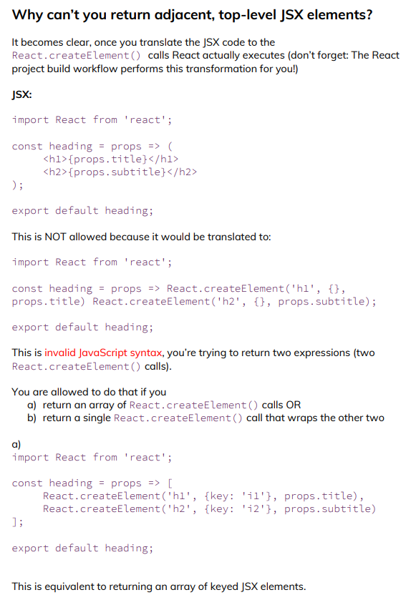
103 Adjacent JSX
https://www.udemy.com/course/react-the-complete-guide-incl-redux/learn/lecture/13556324#notes
Adjacent JSX

Slide 3
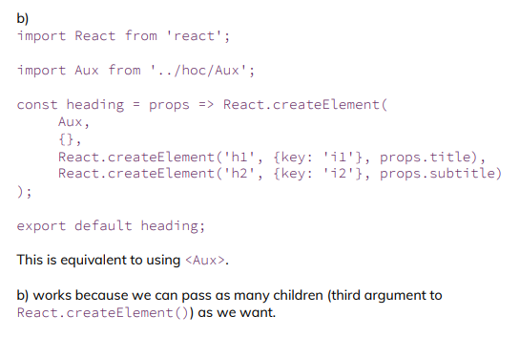
103 Adjacent JSX
https://www.udemy.com/course/react-the-complete-guide-incl-redux/learn/lecture/13556324#notes
Adjacent JSX

Slide 4
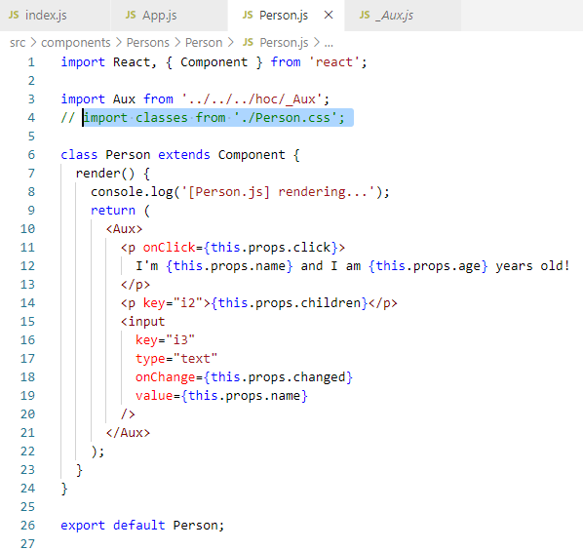
103 Adjacent JSX
https://www.udemy.com/course/react-the-complete-guide-incl-redux/learn/lecture/13556324#notes
Adjacent JSX
How to return multiple component in return?
Add
<Aux> for HOC (Higher Order Component)
<p key= “i2” …></p>
<input key=“i3” … >

Slide 5
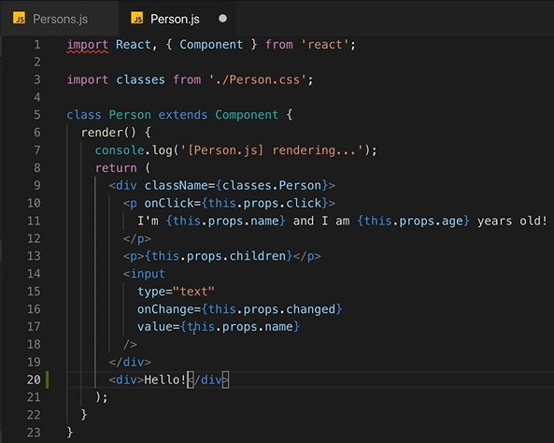
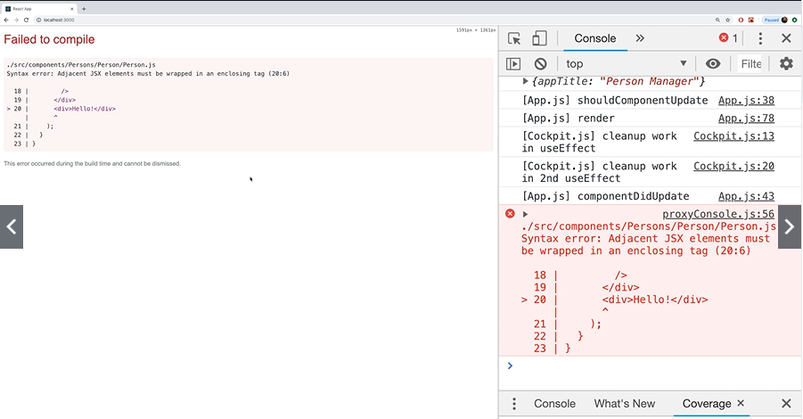
103 Adjacent JSX
https://www.udemy.com/course/react-the-complete-guide-incl-redux/learn/lecture/13556324#notes
We only have one element in the return JSX element.
If you have more element, we have to put all the elements into <div> … </div>
In Person,js, If we return more than one <div>…</div> <div>…</div>, we will get an error “Syntax error: Adjacent JSX elements must be wrapped in an enclcosing tag (20:6).

Slide 6
103.1 Render by Map Function

Slide 7
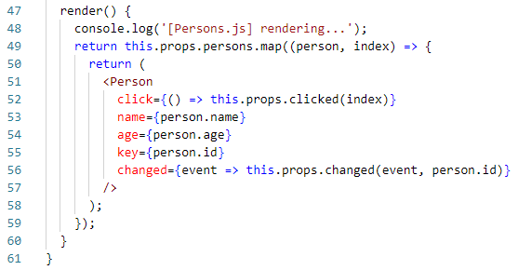
103.1 Render by Map Function
https://www.udemy.com/course/react-the-complete-guide-incl-redux/learn/lecture/13556324#notes
In the Persons.js, we have an object array.
The array object return multiple elements.
Technically, it still one object within multiple element in there.
React allows us to return an array of elements as long as all the items in there have a key. That key is required so that React can efficiently update and reorder these elements.

Slide 8
103.2 Render by Array with ID

Slide 9
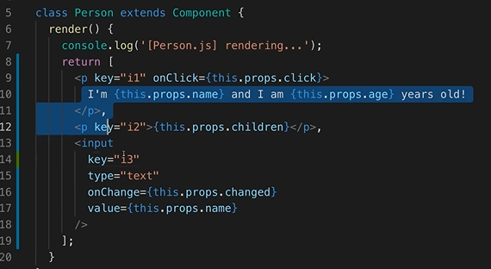
103.2 Render by Array with ID
https://www.udemy.com/course/react-the-complete-guide-incl-redux/learn/lecture/13556324#notes
In the Persons.js, we have an object array.
We can
1. Add the [] around each element.
2. Add unique key for each element.
3. Note: the first element “i1” can be removed, but “i2” and “i3” need to be there.

Slide 10
103.3 Render by Wrapper

Slide 11
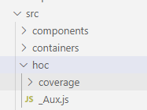
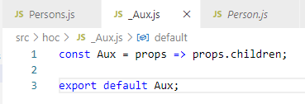
103.3 Render by Wrapper
https://www.udemy.com/course/react-the-complete-guide-incl-redux/learn/lecture/13556324#notes
The other way, we can use hoc.
Create hoc/_Aux.js, In windows.
Note: Aux is a reversed for Windows system. There is no problem for Linux and Mac. You can rename Aux.js into other names, such as, _Aux.js or Auilary.js.
> const Aux = props => props.children;

Slide 12
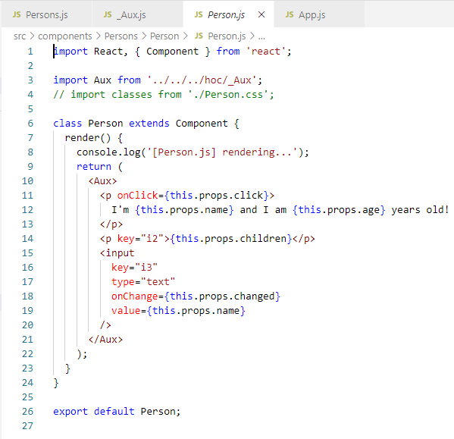
103.3 Render by Wrapper
https://www.udemy.com/course/react-the-complete-guide-incl-redux/learn/lecture/13556324#notes
The other way, we can use hoc.
In the Person.js, we use Aux to wrap all the elements under the children of component Aux.

Slide 13
End of Chapter

