Slide 1

221 Checkout Container
Peter H. Chen

Slide 2
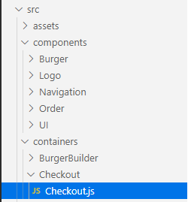
221 Checkout Container
https://www.udemy.com/course/react-the-complete-guide-incl-redux/learn/lecture/13556526#notes
Checkout Container
Add the containers\Checkout\Checkout.js component.

Slide 3
221.1 Checkout Container

Slide 4
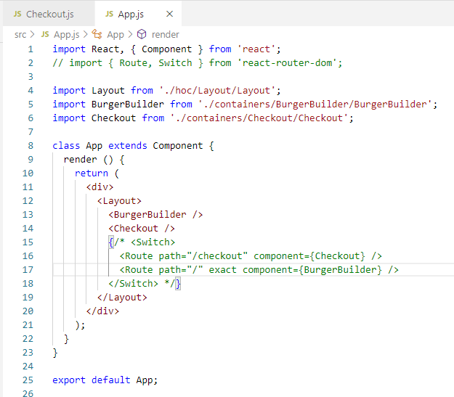
221.1 Checkout Container
https://www.udemy.com/course/react-the-complete-guide-incl-redux/learn/lecture/13556526#notes
Checkout Container

Slide 5
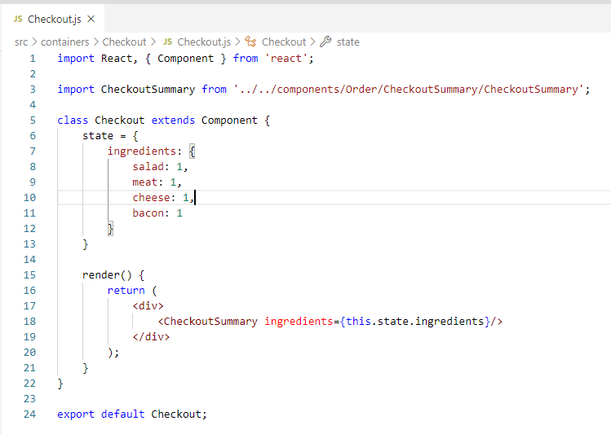
221.1 Checkout Container
https://www.udemy.com/course/react-the-complete-guide-incl-redux/learn/lecture/13556526#notes
Checkout Container

Slide 6
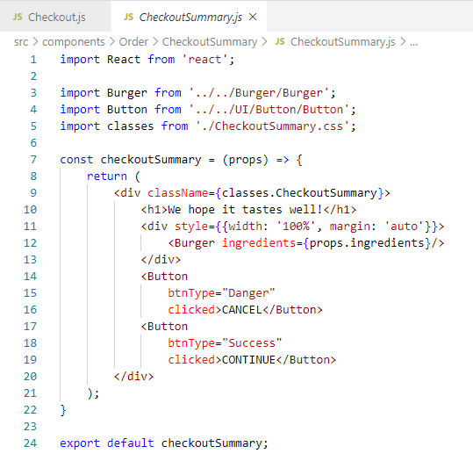
221.1 Checkout Container
https://www.udemy.com/course/react-the-complete-guide-incl-redux/learn/lecture/13556526#notes
Checkout Summary.

Slide 7
221.2 Verify

Slide 8
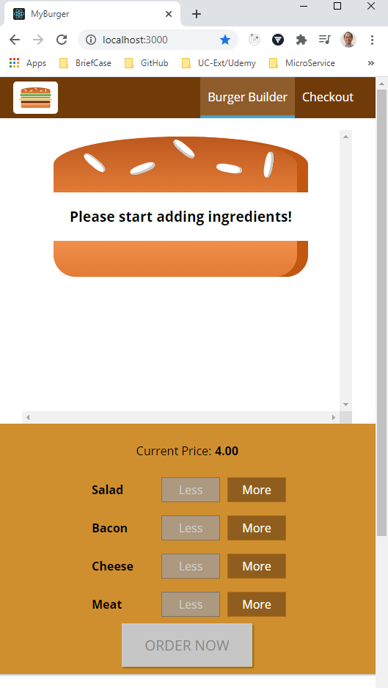
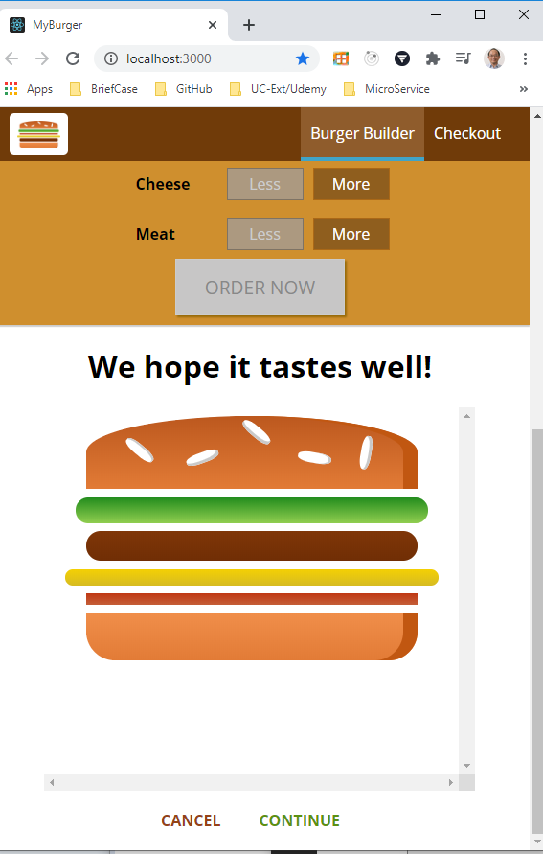
221.2 Verify
https://www.udemy.com/course/react-the-complete-guide-incl-redux/learn/lecture/13556526#notes
Verify
Scroll down the see the check out component.

Slide 9
End of Chapter

