Slide 1

223 Navigation Checkout
Peter H. Chen

Slide 2
223 Navigation Checkout
https://www.udemy.com/course/react-the-complete-guide-incl-redux/learn/lecture/8145944#notes
Setup Route
In last discussion, we build checkout container.
In this discussion, we want to load the checkout container with route.
We installed the route with “npm install react-router-dom”
The package “react-router-dom” already include the “react-router”

Slide 3
223.1 Setup Route

Slide 4
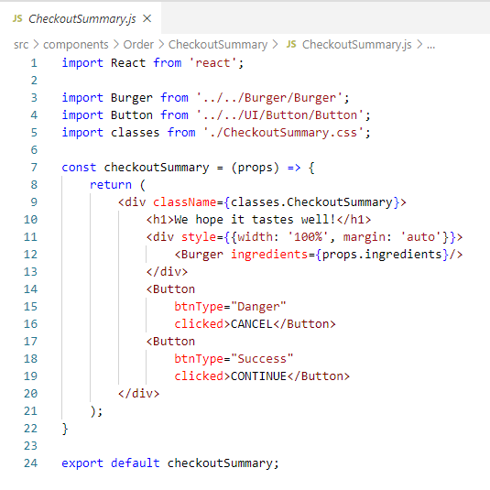
223.1 Setup Route
https://www.udemy.com/course/react-the-complete-guide-incl-redux/learn/lecture/8145944#notes
Checkout Summary

Slide 5
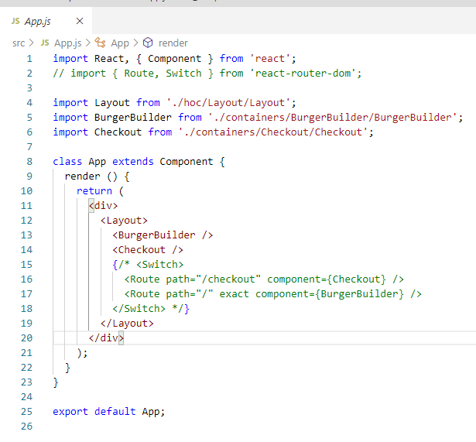
223.1 Setup Route
https://www.udemy.com/course/react-the-complete-guide-incl-redux/learn/lecture/8145944#notes
In App.js, we load the BurgerBuilder and Checkout components.
We can do this in index.js or App.js.

Slide 6
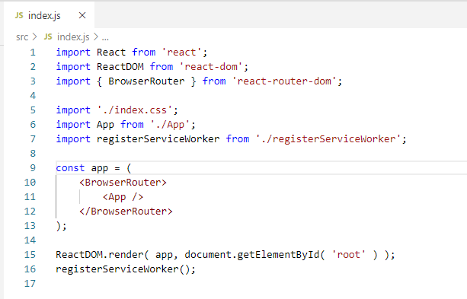
223.1 Setup Route
https://www.udemy.com/course/react-the-complete-guide-incl-redux/learn/lecture/8145944#notes
In App.js, we load the BurgerBuilder and Checkout components.
We can do this in index.js or App.js.
<App />

Slide 7
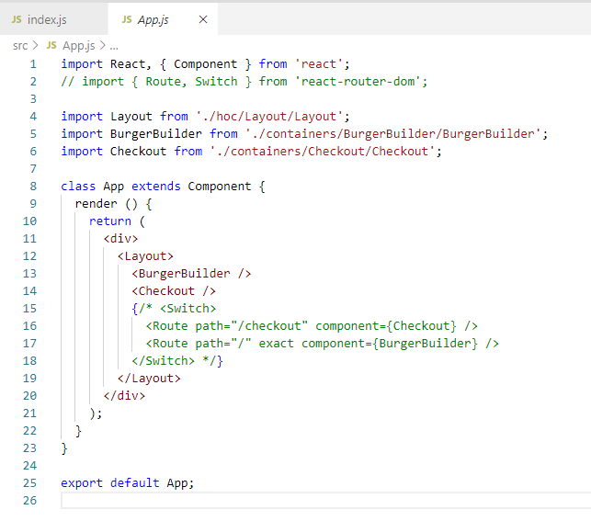
223.1 Setup Route
https://www.udemy.com/course/react-the-complete-guide-incl-redux/learn/lecture/8145944#notes
Then, we can route in the App.js.

Slide 8
223.1 Setup Route
https://www.udemy.com/course/react-the-complete-guide-incl-redux/learn/lecture/8145944#notes
In the App.js, instead of hardcoded <BurgerBuilder /> and <Checkout />, we add the <Route with path=“” and component={} />
For the root path path=“/”, we want the BurgerBuidler component.
<Route with path=“/” and component={ BurgerBuilder } />
For the path=“/checkout”, we wan the Checkout component.

Slide 9
223.2 Verify

Slide 10
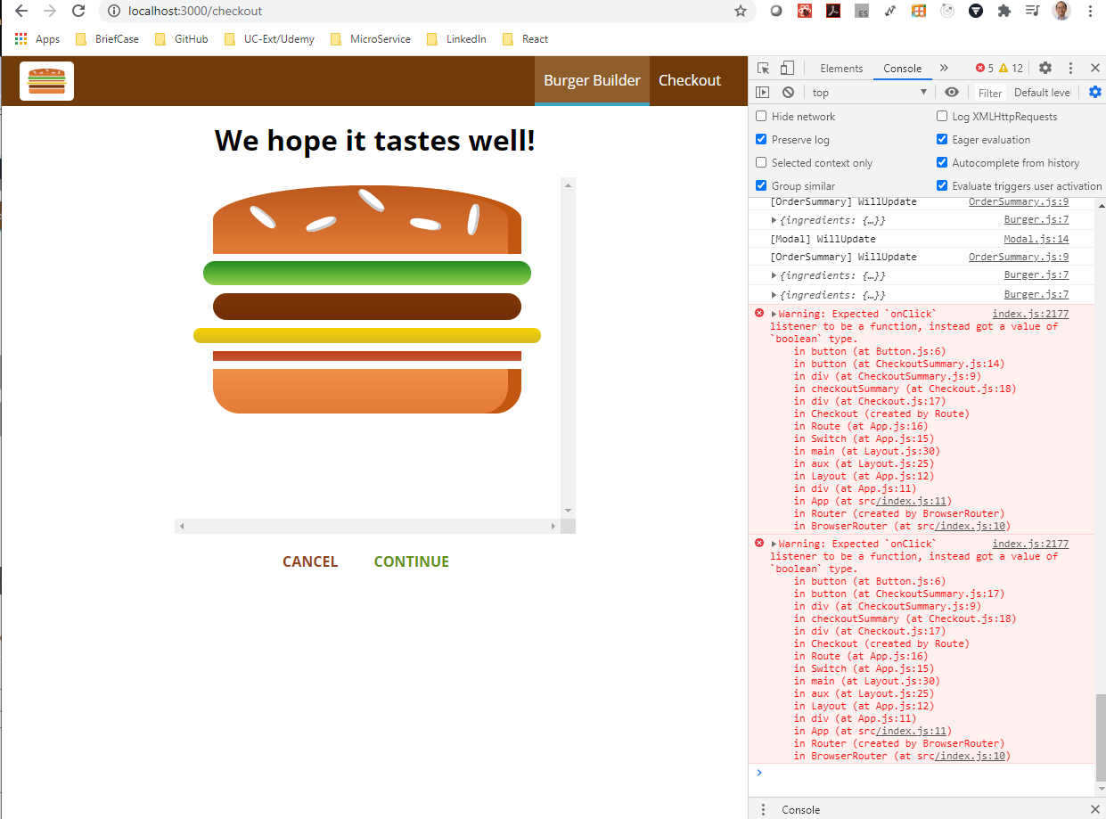
223.2 Verify
https://www.udemy.com/course/react-the-complete-guide-incl-redux/learn/lecture/8145944#notes
Verify
We click CONTINUE and have error message. Will be fixed next.

Slide 11
End of Chapter

