Slide 1

224 Navigation Page
Peter H. Chen

Slide 2
224 Navigation Page
https://www.udemy.com/course/react-the-complete-guide-incl-redux/learn/lecture/8145944#notes
Setup Route
In last discussion, we build checkout container.
In this discussion, we want to load the checkout container with route.
We installed the route with “npm install react-router-dom”
The package “react-router-dom” already include the “react-router”

Slide 3
224.1 Navigation Page

Slide 4
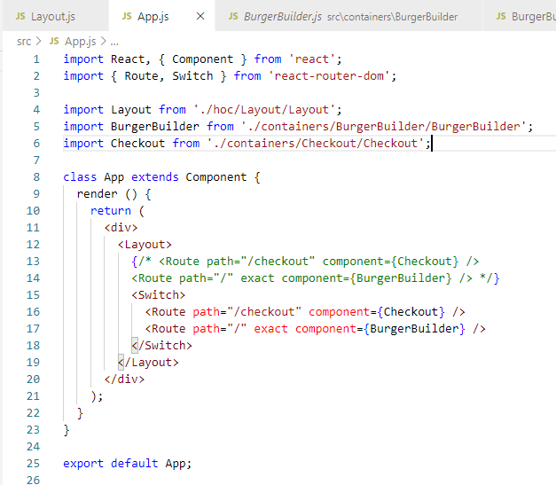
224.1 Navigation Page
https://www.udemy.com/course/react-the-complete-guide-incl-redux/learn/lecture/8145944#notes
Navigation Checkout

Slide 5
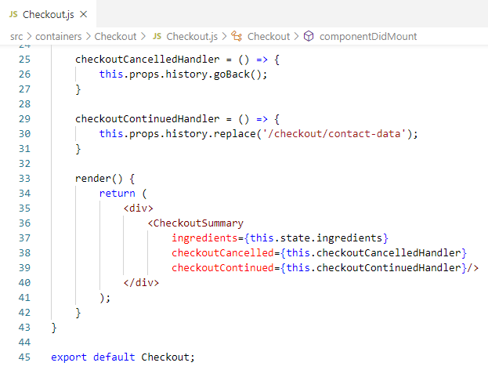
224.1 Navigation Page
https://www.udemy.com/course/react-the-complete-guide-incl-redux/learn/lecture/8145944#notes
Navigation Checkout

Slide 6
223.2 Verify

Slide 7
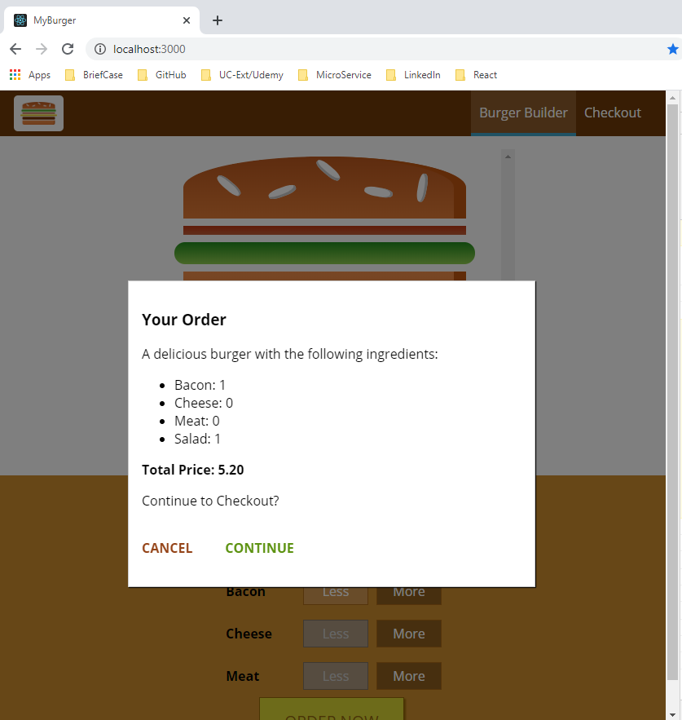
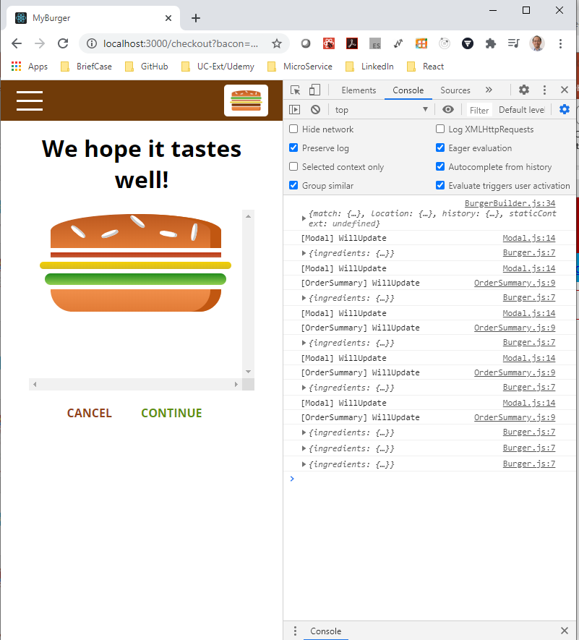
223.2 Verify
https://www.udemy.com/course/react-the-complete-guide-incl-redux/learn/lecture/8145944#notes
Verify

Slide 8
End of Chapter

