Slide 1

225 Pass Ingredient Via Query Param
Peter H. Chen

Slide 2
225 Pass Ingredient Via Query Param
https://www.udemy.com/course/react-the-complete-guide-incl-redux/learn/lecture/8145968#notes
Pass Ingredient via Query Param
Add the pass ingredient via query params

Slide 3
225.1 Pass Ingredient Via Query Param

Slide 4
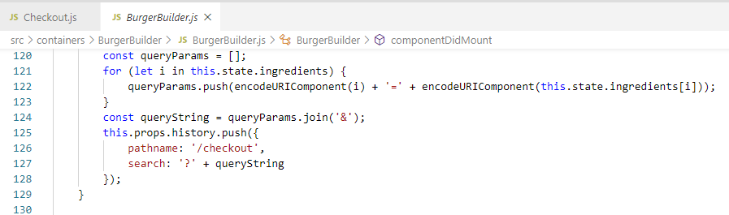
225.1 Pass Ingredient Via Query Param
https://www.udemy.com/course/react-the-complete-guide-incl-redux/learn/lecture/8145968#notes
Pass Ingredient via Query Param

Slide 5
223.2 Verify

Slide 6
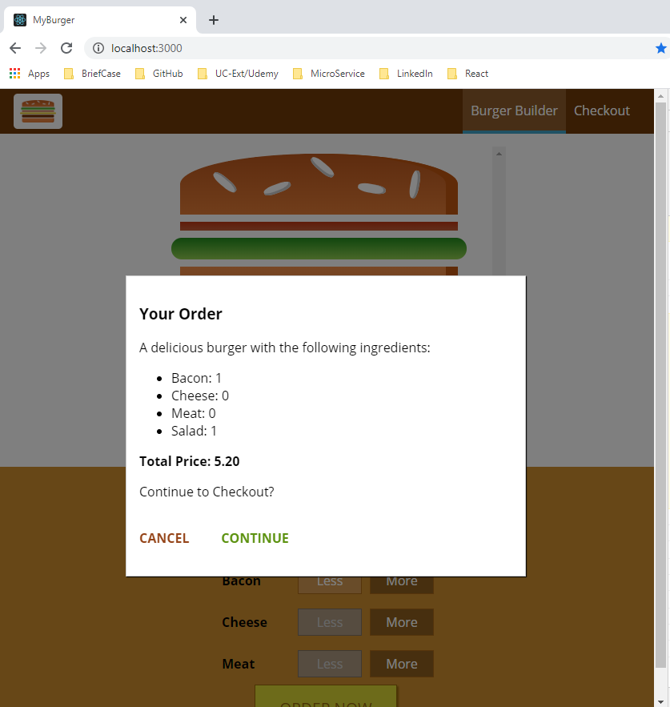
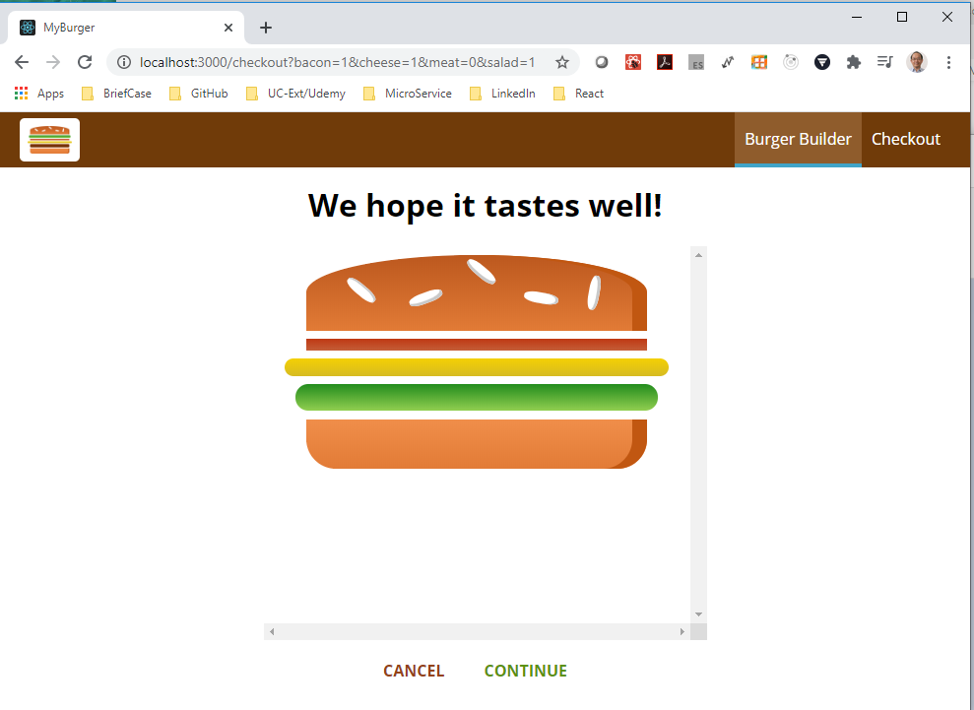
223.2 Verify
https://www.udemy.com/course/react-the-complete-guide-incl-redux/learn/lecture/8145968#notes
Verify: We have the passing parameter in the URL.

Slide 7
225.3 Pass Ingredient Via Query Param

Slide 8
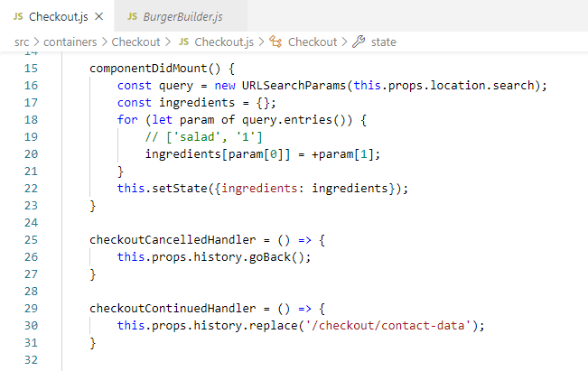
225.3 Pass Ingredient Via Query Param
https://www.udemy.com/course/react-the-complete-guide-incl-redux/learn/lecture/8145968#notes
Add Query Param

Slide 9
223.4 Verify

Slide 10
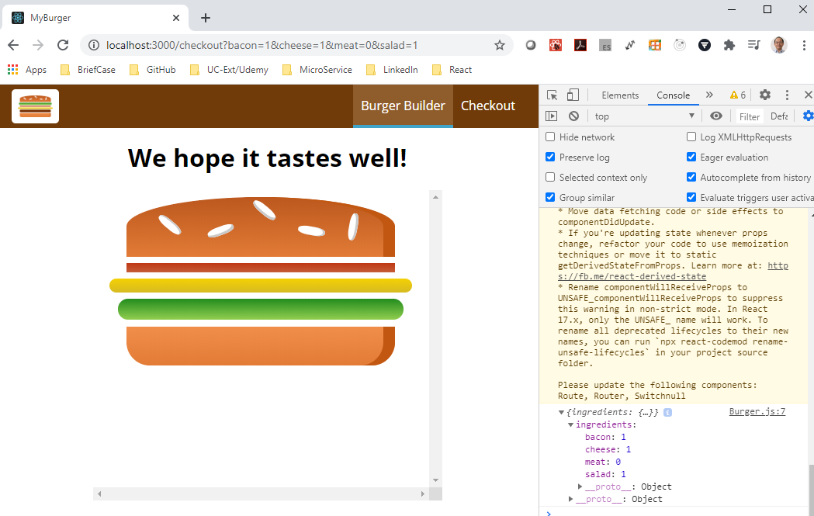
223.4 Verify
https://www.udemy.com/course/react-the-complete-guide-incl-redux/learn/lecture/8145968#notes
Verify: We have the passing parameter in the URL.

Slide 11
223.5 Summary

Slide 12
223.5 Summary
https://www.udemy.com/course/react-the-complete-guide-incl-redux/learn/lecture/8145968#notes
Now, we are able to pass the data with queryParams.
This is a hug progress.

Slide 13
End of Chapter

