Slide 1

54 JSX and Conditional
Peter H. Chen

Slide 2
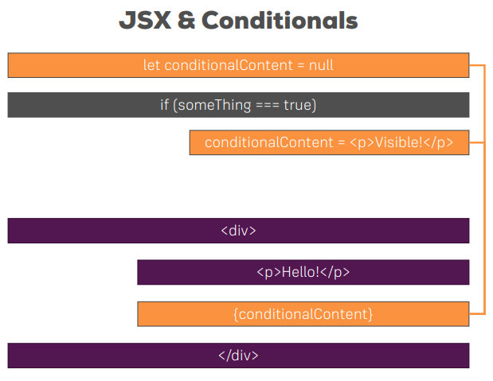
54 JSX and Conditional
https://www.udemy.com/course/react-the-complete-guide-incl-redux/learn/lecture/8211788#overview
JSX and Conditional

Slide 3
End of Chapter

