Slide 1

57 JSX and List
Peter H. Chen

Slide 2
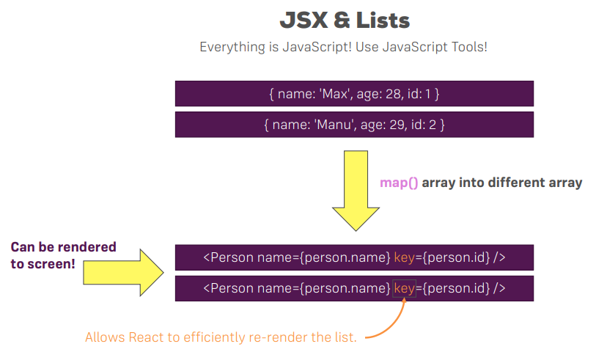
57 JSX and List
https://www.udemy.com/course/react-the-complete-guide-incl-redux/learn/lecture/8211788#overview
JSX and List

Slide 3
End of Chapter

