Slide 1

2 Project 2: List and Conditional
Peter H. Chen

Slide 2
2 Project 2: List and Conditional
https://www.udemy.com/course/react-the-complete-guide-incl-redux/learn/lecture/12982502#overview
List and Condition: Program Assignment 02
Create an input field (in App component) with a change listener which outputsthe entered text below it (e.g. in a paragraph).
Create a Validation component which receives the text length as a prop.
Inside the Validation Component, either output "Text too short“ or "Text long enough“ depending on the text length (e.g. take 5 as a minimum length)
Create another component called Char Component and style it as an inline box, i.e., display: inline-block, padding: 16px, text-align: center, margin: 16px, border: 1px solid black.
Render a list of CharComponents where each CharComponent receives a different letter of the entered text (in the initial input field) as a prop.
When you click a CharComponent, it should be removed from the entered text
Hint: Keep in mind that JavaScript strings are basically arrays!

Slide 3
2.1 Input Field and Display Text

Slide 4
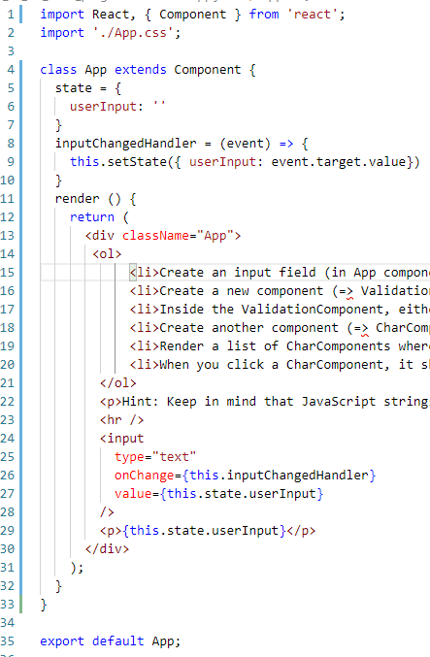
2.1 Input Field and Display Text
https://www.udemy.com/course/react-the-complete-guide-incl-redux/learn/lecture/8091068#overview
Create an input field (in App component) with a change listener which outputs the entered text below it (e.g. in a paragraph).
Create an input field (in App component)
Create change listener
Outputs the entered text below it (e.g., in a paragraph).

Slide 5
2.2 Validate Component

Slide 6
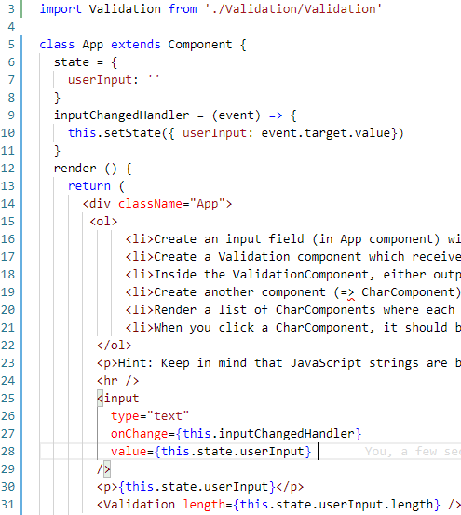
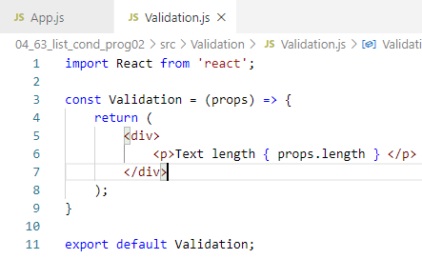
2.2 Validate Component
https://www.udemy.com/course/react-the-complete-guide-incl-redux/learn/lecture/8091068#overview
Create a Validation component which receives the text length as a prop.

Slide 7
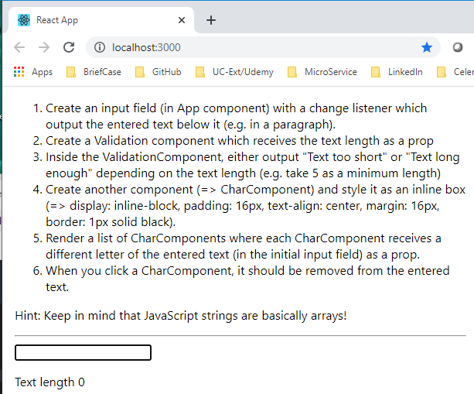
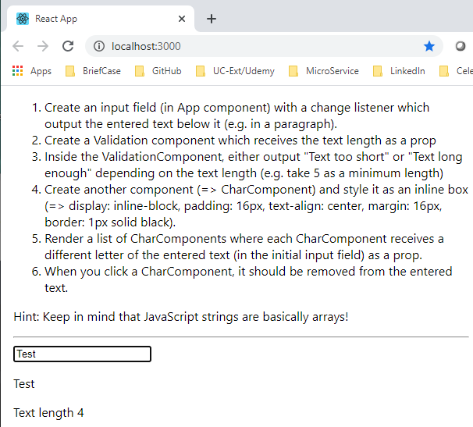
2.2 Validate Component
https://www.udemy.com/course/react-the-complete-guide-incl-redux/learn/lecture/8091068#overview
Verify Result

Slide 8
2.3 Conditional Display

Slide 9
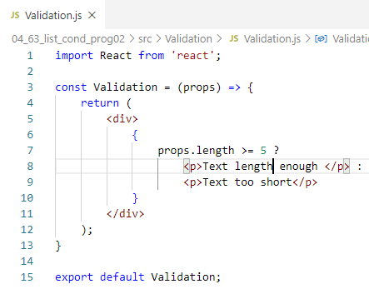
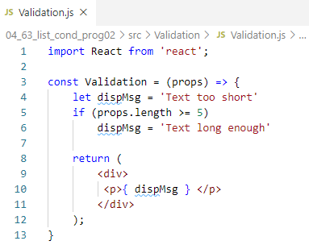
2.3 Conditional Display
https://www.udemy.com/course/react-the-complete-guide-incl-redux/learn/lecture/8091068#overview
Inside the Validation Component, either output "Text too short“ or "Text long enough“ depending on the text length (e.g. take 5 as a minimum length)
This is a recommended and elegant way.

Slide 10
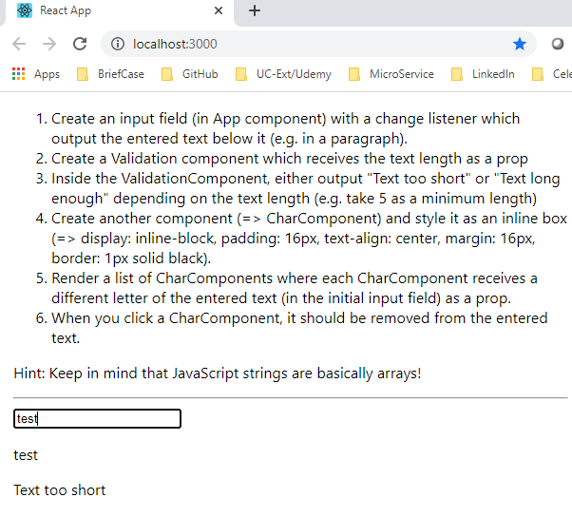
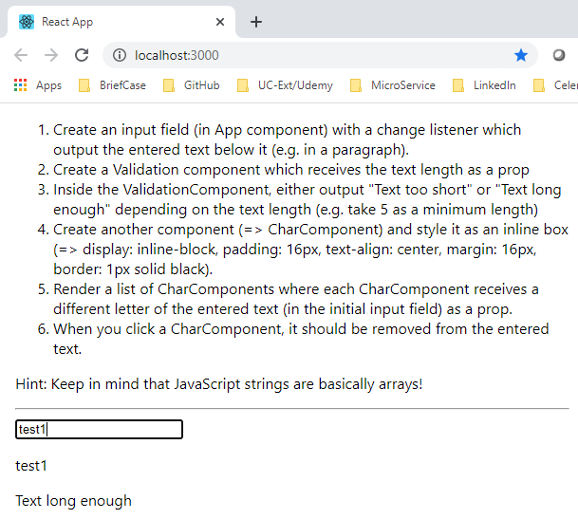
2.3 Conditional Display
https://www.udemy.com/course/react-the-complete-guide-incl-redux/learn/lecture/8091068#overview
Verify Result

Slide 11
2.4 Display Text Box

Slide 12
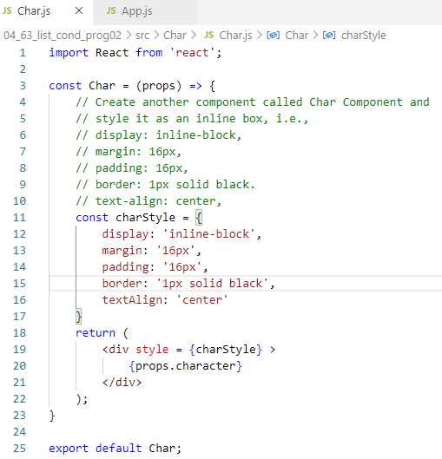
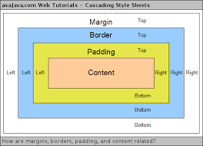
2.4 Display Text Box
https://www.udemy.com/course/react-the-complete-guide-incl-redux/learn/lecture/8091068#overview
Create another component called Char Component and style it as an inline box, i.e., display: inline-block, padding: 16px, text-align: center, margin: 16px, border: 1px solid black.

Slide 13
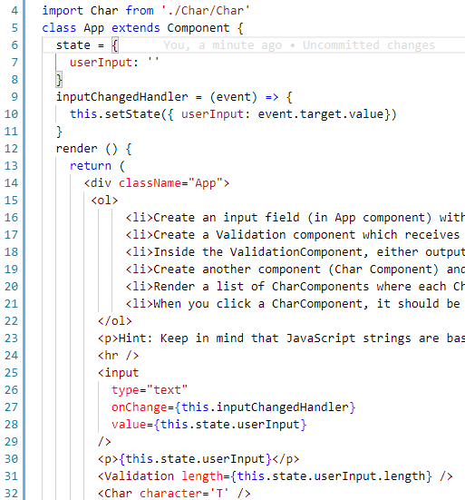
2.4 Display Text Box
https://www.udemy.com/course/react-the-complete-guide-incl-redux/learn/lecture/8091068#overview
Create another component called Char Component and style it as an inline box, i.e., display: inline-block, padding: 16px, text-align: center, margin: 16px, border: 1px solid black.

Slide 14
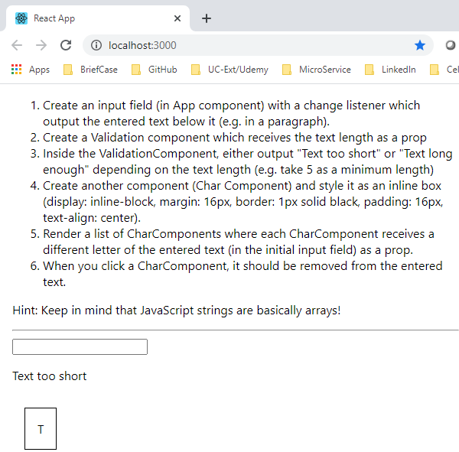
2.4 Display Text Box
https://www.udemy.com/course/react-the-complete-guide-incl-redux/learn/lecture/8091068#overview
Verify

Slide 15
2.5 Split Array to Style Character

Slide 16
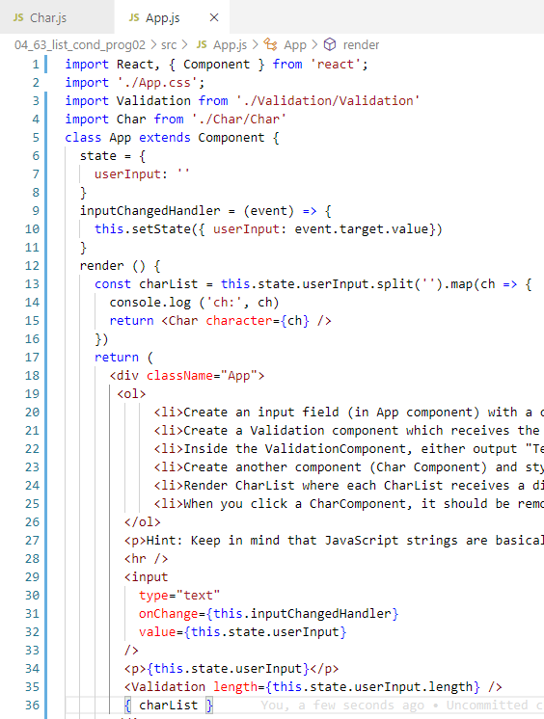
2.5 Split Array to Style Character
https://www.udemy.com/course/react-the-complete-guide-incl-redux/learn/lecture/8091068#overview
From CharList Array to character

Slide 17
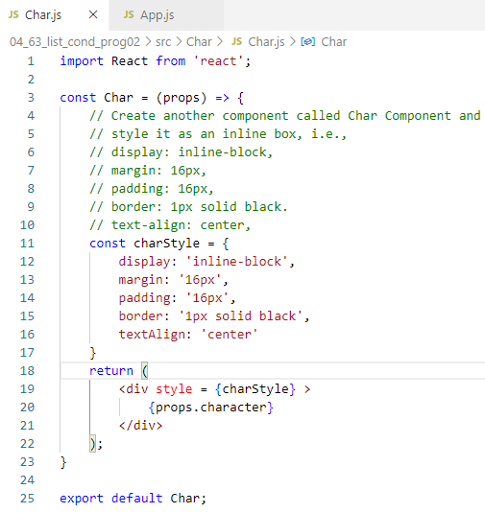
2.5 Split Array to Style Character
https://www.udemy.com/course/react-the-complete-guide-incl-redux/learn/lecture/8091068#overview
Function Char to style character.

Slide 18
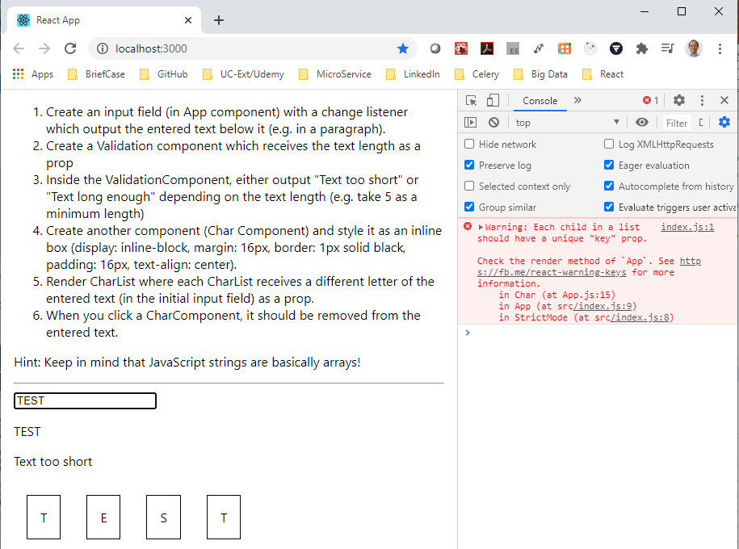
2.5 Split Array to Style Character
https://www.udemy.com/course/react-the-complete-guide-incl-redux/learn/lecture/8091068#overview
Verify. It looks work, however, the console shows the warning message.
The charList needs a key when split into a list of characters. How to solve this?

Slide 19

2.5 Split Array to Style Character
https://www.udemy.com/course/react-the-complete-guide-incl-redux/learn/lecture/8091068#overview
From CharList Array to character, we need to add index for map, i.e., map (char, index) and then key={index}

Slide 20
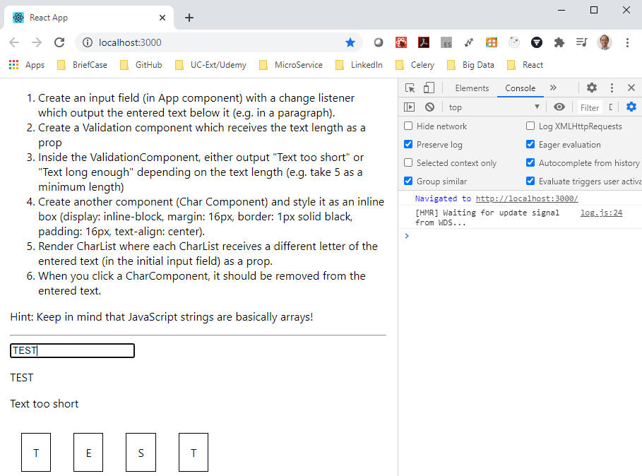
2.5 Split Array to Style Character
https://www.udemy.com/course/react-the-complete-guide-incl-redux/learn/lecture/8091068#overview
Verify again. Warning message is fixed.

Slide 21
2.6 Remove Char Component

Slide 22
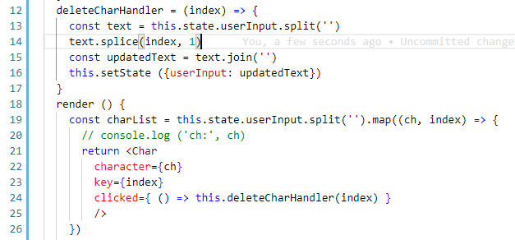

2.6 Remove Char Component
https://www.udemy.com/course/react-the-complete-guide-incl-redux/learn/lecture/8091068#overview
When you click a Char Component, it should be removed from the entered text

Slide 23
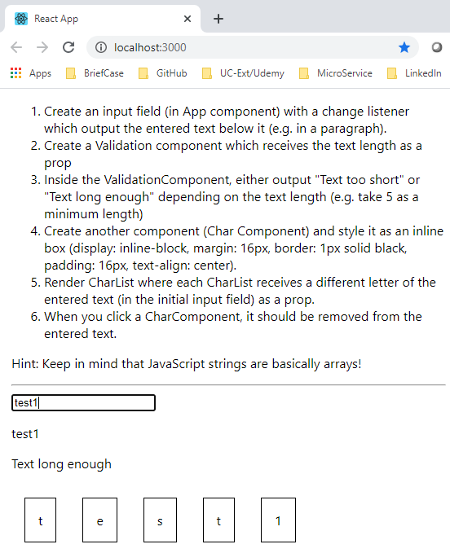
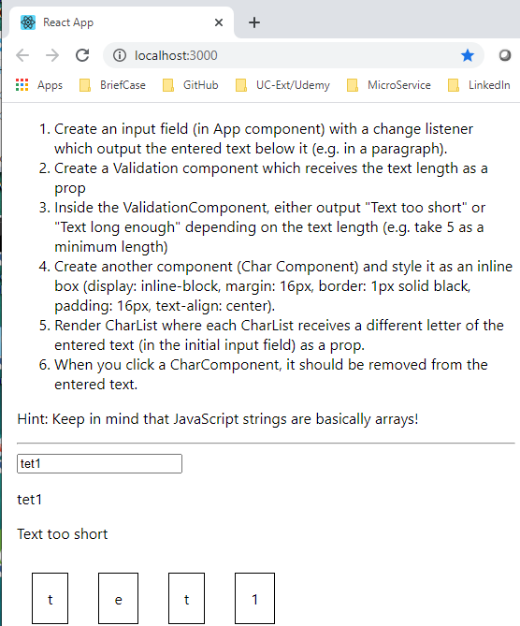
2.6 Remove Char Component
https://www.udemy.com/course/react-the-complete-guide-incl-redux/learn/lecture/8091068#overview
Verify: When you click a Char Component, it should be removed from the entered text.

Slide 24
End of Chapter

