Slide 1

125 Create Layout Component
Peter H. Chen

Slide 2
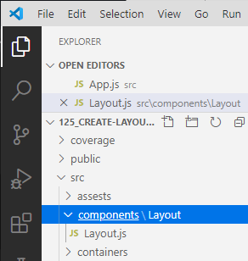
125 Create Layout Component
https://www.udemy.com/course/react-the-complete-guide-incl-redux/learn/lecture/13556476#overview
Create Layout Component
Create containers folder: Containers are stateful components.
Create components folder: Components are stateless components.
Under components folder, we create the Layout/Layput.js.
Other folder include the assets folder for logo.

Slide 3
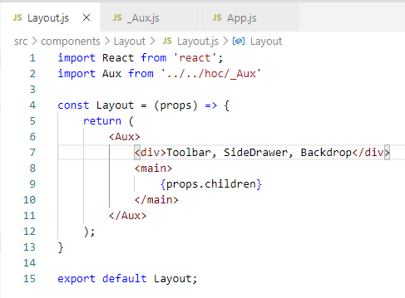
125 Create Layout Component
https://www.udemy.com/course/react-the-complete-guide-incl-redux/learn/lecture/13556476#overview
Create Layout Component
In the layout.js, type ‘rfce’ (React Functional Component ES7).
<main> … </main> is the major entry of HTML.

Slide 4
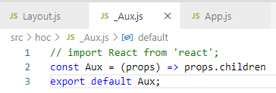
125 Create Layout Component
https://www.udemy.com/course/react-the-complete-guide-incl-redux/learn/lecture/13556476#overview
Create Layout Component
In the _Aux.js,
> const Aux = (props) => props.children

Slide 5
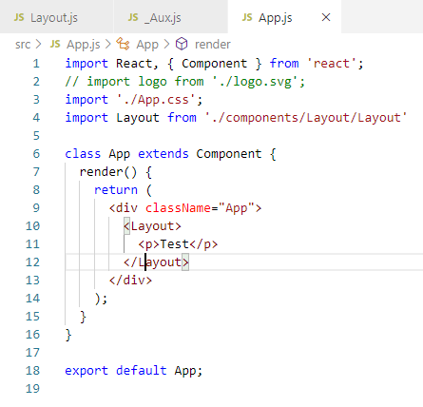
125 Create Layout Component
https://www.udemy.com/course/react-the-complete-guide-incl-redux/learn/lecture/13556476#overview
Create Layout Component
In App.js, <Layout> … </Layout>

Slide 6
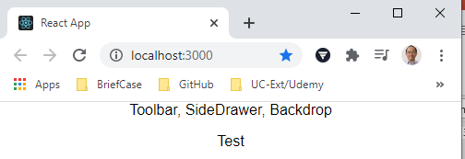
125 Create Layout Component
https://www.udemy.com/course/react-the-complete-guide-incl-redux/learn/lecture/13556476#overview
Create Layout Component
> npm start

Slide 7
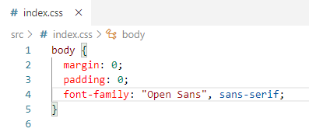
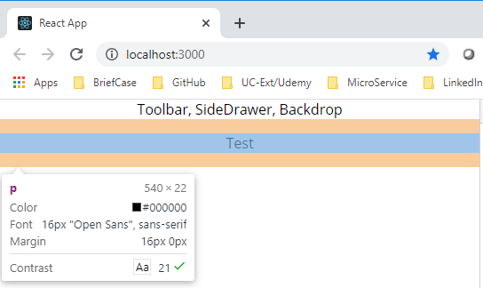
125 Create Layout Component
https://www.udemy.com/course/react-the-complete-guide-incl-redux/learn/lecture/13556476#overview
Create Layout Component
Add
> font-family: “Open Sans”, …

Slide 8
End of Chapter

