Slide 1

126 Implement Container
Peter H. Chen

Slide 2
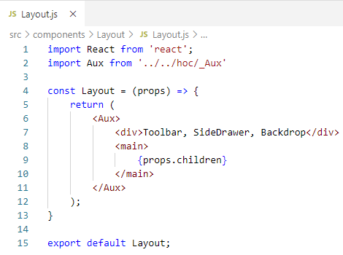
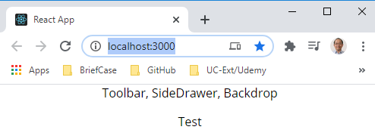
126 Implement Container
https://www.udemy.com/course/react-the-complete-guide-incl-redux/learn/lecture/13556484#notes
Implement Container
We already have the Layout.js as below.

Slide 3
126 Implement Container
https://www.udemy.com/course/react-the-complete-guide-incl-redux/learn/lecture/13556484#notes
Implement Container
We will implement the Container
Layout.js: Layout Component
App Component
Title
Layout Component
children
BurgerBuilder.js: BurgerBuilder Component
BurgerBuilder Component
<Aux>
Burger
Burger Control
</Aux>

Slide 4
126.1 Layout and Container

Slide 5
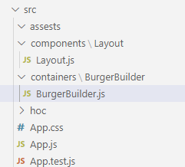
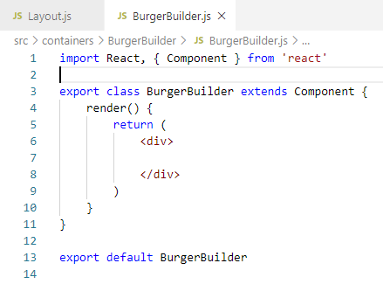
126.1 Layout and Container
https://www.udemy.com/course/react-the-complete-guide-incl-redux/learn/lecture/13556484#notes
Layout and Container
Create BurgerBuilder/BurgerBuilder.js, we do the class based component here.
We will change to functional component later.
Type ‘rce’ (React Class Component for ES7).
We need to implement what to return here.

Slide 6
126.2 App Component

Slide 7
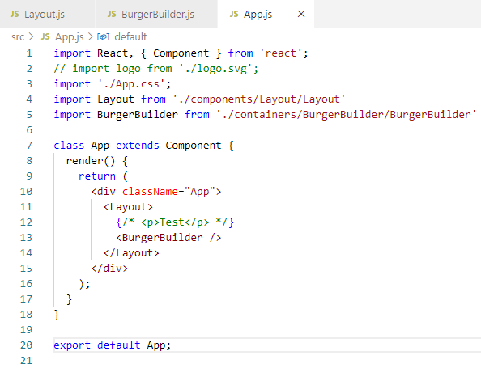
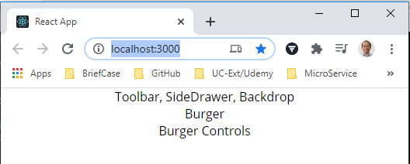
126.2 App Component
https://www.udemy.com/course/react-the-complete-guide-incl-redux/learn/lecture/13556484#notes
App Component
In App.js, put the <Layout> and then put <BurgerBuilder /> inside the <Layout>.

Slide 8
126.3 Layout Component

Slide 9
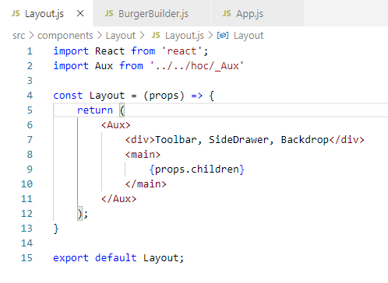
126.3 Layout Component
https://www.udemy.com/course/react-the-complete-guide-incl-redux/learn/lecture/13556484#notes
Layout Component
Put the container <BurgerBuilder /> inside the Layout.

Slide 10
126.4 BurgerBuilder Component

Slide 11
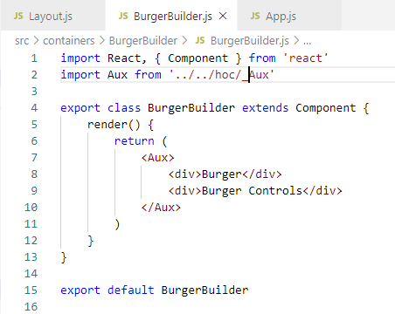
126.4 BurgerBuilder Component
https://www.udemy.com/course/react-the-complete-guide-incl-redux/learn/lecture/13556484#notes
BurgerBuilder Component
We use Wrapper <Aux> and have two elements <div>…</div> and <div>…</div>.

Slide 12
126.5 Layout.css

Slide 13
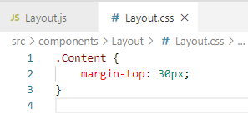
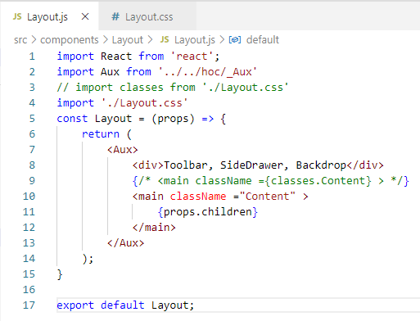
126.5 Layout.css
https://www.udemy.com/course/react-the-complete-guide-incl-redux/learn/lecture/13556484#notes
Layout CSS
Layout.css
Layout.js: import “./Layout.css”
className = “Content”

Slide 14
End of Chapter

