Slide 1

127 Dynamic Component
Peter H. Chen

Slide 2
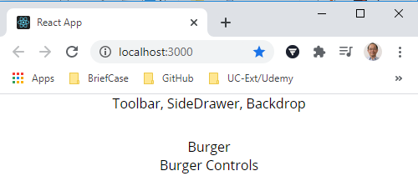
127 Dynamic Component
https://www.udemy.com/course/react-the-complete-guide-incl-redux/learn/lecture/8109012#notes
Dynamic Component
We already have the Layout of Burger Builder.

Slide 3
127.1 Create Burger Folder

Slide 4
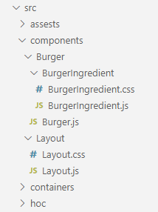
127.1 Create Burger Folder
https://www.udemy.com/course/react-the-complete-guide-incl-redux/learn/lecture/8109012#notes
Create Burger Folder
We have to keep the folder structure.
In the components folder, we create
Burger/Burger.js
Burger/Ingredient/Ingredients.js, BurgerIngredient.css

Slide 5
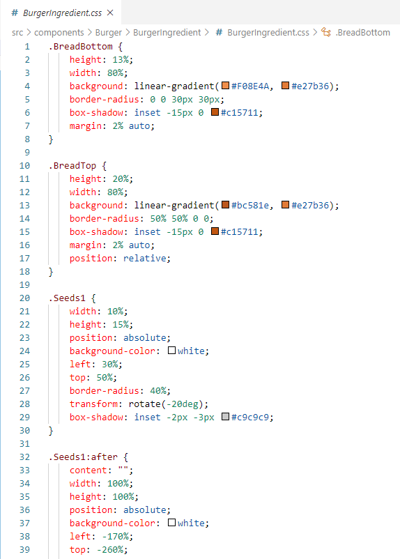
127.1 Create Burger Folder
https://www.udemy.com/course/react-the-complete-guide-incl-redux/learn/lecture/8109012#notes
Create Burger Folder
Add Burger Ingredient Style: BurgerIngredient.css

Slide 6
127.2 Create Burger Ingredient

Slide 7
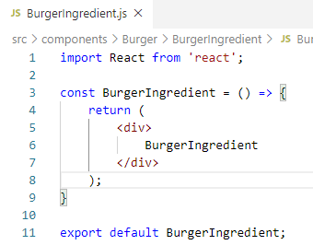
127.2 Create Burger Ingredient
https://www.udemy.com/course/react-the-complete-guide-incl-redux/learn/lecture/8109012#notes
Create Burger Ingredient
Type ‘rfc’ (React Functional Component) Create BurgerIngredient Component

Slide 8
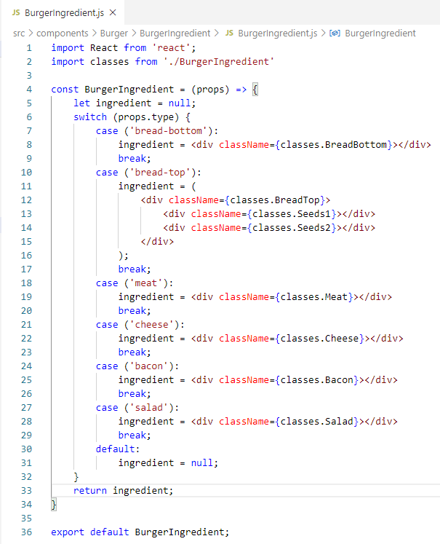
127.2 Create Burger Ingredient
https://www.udemy.com/course/react-the-complete-guide-incl-redux/learn/lecture/8109012#notes
Create Burger Ingredient
Add the code to
switch (props.type) and
set ingredient

Slide 9
End of Chapter

