Slide 1

128 Prop Type Validation
Peter H. Chen

Slide 2
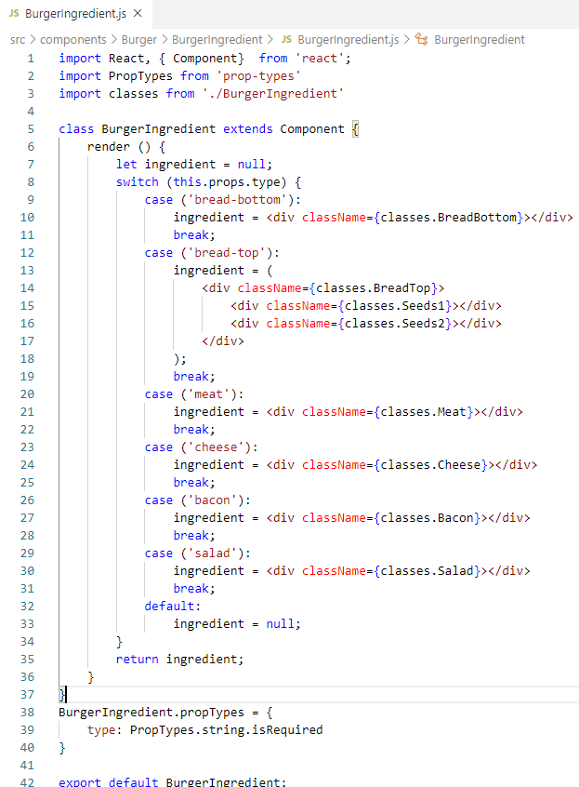
128 Prop Type Validation
https://www.udemy.com/course/react-the-complete-guide-incl-redux/learn/lecture/13556488#notes
Prop Type Validation
> npm install --save prop-types
> Import PropTypes from ‘prop-types’
Change the functional component to class component.
Set the PropTypes.
Note:
> import classes from “…”
need the css-loader and style-loader in the package.json.

Slide 3
End of Chapter

