Slide 1

129 Burger Component
Peter H. Chen

Slide 2
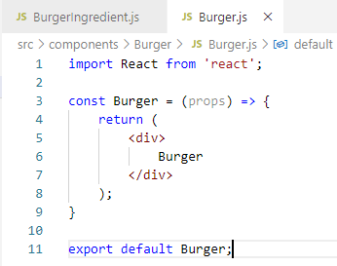
129 Burger Component
https://www.udemy.com/course/react-the-complete-guide-incl-redux/learn/lecture/8109016#notes
Burger Component
> npm install --save prop-types
Type ‘rfc” (React Functional Component)

Slide 3
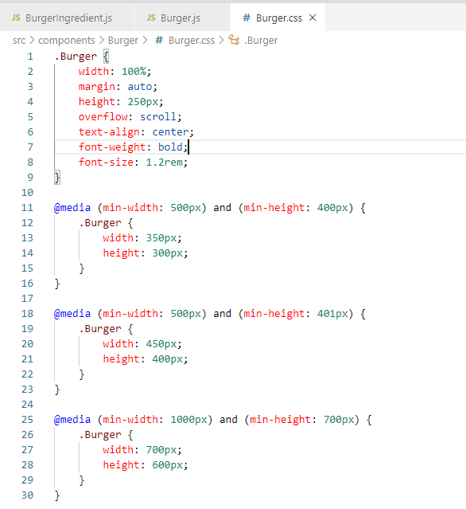
129 Burger Component
https://www.udemy.com/course/react-the-complete-guide-incl-redux/learn/lecture/8109016#notes
Burger Component
When user scroll the window size, set Burger component for smaller than window size
500 x 400
350 x 300

Slide 4
129 Burger Component
https://www.udemy.com/course/react-the-complete-guide-incl-redux/learn/lecture/8109016#notes
Burger Component
https://stackoverflow.com/questions/53572200/react-css-class-name-import-not-working
> npm install --save eject
> npm install --save style-loader
> npm install --save css-loader

Slide 5
End of Chapter

