Slide 1

132 Build Control Button
Peter H. Chen

Slide 2
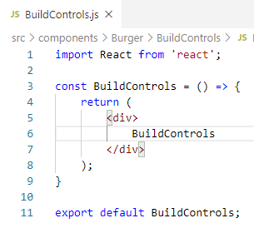
132 Build Control Button
https://www.udemy.com/course/react-the-complete-guide-incl-redux/learn/lecture/8109022#notes
Build Control Button
Create BuildControls/BuildControls.js
Create BuildControls/BuildControl/BuildControl.js
Type ‘rfc’ (React Functional Component).

Slide 3
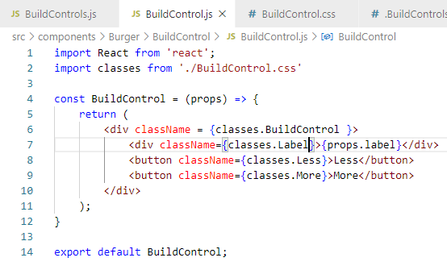
132 Build Control Button
https://www.udemy.com/course/react-the-complete-guide-incl-redux/learn/lecture/8109022#notes
Build Control Button
Add BuildControl.js

Slide 4
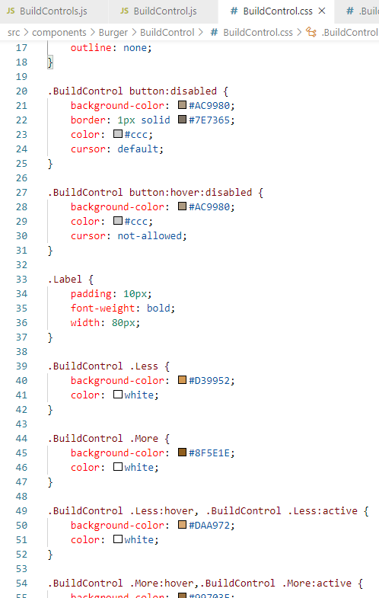
132 Build Control Button
https://www.udemy.com/course/react-the-complete-guide-incl-redux/learn/lecture/8109022#notes
Build Control Button
Add BuildControl.css

Slide 5
End of Chapter

