Slide 1

133 Output Control Button
Peter H. Chen

Slide 2
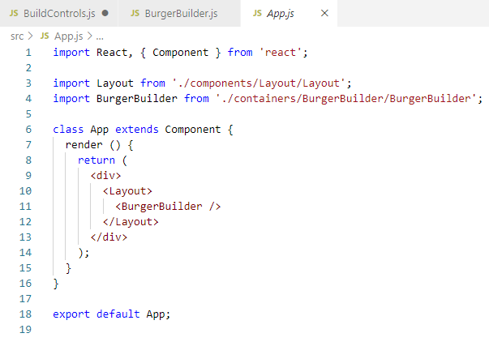
133 Output Control Button
https://www.udemy.com/course/react-the-complete-guide-incl-redux/learn/lecture/8109022#notes
Output Control Button
In App.js, <BurgerBuilder />

Slide 3
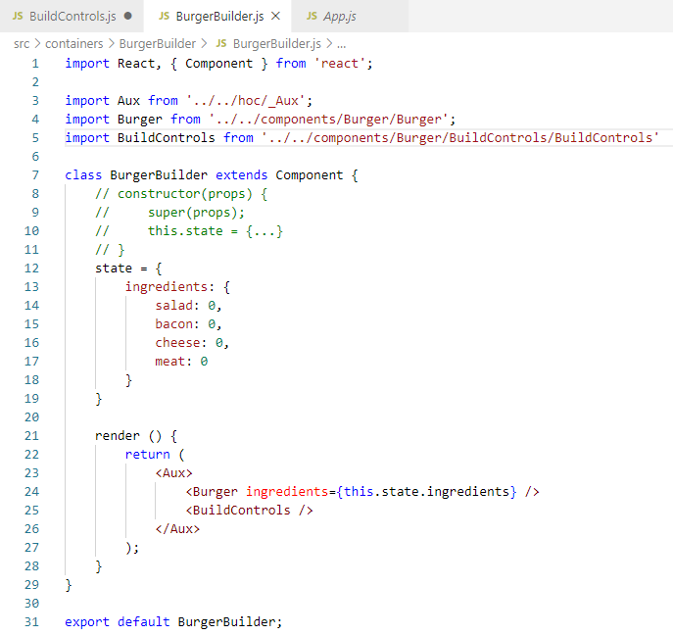
133 Output Control Button
https://www.udemy.com/course/react-the-complete-guide-incl-redux/learn/lecture/8109022#notes
Output Control Button
In BurgerBuilder.js

Slide 4
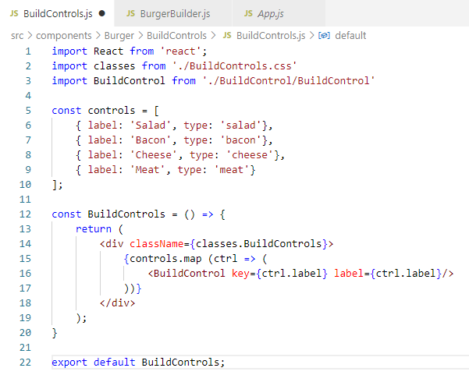
133 Output Control Button
https://www.udemy.com/course/react-the-complete-guide-incl-redux/learn/lecture/8109022#notes
Output Control Button
In BuildControls.js

Slide 5
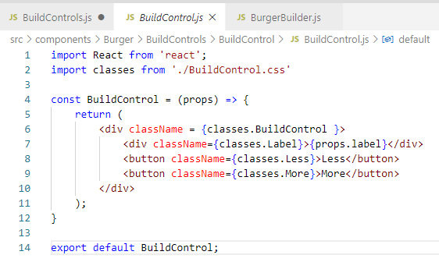
133 Output Control Button
https://www.udemy.com/course/react-the-complete-guide-incl-redux/learn/lecture/8109022#notes
Output Control Button
In BuildControl.js

Slide 6
133.1 Verify

Slide 7
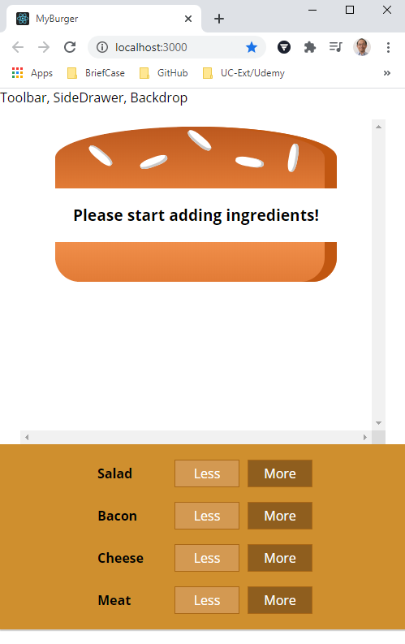
133.1 Verify
https://www.udemy.com/course/react-the-complete-guide-incl-redux/learn/lecture/8109022#notes
Verify
> npm start

Slide 8
End of Chapter

