Slide 1

134 Connect State Button
Peter H. Chen

Slide 2
134 Connect State and Button
https://www.udemy.com/course/react-the-complete-guide-incl-redux/learn/lecture/8109028#notes
Connect State and Button
We connects the state for each ingredient buttons.

Slide 3
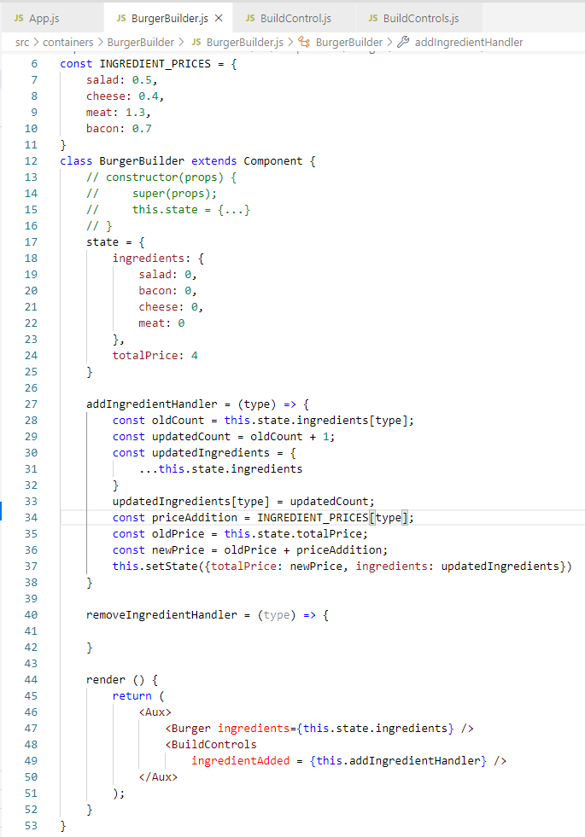
134 Burger Builder Container
https://www.udemy.com/course/react-the-complete-guide-incl-redux/learn/lecture/8109028#notes
Burger Builder Container
Passed in ingredients for Build Controls
state = { ingredients: {salad: 0, bacon: 0, cheese:0, meat: 0}, totalPrice: 4 }
Note:
Dictionary is an associated array.
The index is used to access the array element.
Ingredients[salad] => 0
Ingredients[bacon] => 0
Pass Handler to <BuildConrtols Handler />

Slide 4
134.1 Ingredient Control

Slide 5
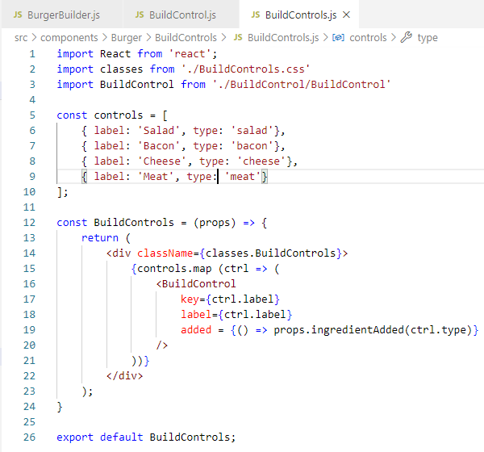
134.1 Ingredient Control
https://www.udemy.com/course/react-the-complete-guide-incl-redux/learn/lecture/8109028#notes
Ingredient Control
Build Controls:
Array controls define label and type.
Use map to loop through all the array elements.
Pass individual Ingredient and type (salad, bacon, cheese, meat).

Slide 6
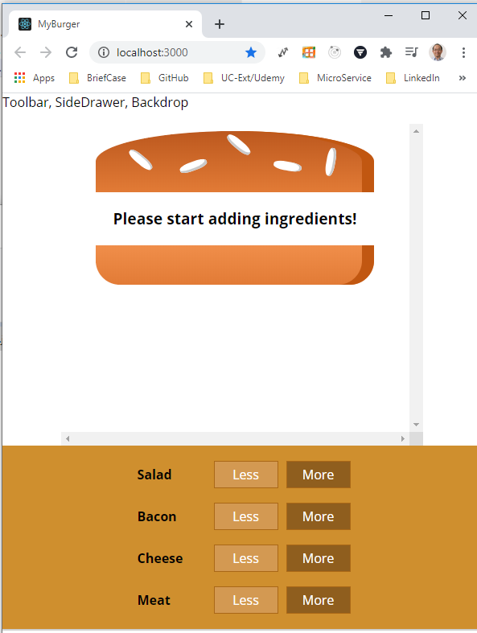
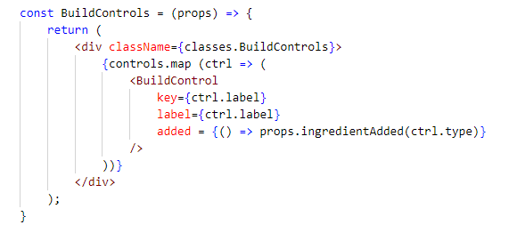
134.1 Ingredient Control
https://www.udemy.com/course/react-the-complete-guide-incl-redux/learn/lecture/8109028#notes
Ingredient Control
Build Controls:
Map is used to display individual ingredient component: Salad component, Bacon component, Cheese component, Meat component.

Slide 7
134.2 Ingredient Button

Slide 8
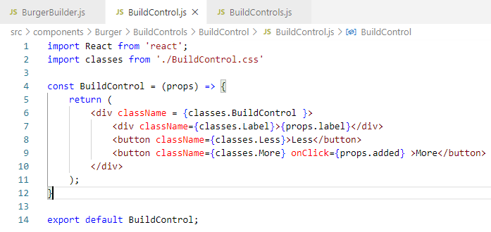
134.2 Ingredient Button
https://www.udemy.com/course/react-the-complete-guide-incl-redux/learn/lecture/8109028#notes
Ingredient Button
Button connect with assigned in Handler with onClick.

Slide 9
134.3 Verify

Slide 10
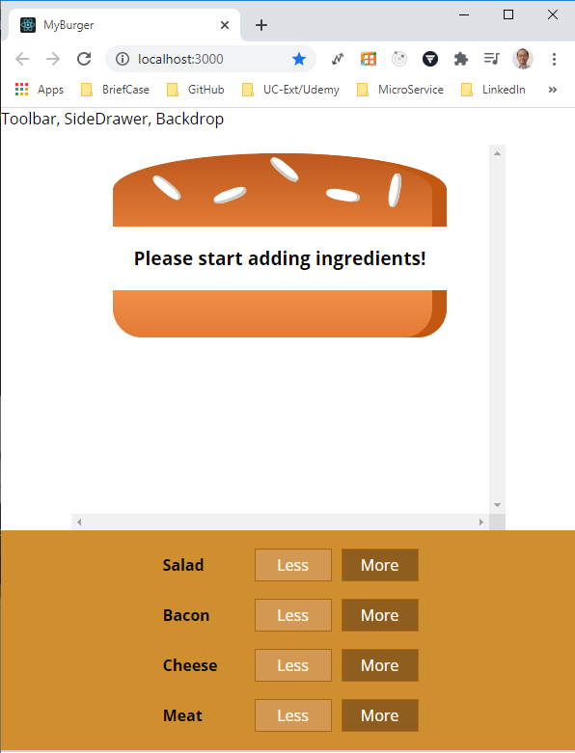
134.3 Verify
https://www.udemy.com/course/react-the-complete-guide-incl-redux/learn/lecture/8109028#notes
Verify
> npm start
Click “More” to add

Slide 11
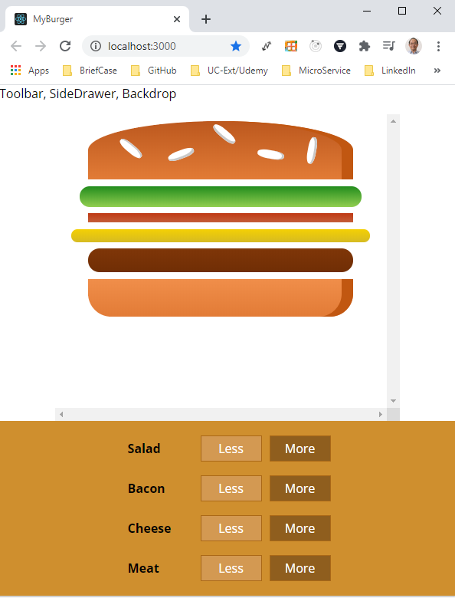
134.3 Verify
https://www.udemy.com/course/react-the-complete-guide-incl-redux/learn/lecture/8109028#notes
Verify
> npm start
Click “More” to add

Slide 12
End of Chapter

