Slide 1

135 Remove Ingredient Button
Peter H. Chen

Slide 2
135 Remove Ingredient Button
https://www.udemy.com/course/react-the-complete-guide-incl-redux/learn/lecture/8109030#notes
Remove Ingredient Button
We connect the handler the remove ingredient button.

Slide 3
135.1 Remove Ingredient Handler

Slide 4
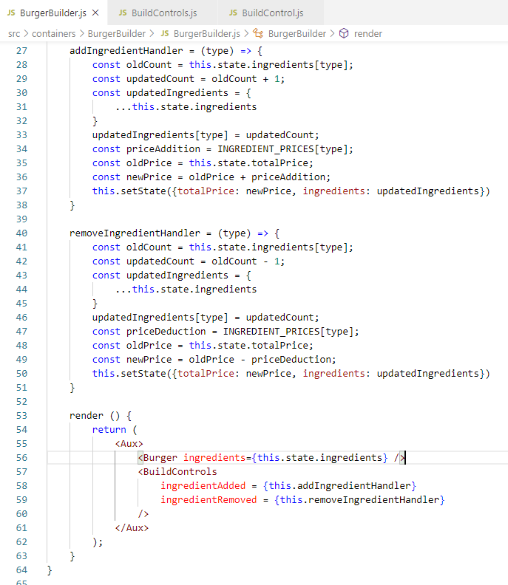
135.1 Remove Ingredient Handler
https://www.udemy.com/course/react-the-complete-guide-incl-redux/learn/lecture/8109030#notes
Remove Ingredient Button
We add function removedIngredientHandler ()
Pass the function to BuildControls component.

Slide 5
135.2 Pass Ingredient to Build Controls

Slide 6
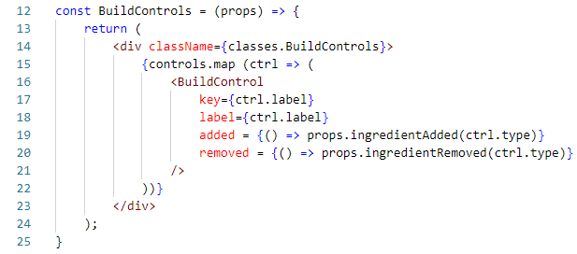
135.2 Pass Ingredient to Build Controls
https://www.udemy.com/course/react-the-complete-guide-incl-redux/learn/lecture/8109030#notes
Remove Ingredient Button
Pass the IngredientRemoved props to Build Control component.

Slide 7
135.3 onClick for Build Control

Slide 8
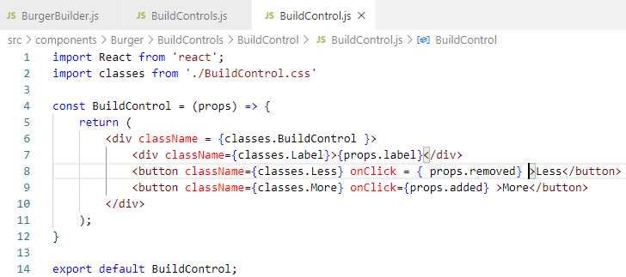
135.3 onClick for Build Control
https://www.udemy.com/course/react-the-complete-guide-incl-redux/learn/lecture/8109030#notes
onCLick for Build Control
Pass prop.removed for onClick.

Slide 9
135.4 Disable When Count = 0

Slide 10
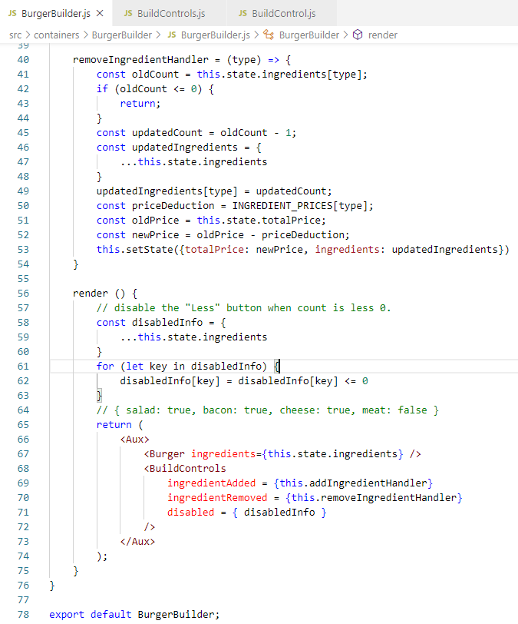
135.4 Disable When Count = 0
https://www.udemy.com/course/react-the-complete-guide-incl-redux/learn/lecture/8109030#notes
Disable When Count = 0
When Count <= 0, do not do anything.
Set disabled flag = true when count <= 0.
Pass the disabled flag to Build Controls component.

Slide 11
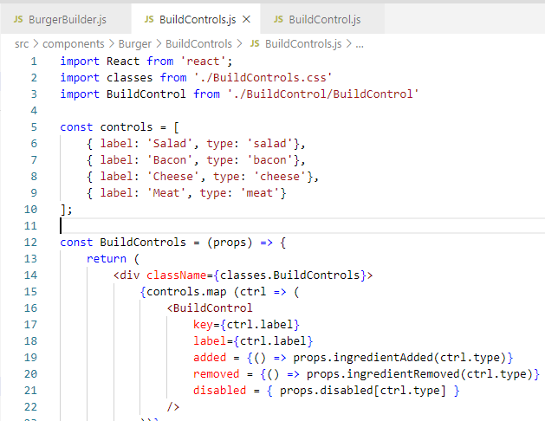
135.4 Disable When Count = 0
https://www.udemy.com/course/react-the-complete-guide-incl-redux/learn/lecture/8109030#notes
Disable When Count = 0
Passed property disabled = …

Slide 12
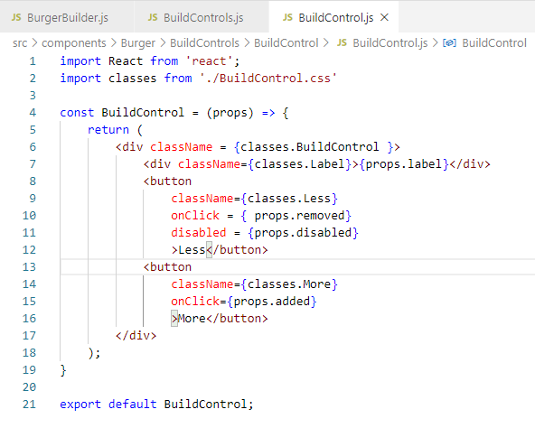
135.4 Disable When Count = 0
https://www.udemy.com/course/react-the-complete-guide-incl-redux/learn/lecture/8109030#notes
Set <button disabled={} > Less </button>

Slide 13
135.5 Verify

Slide 14
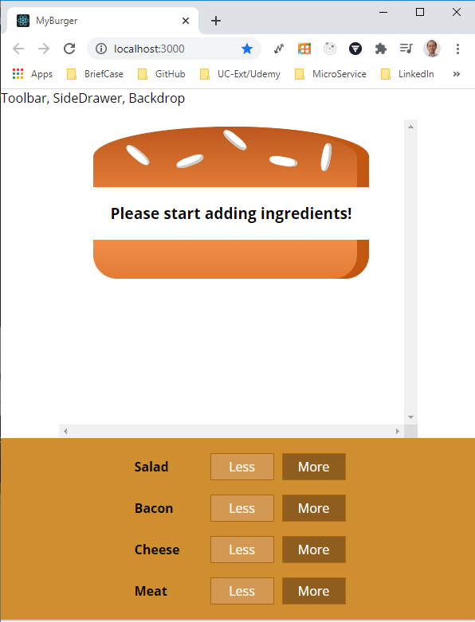
135.5 Verify
https://www.udemy.com/course/react-the-complete-guide-incl-redux/learn/lecture/8109030#notes
Verify
> npm start
Click “More” to add

Slide 15
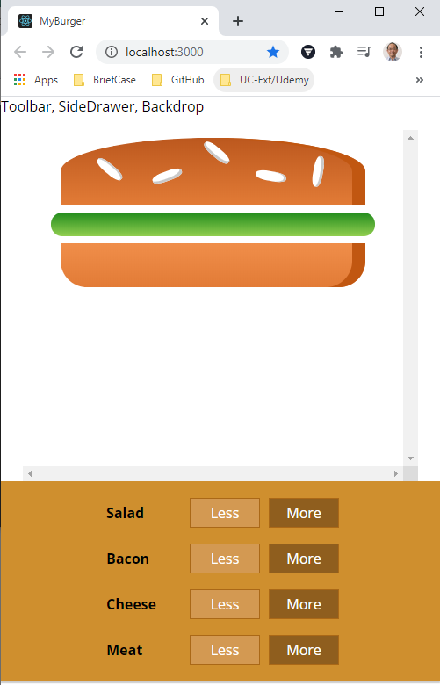
135.5 Verify
https://www.udemy.com/course/react-the-complete-guide-incl-redux/learn/lecture/8109030#notes
Verify
> npm start
Click “Less” to remove

Slide 16
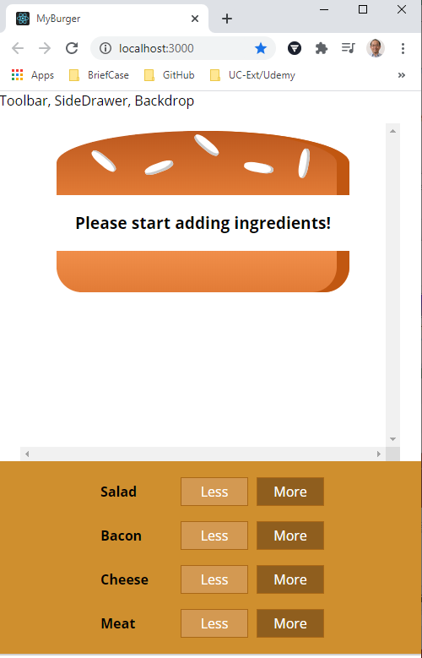
135.5 Verify
https://www.udemy.com/course/react-the-complete-guide-incl-redux/learn/lecture/8109030#notes
Verify

Slide 17
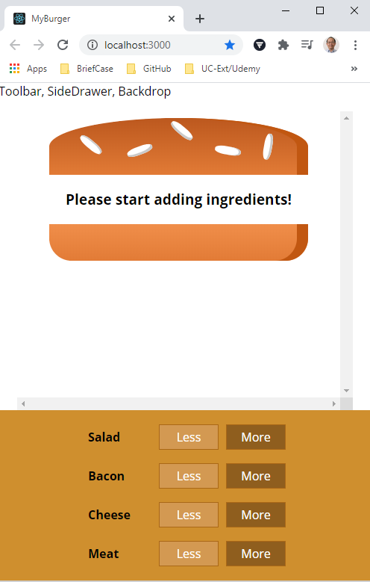
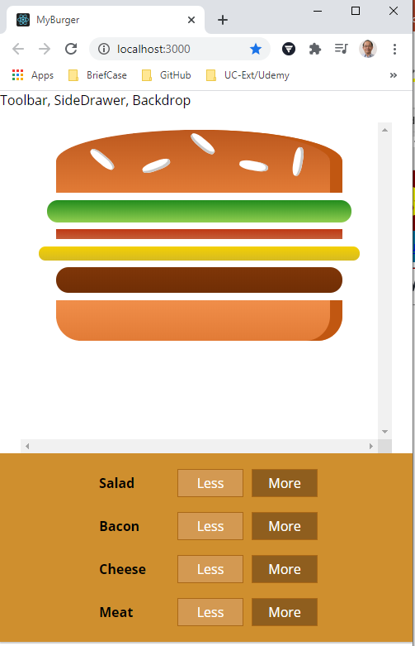
135.5 Verify
https://www.udemy.com/course/react-the-complete-guide-incl-redux/learn/lecture/8109030#notes
Verify
More
Less

Slide 18
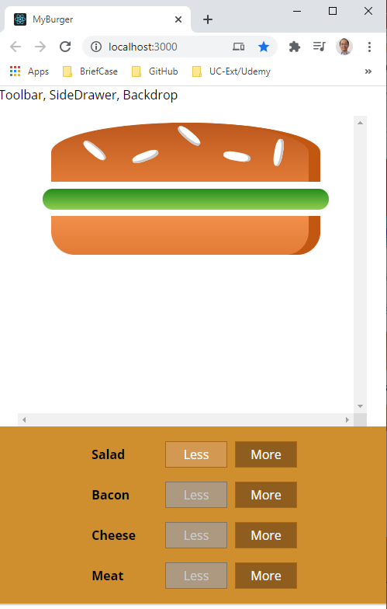
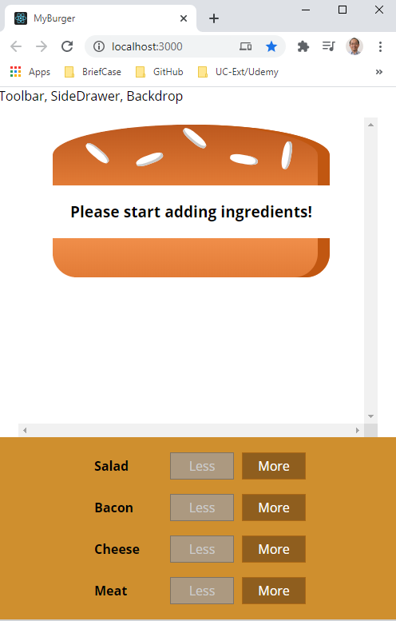
135.5 Verify
https://www.udemy.com/course/react-the-complete-guide-incl-redux/learn/lecture/8109030#notes
Verify Enabled and Disabled

Slide 19
End of Chapter

