Slide 1

136 Display Price
Peter H. Chen

Slide 2
136 Display Price
https://www.udemy.com/course/react-the-complete-guide-incl-redux/learn/lecture/8109034#notes
Display Price
We have implemented More or Less button.
Now, we want to display the Burger price.
The price is displayed above the build controls.

Slide 3
136.1 Pass Property Price

Slide 4
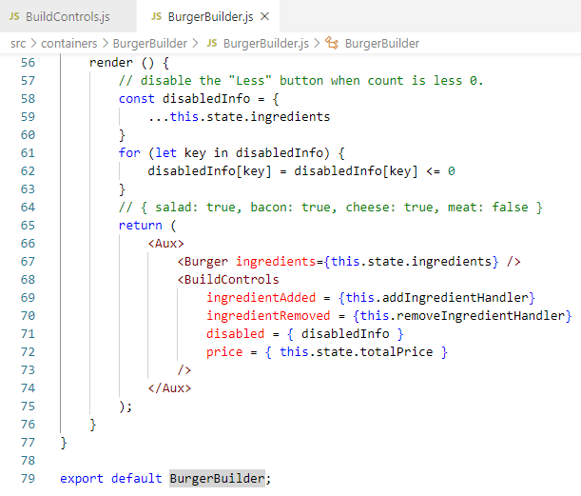
136.1 Pass Property Price
https://www.udemy.com/course/react-the-complete-guide-incl-redux/learn/lecture/8109034#notes
Pass Property Price
Pass price = { this.state.totalPirce }.

Slide 5
136.2 Display Total Price

Slide 6
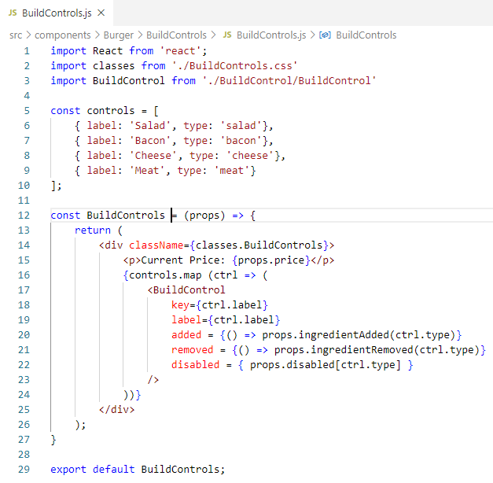
136.2 Display Total Price
https://www.udemy.com/course/react-the-complete-guide-incl-redux/learn/lecture/8109034#notes
Display Total Price
In Build Controls Component, display the toral Price.

Slide 7
136.3 Verify

Slide 8
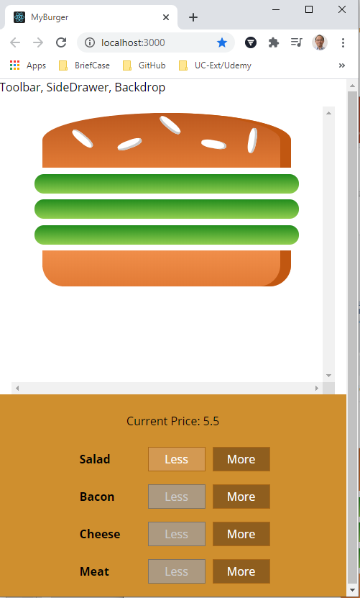
136.3 Verify
https://www.udemy.com/course/react-the-complete-guide-incl-redux/learn/lecture/8109034#notes
Verify
> npm start
Check the displayed price.

Slide 9
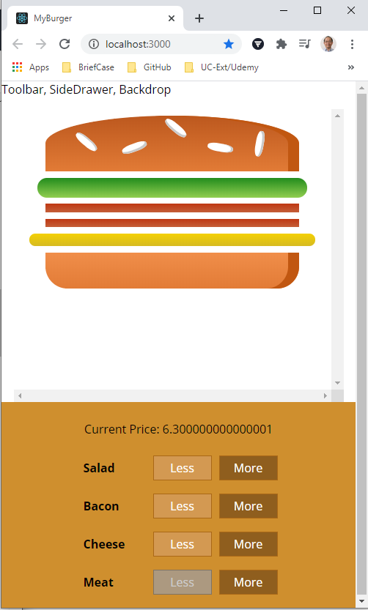
136.3 Verify
https://www.udemy.com/course/react-the-complete-guide-incl-redux/learn/lecture/8109034#notes
Verify
> npm start
Add cheese decimal point overflow.

Slide 10
136.4 Fixed Decimal Point

Slide 11
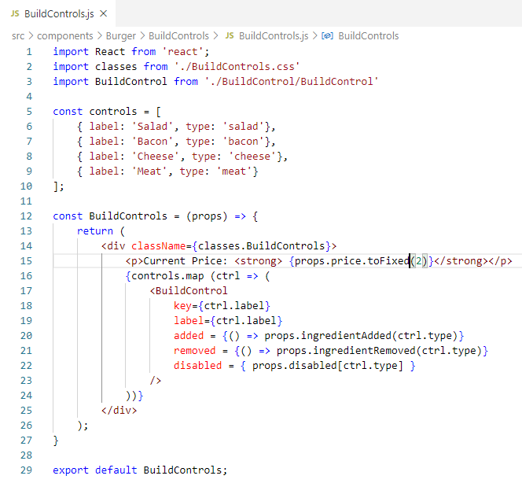
136.4 Fixed Decimal Point
https://www.udemy.com/course/react-the-complete-guide-incl-redux/learn/lecture/8109034#notes
Fixed Decimal Point
Add <strong> and toFixed (2)</strong>
https://www.geeksforgeeks.org/javascript-tofixed-function/#:~:text=The%20toFixed()%20function%20in,the%20right%20of%20the%20decimal.&text=The%20toFixed()%20function%20is,'%20operator.

Slide 12
136.5 Verify Fix Decimal Point

Slide 13

136.5 Verify Fix Decimal Point
https://www.udemy.com/course/react-the-complete-guide-incl-redux/learn/lecture/8109034#notes
Verify Fix Decimal Point
> npm start
Verify fixed number.

Slide 14
End of Chapter

