Slide 1

137 Order Button
Peter H. Chen

Slide 2
137 Order Button
https://www.udemy.com/course/react-the-complete-guide-incl-redux/learn/lecture/8109036#notes
Order Button
We create an order button.
When no ingredients added, the order button is disabled.
When some ingredients are added, the order button is enabled.

Slide 3
137.1 Update Purchase State

Slide 4
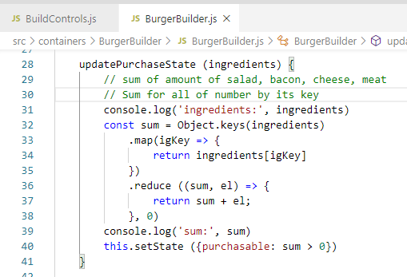
137.1 Update Purchase State
https://www.udemy.com/course/react-the-complete-guide-incl-redux/learn/lecture/8109036#notes
Update Purchase State
Use Object.keys() to loop for key array of dictionary ingredients.
Use key array to map the value array.
Use reduce function to get the sum.
Note: reduce (func, initial-value)

Slide 5
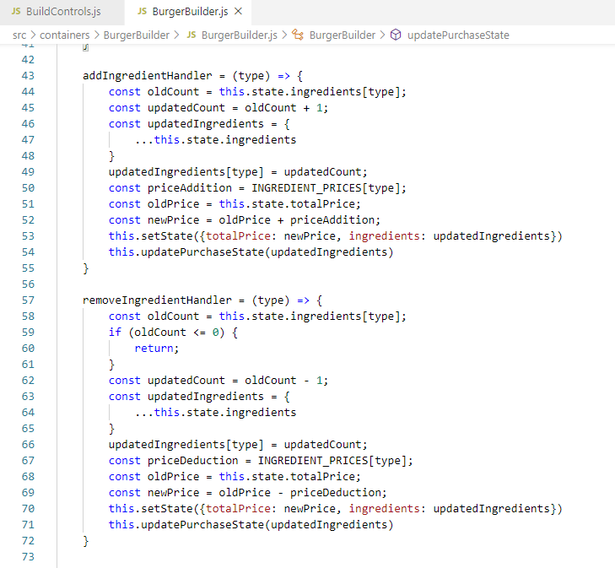
137.1 Update Purchase State
https://www.udemy.com/course/react-the-complete-guide-incl-redux/learn/lecture/8109036#notes
Update Purchase State
Update ingredients and update purchase state.

Slide 6
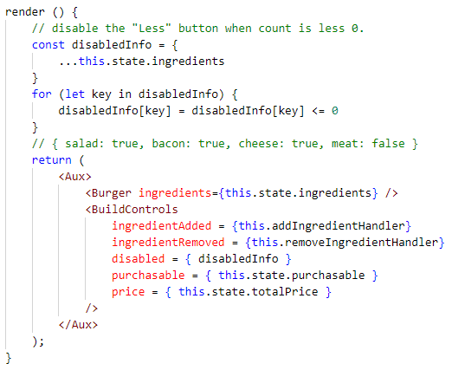
137.1 Update Purchase State
https://www.udemy.com/course/react-the-complete-guide-incl-redux/learn/lecture/8109036#notes
Update Purchase State
Set purchasable flag.

Slide 7
137.2 Order Button

Slide 8
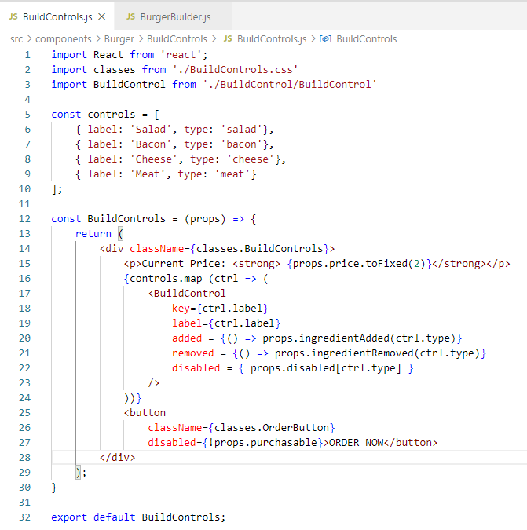
137.2 Order Button
https://www.udemy.com/course/react-the-complete-guide-incl-redux/learn/lecture/8109036#notes
Order Button
Set purchasable flag.

Slide 9
137.3 Verify

Slide 10
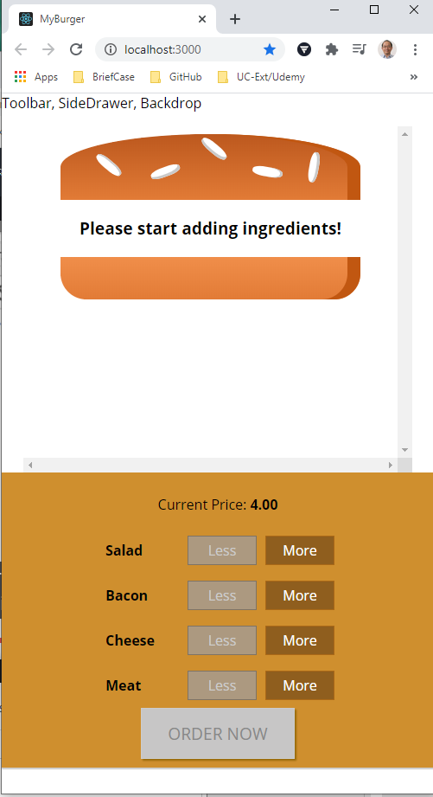
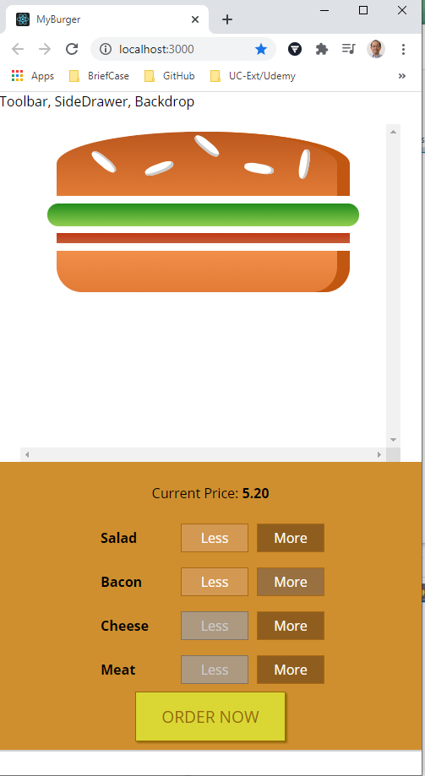
137.3 Verify
https://www.udemy.com/course/react-the-complete-guide-incl-redux/learn/lecture/8109034#notes
Verify
> npm start
Check the order button.

Slide 11
End of Chapter

