Slide 1

138 Order Summary
Peter H. Chen

Slide 2
138 Order Summary
https://www.udemy.com/course/react-the-complete-guide-incl-redux/learn/lecture/8109038#notes
Order Summary
We have order button working.
We create the modal for order summary.
We create:
components\UI\Modal\Modal.js and
components\UI\Backdrop\Backdrop.js

Slide 3
138.1 Create Modal

Slide 4
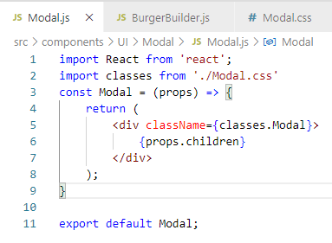
138.1 Create Modal
https://www.udemy.com/course/react-the-complete-guide-incl-redux/learn/lecture/8109038#notes
Create Modal

Slide 5
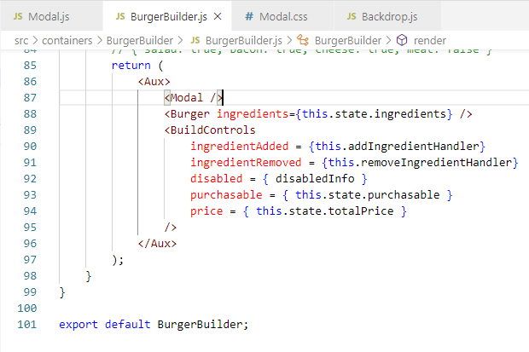
138.1 Create Modal
https://www.udemy.com/course/react-the-complete-guide-incl-redux/learn/lecture/8109038#notes
Create Modal

Slide 6
138.2 Verify

Slide 7
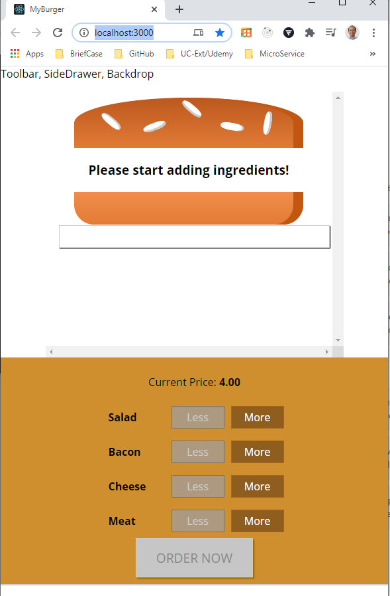
138.2 Verify
https://www.udemy.com/course/react-the-complete-guide-incl-redux/learn/lecture/8109038#notes
Verify
> npm start
Check the Modal.

Slide 8
138.3 Order Summary

Slide 9
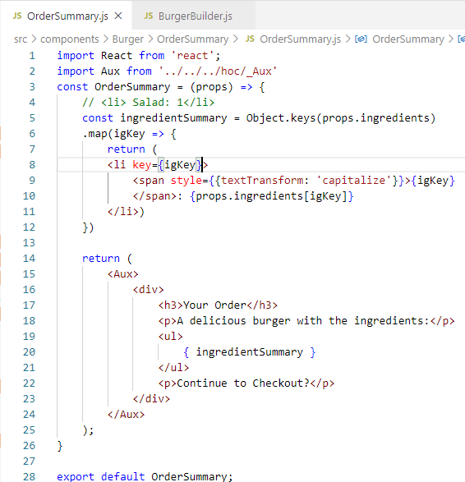
138.4 Order Summary
https://www.udemy.com/course/react-the-complete-guide-incl-redux/learn/lecture/8109038#notes
Order Summary
Ingredient Summary

Slide 10
138.4 Order in Modal

Slide 11
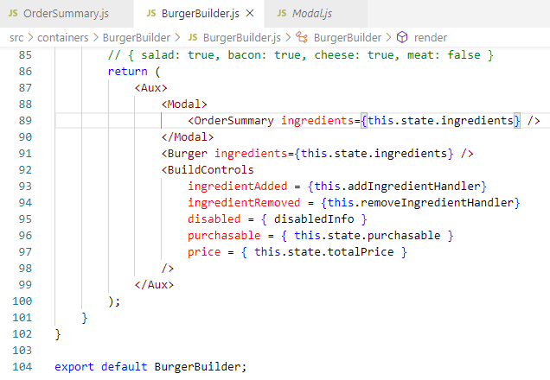
138.4 Order in Modal
https://www.udemy.com/course/react-the-complete-guide-incl-redux/learn/lecture/8109038#notes
Order in Modal
Modal

Slide 12
138.5 Verify Order Summary

Slide 13
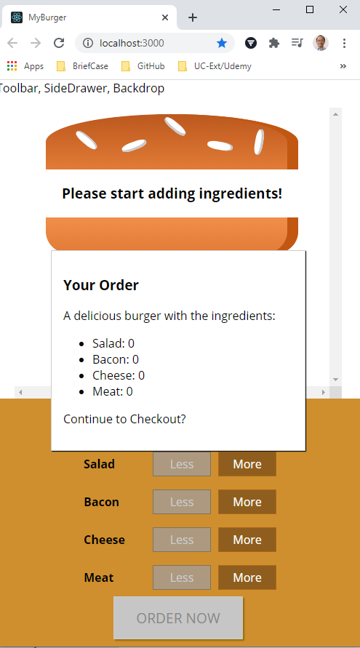
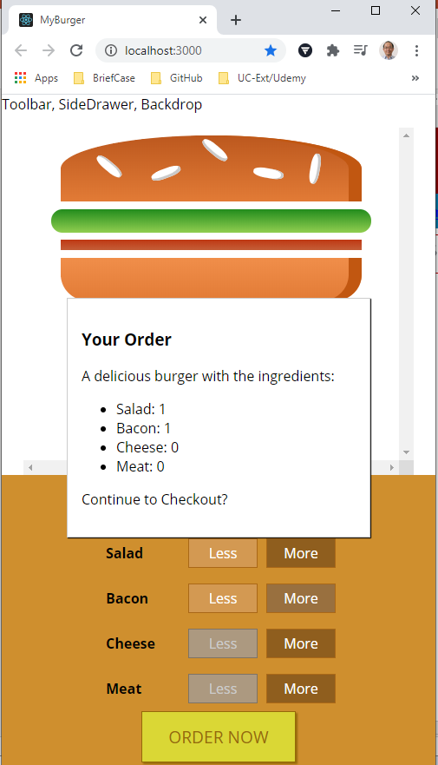
138.5 Verify Order Summary
https://www.udemy.com/course/react-the-complete-guide-incl-redux/learn/lecture/8109038#notes
Verify Order Summary

Slide 14
End of Chapter

