Slide 1

139 Hide Modal
Peter H. Chen

Slide 2
139 Hide Modal
https://www.udemy.com/course/react-the-complete-guide-incl-redux/learn/lecture/8109040#notes
Hide Modal
We added the modal display.
We want to hide the modal initially.
When we click the “ORDER NOW” button, the modal screen slide into.

Slide 3
139.1 Setup Purchasing Flag

Slide 4
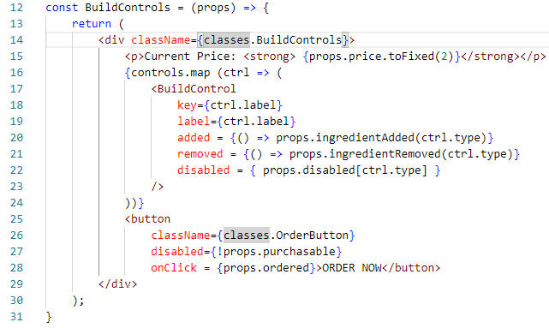
139.1 Setup Purchasing Flag
https://www.udemy.com/course/react-the-complete-guide-incl-redux/learn/lecture/8109040#notes
Setup Purchasing Flag
onClick, get ordered property.

Slide 5
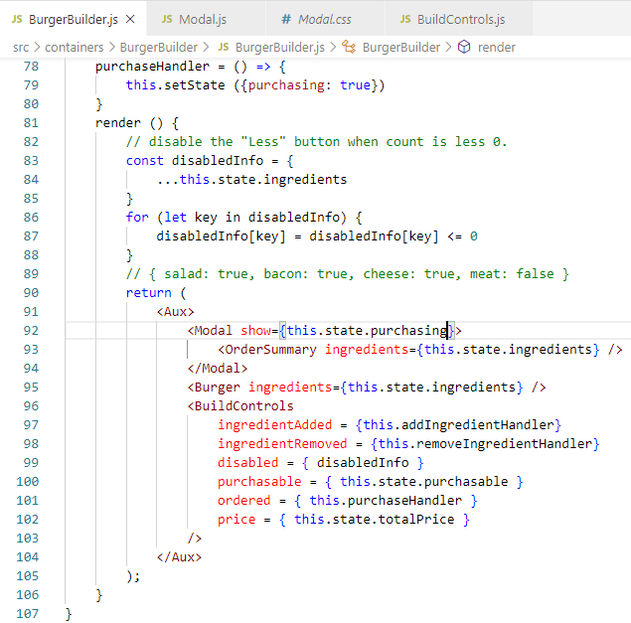
139.1 Setup Purchasing Flag
https://www.udemy.com/course/react-the-complete-guide-incl-redux/learn/lecture/8109040#notes
Setup Purchasing Flag
Setup purchaseHandler ()
Pass property show = tru or false.

Slide 6
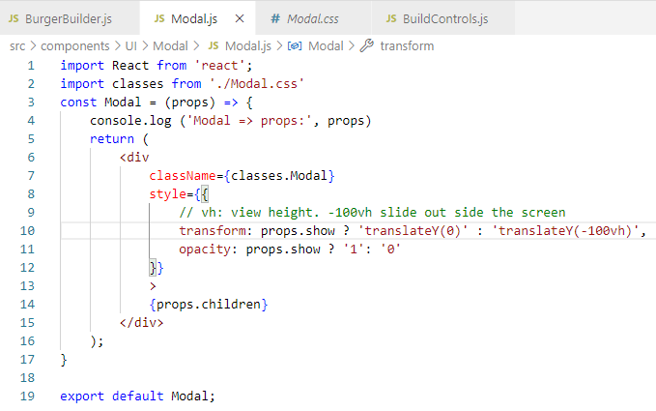
139.1 Setup Purchasing Flag
https://www.udemy.com/course/react-the-complete-guide-incl-redux/learn/lecture/8109040#notes
Setup Purchasing Flag
Modal: Screen slide in.

Slide 7
139.2 Verify Hide Modal

Slide 8
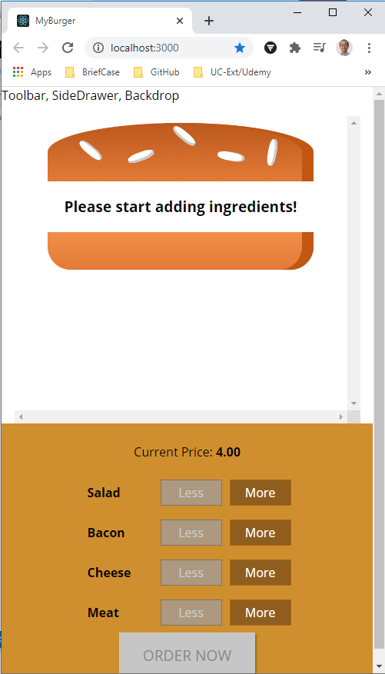
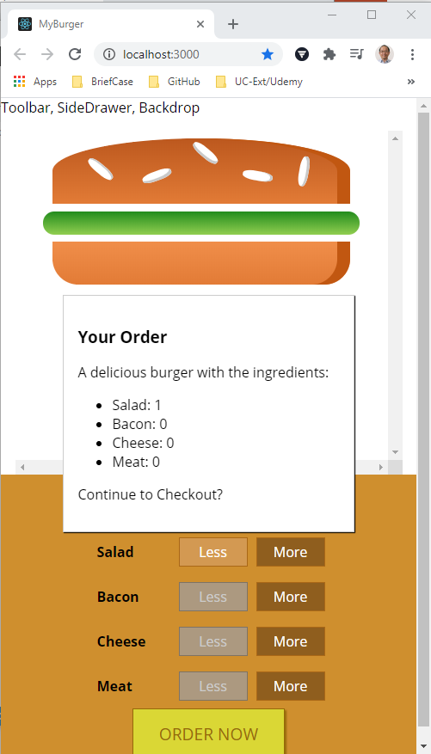
139.2 Verify Hide Modal
https://www.udemy.com/course/react-the-complete-guide-incl-redux/learn/lecture/8109040#notes
Verify Hide Modal

Slide 9
End of Chapter

