Slide 1

140 Backdrop
Peter H. Chen

Slide 2
140 Backdrop
https://www.udemy.com/course/react-the-complete-guide-incl-redux/learn/lecture/13556496#notes
Backdrop
Backdrop means “background”. When you click background, the front Modal (screen) will be closed.

Slide 3
140.1 Clicked Background

Slide 4
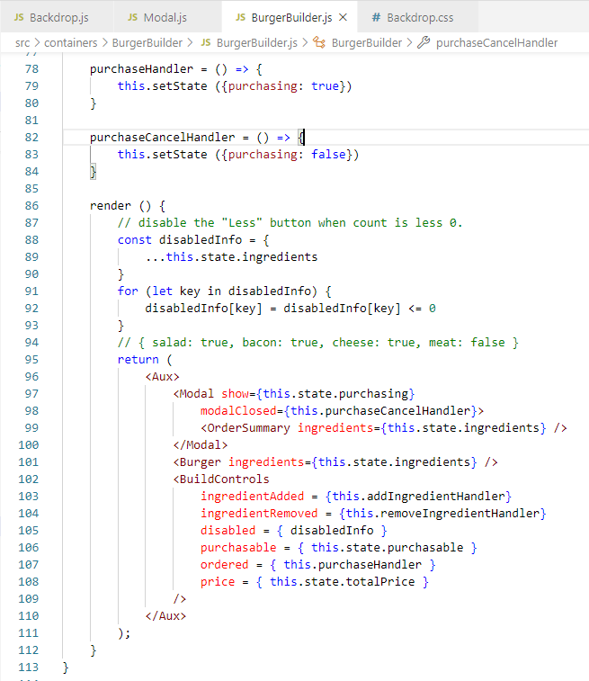
140.1 Clicked Background
https://www.udemy.com/course/react-the-complete-guide-incl-redux/learn/lecture/13556496#notes
Burger Builder passed in puchaseCancelHandler to set up purchasing flag to false.
The show = purchasing true or false.
The show is used to display the Modal display or Modal closed.

Slide 5
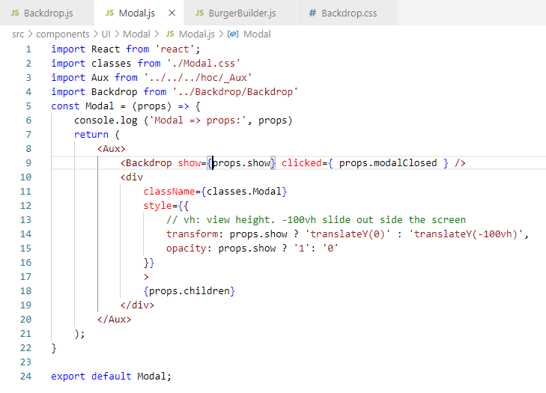
140.1 Clicked Background
https://www.udemy.com/course/react-the-complete-guide-incl-redux/learn/lecture/13556496#notes
When Modal passed int clicked to Backdrop.

Slide 6
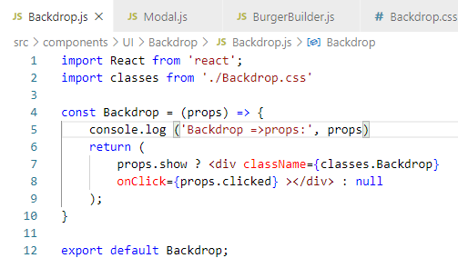
140.1 Clicked Background
https://www.udemy.com/course/react-the-complete-guide-incl-redux/learn/lecture/13556496#notes
When user click the background, triggered passed in clicked and display null.

Slide 7
140.2 Verify Backdrop

Slide 8
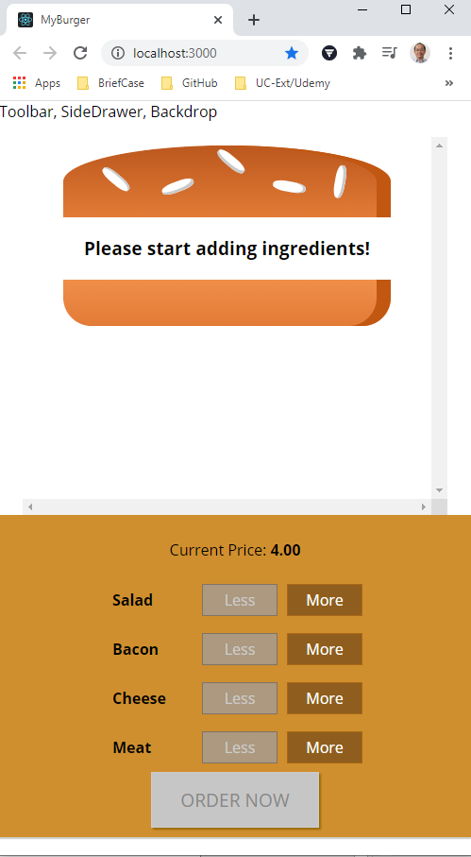
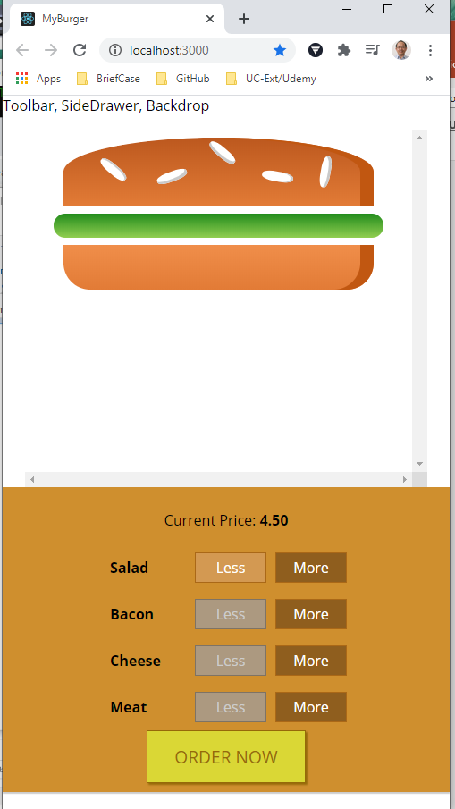
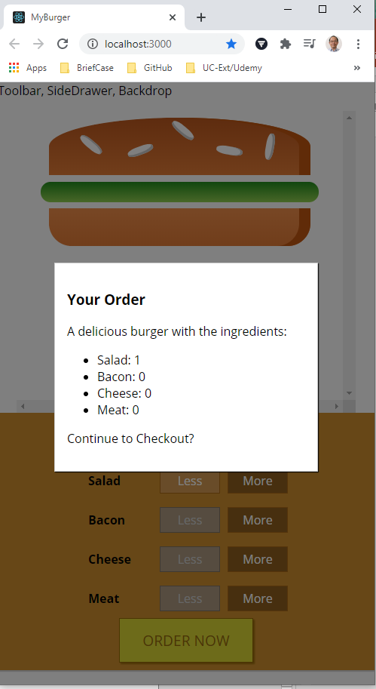
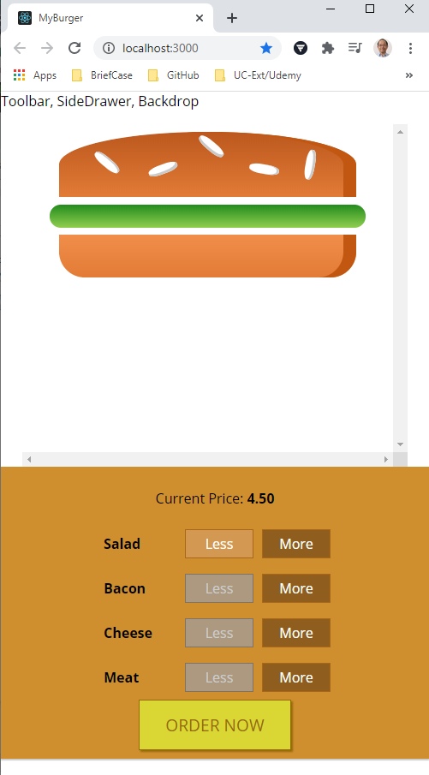
140.2 Verify Backdrop
https://www.udemy.com/course/react-the-complete-guide-incl-redux/learn/lecture/13556496#notes
Verify Backdrop: Click More, Click Order, Pop up the Modal Screen, Click backdrop to close Modal Screen.

Slide 9
End of Chapter

