Slide 1

141 Custom Button
Peter H. Chen

Slide 2
141 Custom Button
https://www.udemy.com/course/react-the-complete-guide-incl-redux/learn/lecture/13556496#notes
Custom Button
We have done the order summary and cancel by backdrop (background clicked).
We will add more buttons: CANCEL and CONTINUE
Cancel will be the same as clicking on the backdrop does.
We cannot do much on continue now. We will submit to this to a server and etc. The continue will be added latter.
We will use style for a lot of buttons.

Slide 3
141.1 Button.js and Button.css

Slide 4
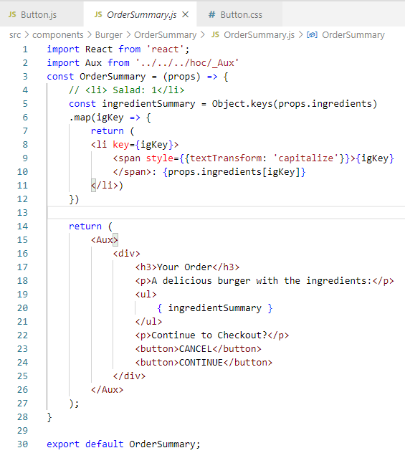
141.1 Button.js and Button.css
https://www.udemy.com/course/react-the-complete-guide-incl-redux/learn/lecture/13556496#notes
In Order Summary, we add two more buttons.

Slide 5
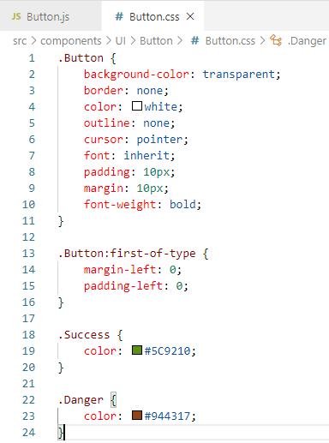
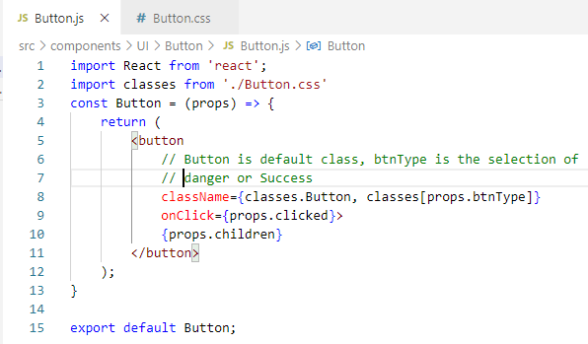
141.1 Button.js and Button.css
https://www.udemy.com/course/react-the-complete-guide-incl-redux/learn/lecture/13556496#notes
We create
Components/UI/Button/Button.js and Button.css
We us classes.Button by default and select classes by [props.btnType]

Slide 6
End of Chapter

