Slide 1

142 Implement Custom Button
Peter H. Chen

Slide 2
142 Implement Custom Button
https://www.udemy.com/course/react-the-complete-guide-incl-redux/learn/lecture/8109056#notes
Implement Custom Button
We use the custom button for order summary

Slide 3
142.1 Button.js and Button.css

Slide 4
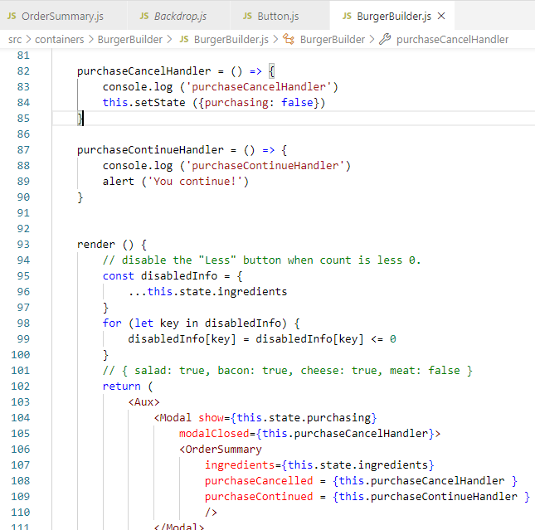
142.1 Button.js and Button.css
https://www.udemy.com/course/react-the-complete-guide-incl-redux/learn/lecture/8109056#notes
In Burger Builder.js, we Passed the Cancel Handler and Continued Handler.

Slide 5
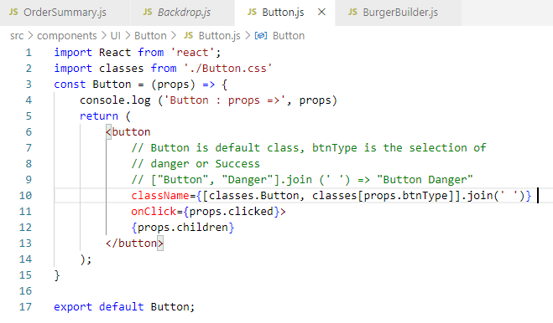
142.1 Button.js and Button.css
https://www.udemy.com/course/react-the-complete-guide-incl-redux/learn/lecture/8109056#notes
In Button.js, we custom the <button>

Slide 6
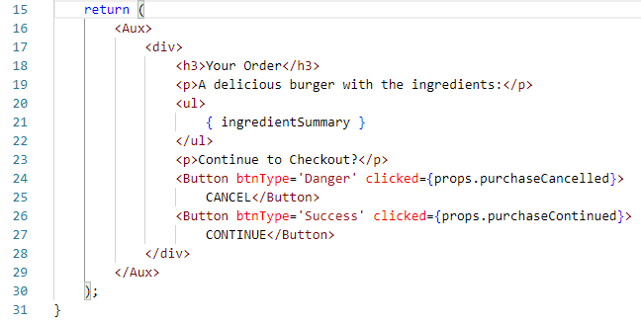
142.1 Button.js and Button.css
https://www.udemy.com/course/react-the-complete-guide-incl-redux/learn/lecture/8109056#notes
In Order Summary, we add two more buttons.

Slide 7
142.2 Verify Button

Slide 8
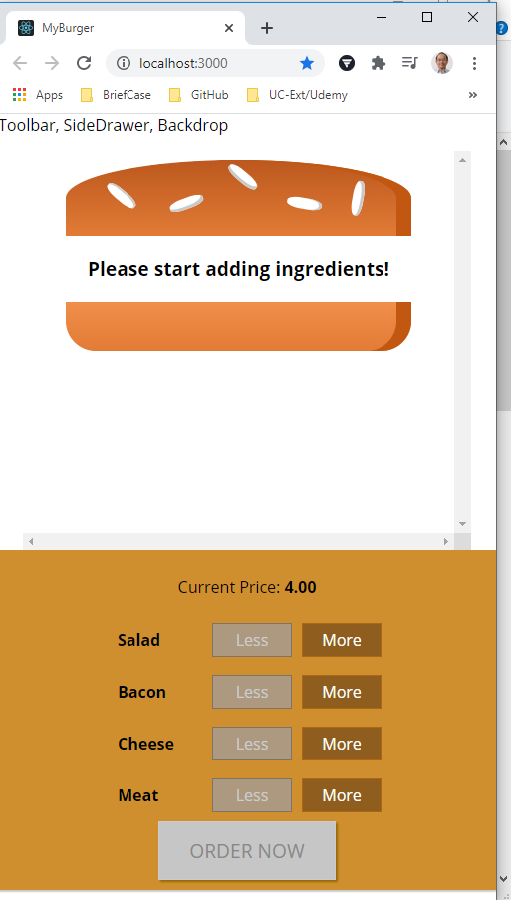
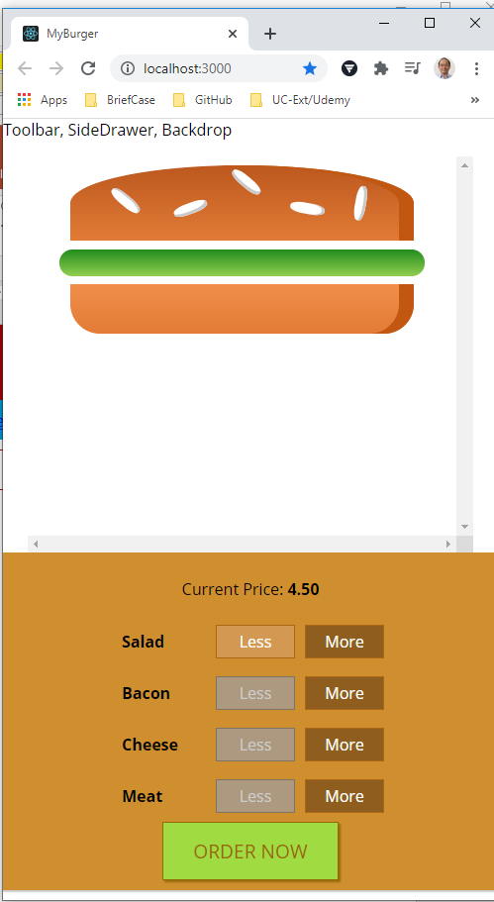
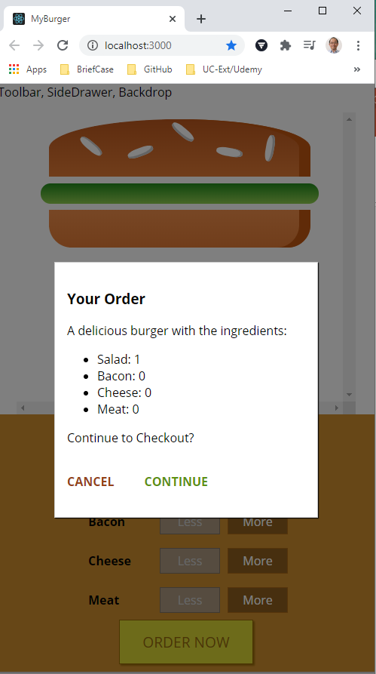
142.2 Verify Button
https://www.udemy.com/course/react-the-complete-guide-incl-redux/learn/lecture/8109056#notes
Verify Button

Slide 9
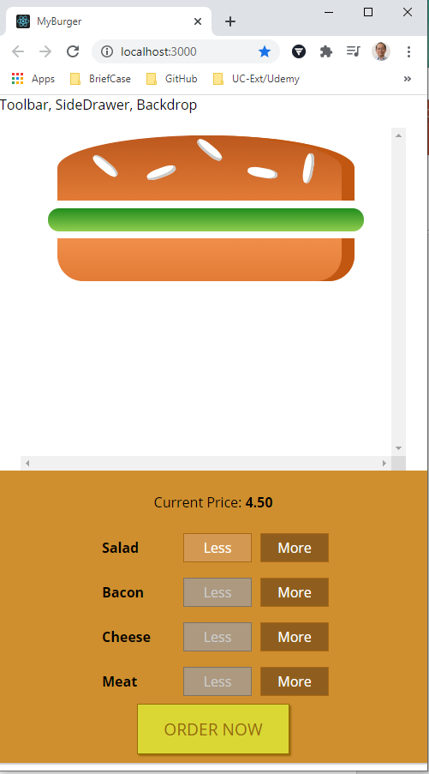
142.2 Verify Button
https://www.udemy.com/course/react-the-complete-guide-incl-redux/learn/lecture/8109056#notes
Verify Button: Click CANCEL button.

Slide 10
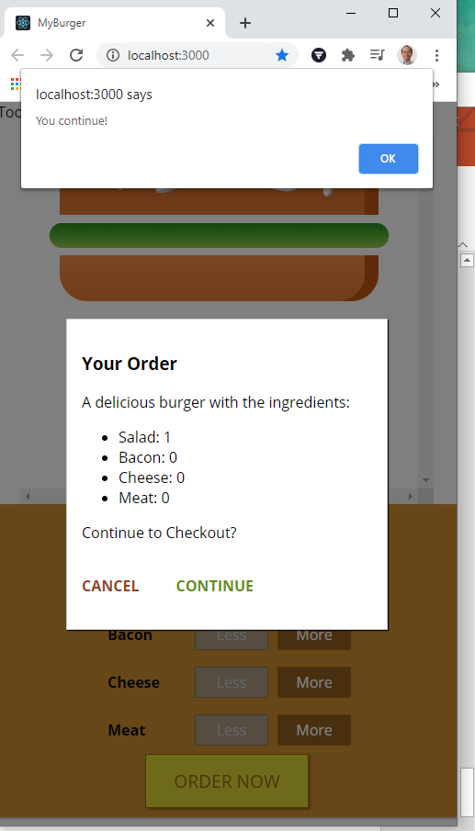
142.2 Verify Button
https://www.udemy.com/course/react-the-complete-guide-incl-redux/learn/lecture/8109056#notes
Verify Button: Click CONTINUE button.

Slide 11
End of Chapter

