Slide 1

143 Total Price
Peter H. Chen

Slide 2
143 Total Price
https://www.udemy.com/course/react-the-complete-guide-incl-redux/learn/lecture/8125726#notes
Total Price
Display Total Price in Order Summary

Slide 3
143.1 Total Price in Order Summary

Slide 4
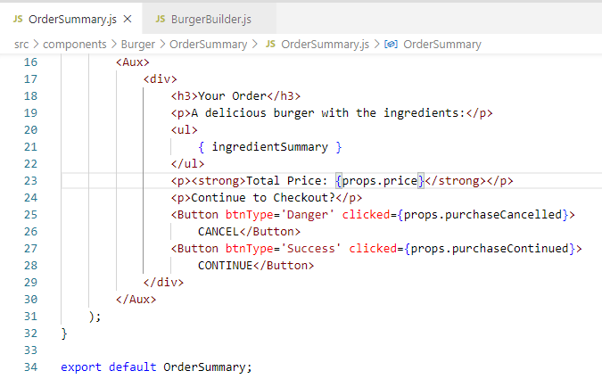
143.1 Total Price in Order Summary
https://www.udemy.com/course/react-the-complete-guide-incl-redux/learn/lecture/8125726#notes
Total Price in Order Summary

Slide 5
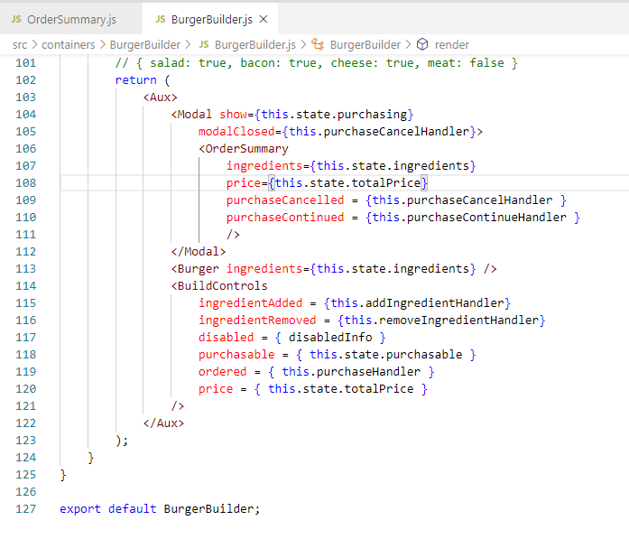
143.1 Total Price in Order Summary
https://www.udemy.com/course/react-the-complete-guide-incl-redux/learn/lecture/8125726#notes
Total Price in Order Summary

Slide 6
143.2 Verify Total Price

Slide 7
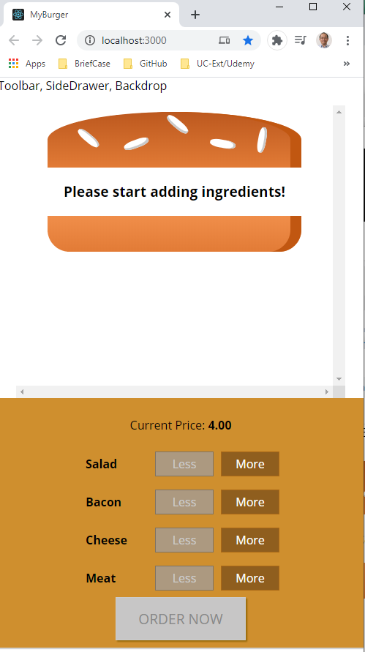
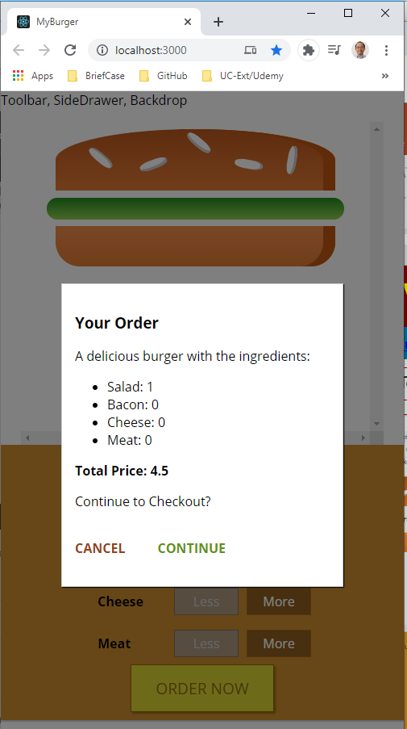
143.2 Verify Total Price
https://www.udemy.com/course/react-the-complete-guide-incl-redux/learn/lecture/8125726#notes
Verify Total Price

Slide 8
End of Chapter

