Slide 1

144 Toolbar
Peter H. Chen

Slide 2
144 Toolbar
https://www.udemy.com/course/react-the-complete-guide-incl-redux/learn/lecture/8125726#notes
Toolbar
We have the core functionality done.
We need to have multiple pages.
Before we do that, we add a bar and a side drawer.
This crucial because later we need add multiple pages and need to have some way of navigation.
Every application needs to have a tool bar.
We add components\Navigation\Toolbar\Toolbar.js

Slide 3
144.1 Add Toolbar Component

Slide 4
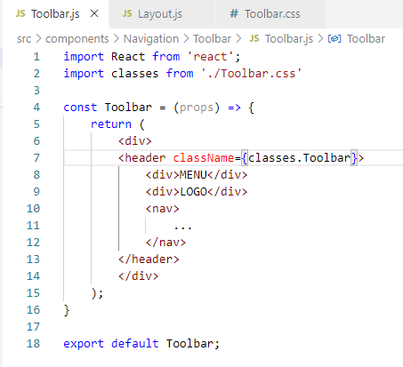
144.1 Add Toolbar Component
https://www.udemy.com/course/react-the-complete-guide-incl-redux/learn/lecture/8125726#notes
Add Toolbar Component

Slide 5
144.1 Add Toolbar

Slide 6
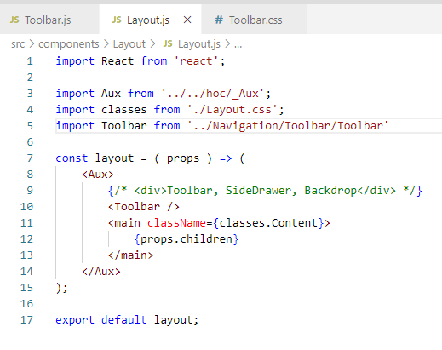
144.1 Add Toolbar
https://www.udemy.com/course/react-the-complete-guide-incl-redux/learn/lecture/8125726#notes
Add Toolbar

Slide 7
144.3 Verify

Slide 8
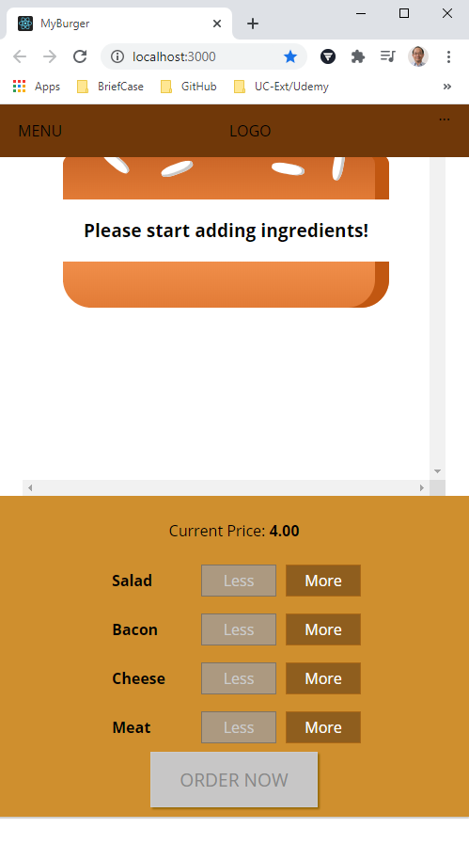
144.3 Verify
https://www.udemy.com/course/react-the-complete-guide-incl-redux/learn/lecture/8125726#notes
Verify Toolbar

Slide 9
144.4 Add Content Space

Slide 10
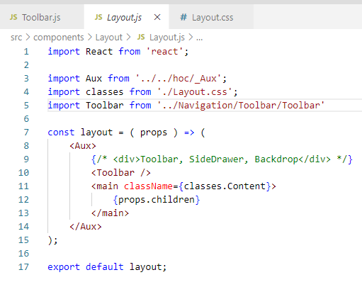
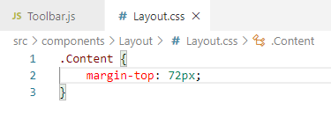
144.4 Add Content Space
https://www.udemy.com/course/react-the-complete-guide-incl-redux/learn/lecture/8125726#notes
Add Content Space

Slide 11
144.5 Verify Layout Content

Slide 12
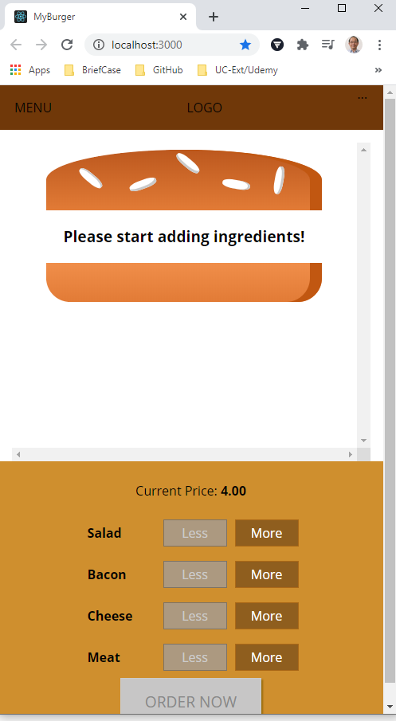
144.5 Verify Layout Content
https://www.udemy.com/course/react-the-complete-guide-incl-redux/learn/lecture/8125726#notes
Verify Layout content

Slide 13
End of Chapter

