Slide 1

145 Logo
Peter H. Chen

Slide 2
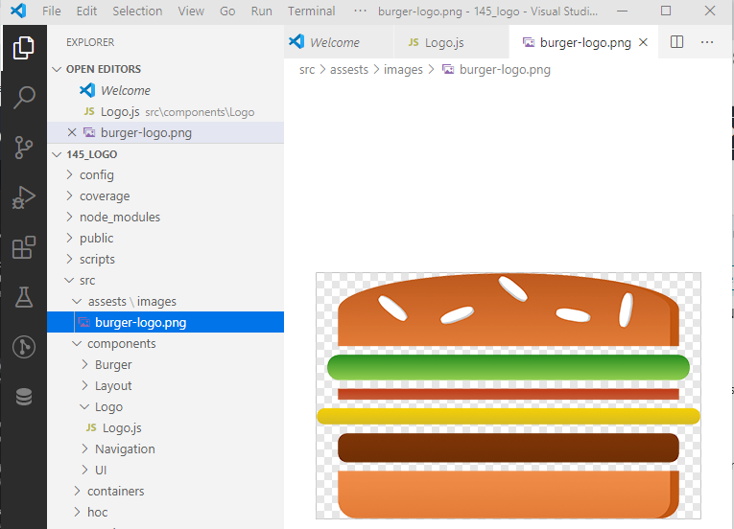
145 Logo
https://www.udemy.com/course/react-the-complete-guide-incl-redux/learn/lecture/8125734#notes
Logo
We added the toolbar.
Now, we add the logo.
Create components\Logo\Logo.js
Create components\assets\images\burger-logo.png

Slide 3
145.1 Add Log Image

Slide 4
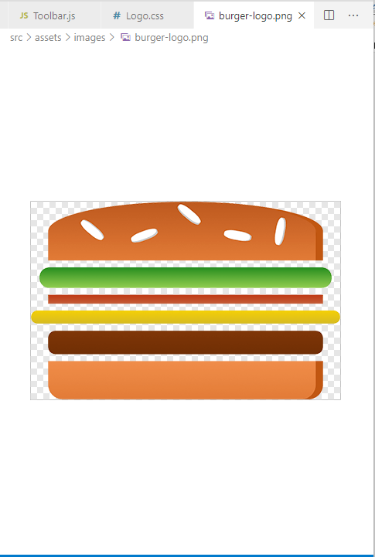
145.1 Add Logo Image
https://www.udemy.com/course/react-the-complete-guide-incl-redux/learn/lecture/8125726#notes
Logo: burger-logo.png

Slide 5
145.2 Add Log Component

Slide 6
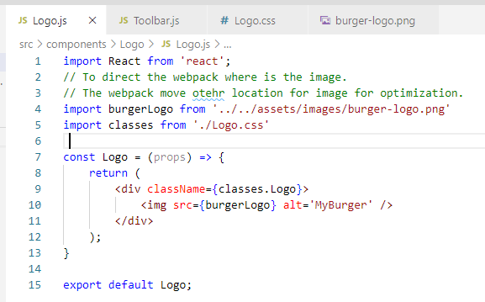
145.2 Add Log Component
https://www.udemy.com/course/react-the-complete-guide-incl-redux/learn/lecture/8125726#notes
Add Logo.js

Slide 7
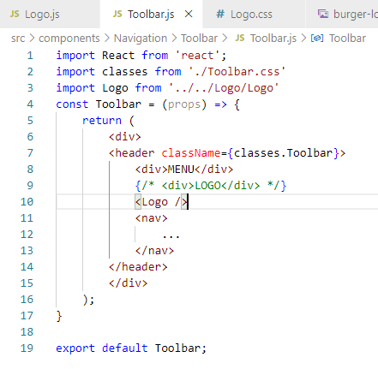
145.2 Add Log Component
https://www.udemy.com/course/react-the-complete-guide-incl-redux/learn/lecture/8125726#notes
Add Logo Component

Slide 8
145.3 Verify Logo

Slide 9
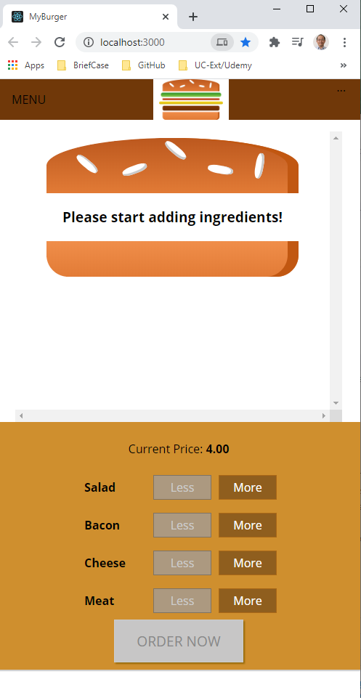
145.3 Verify Logo
https://www.udemy.com/course/react-the-complete-guide-incl-redux/learn/lecture/8125726#notes
Verify Logo

Slide 10
145.4 Add Spaces for Eight for Logo

Slide 11
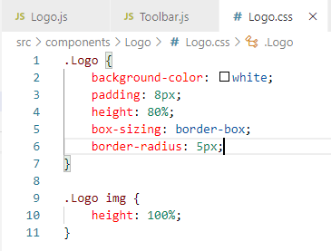
145.4 Add Spaces for Eight for Logo
https://www.udemy.com/course/react-the-complete-guide-incl-redux/learn/lecture/8125726#notes
Add Spaces: Change from 100% to 80%

Slide 12
145.5 Verify Logo Sizing

Slide 13
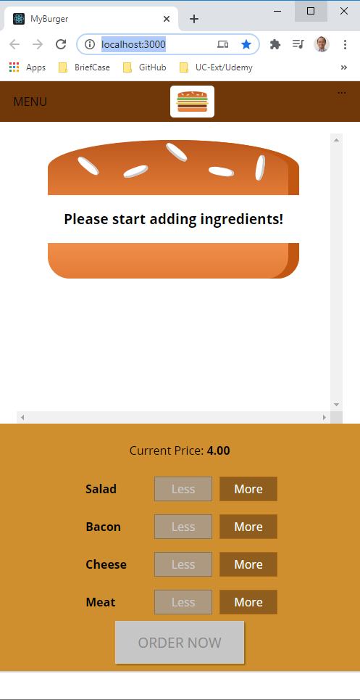
145.5 Verify Logo Sizing
https://www.udemy.com/course/react-the-complete-guide-incl-redux/learn/lecture/8125726#notes
Verify Logo Sizing

Slide 14
End of Chapter

