Slide 1

146 Navigation
Peter H. Chen

Slide 2
146 Navigation
https://www.udemy.com/course/react-the-complete-guide-incl-redux/learn/lecture/8125738#notes
Logo
We added the Logo.
Now, we add the navigation items.
We will use the navigation items in the side drawer.
We create the:
components\Navigation\NavigationItems\NagivationItems.js and
components\Navigation\NavigationItems\NavigationItem\NagivationItem.js.

Slide 3
146.1 Add Navigation Items

Slide 4
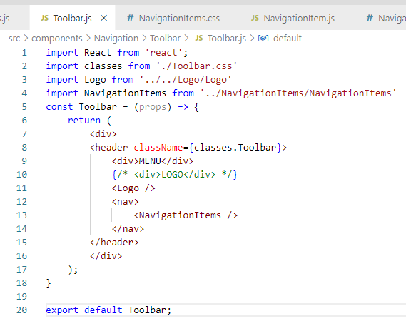
146.1 Add Navigation Items
https://www.udemy.com/course/react-the-complete-guide-incl-redux/learn/lecture/8125738#notes
Add Navigation Items component

Slide 5
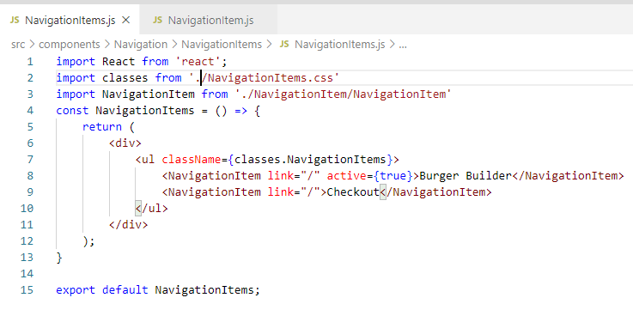
146.1 Add Navigation Items
https://www.udemy.com/course/react-the-complete-guide-incl-redux/learn/lecture/8125738#notes
Add Navigation Items

Slide 6
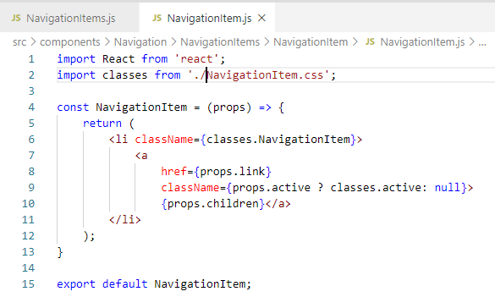
146.1 Add Navigation Items
https://www.udemy.com/course/react-the-complete-guide-incl-redux/learn/lecture/8125738#notes
Add Navigation Item

Slide 7
146.2 Verify Navigations

Slide 8
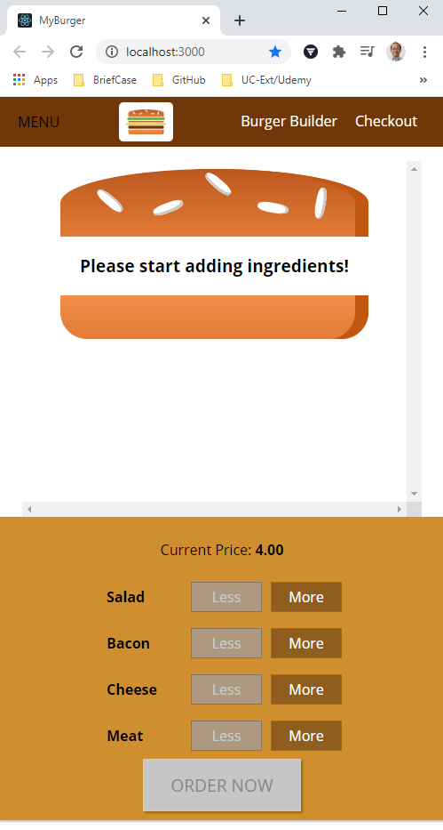
146.3 Verify Navigations
https://www.udemy.com/course/react-the-complete-guide-incl-redux/learn/lecture/8125738#notes
Verify Navigations

Slide 9
End of Chapter

