Slide 1

147 Side Drawer
Peter H. Chen

Slide 2
147 Side Drawer
https://www.udemy.com/course/react-the-complete-guide-incl-redux/learn/lecture/8125740#notes
Side Drawer
We added navigation items.
We will add Side Drawer.

Slide 3
147.1 Add Side Drawer

Slide 4
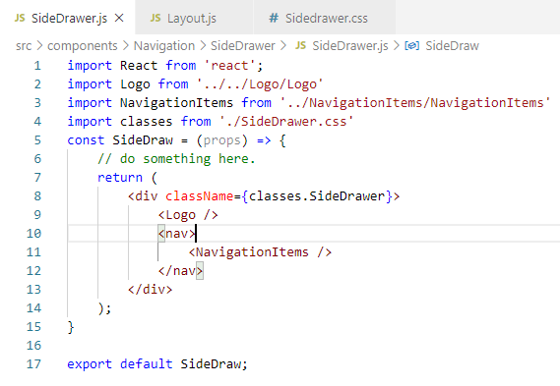
147.1 Add Side Drawer
https://www.udemy.com/course/react-the-complete-guide-incl-redux/learn/lecture/8125740#notes
Add Side Drawer

Slide 5
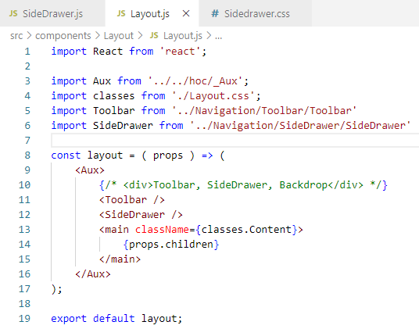
147.1 Add Side Drawer
https://www.udemy.com/course/react-the-complete-guide-incl-redux/learn/lecture/8125740#notes
Add Side Drawer

Slide 6
147.2 Verify Side Drawer

Slide 7
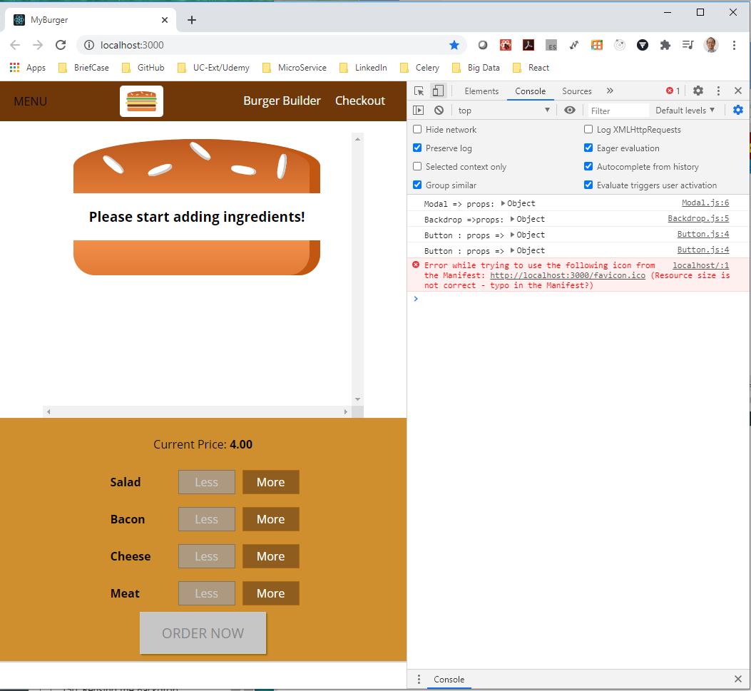
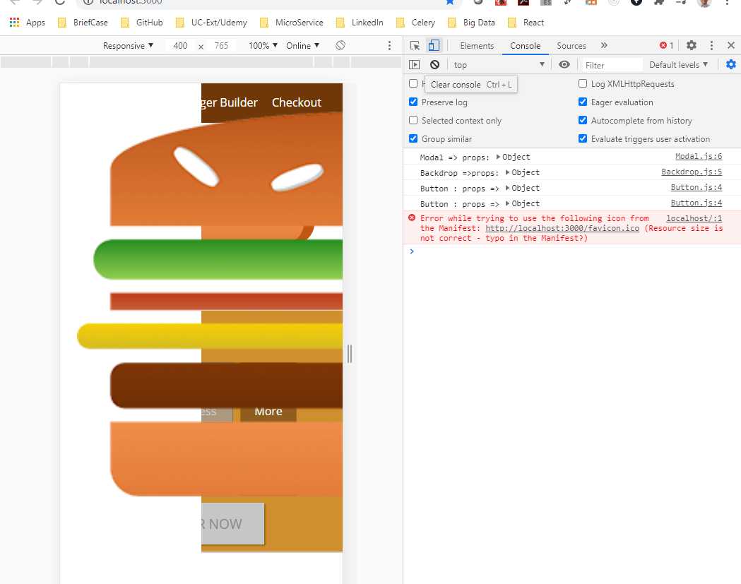
147.2 Verify Side Drawer
https://www.udemy.com/course/react-the-complete-guide-incl-redux/learn/lecture/8125740#notes
Click the Mobile and regular device to check the Display. It display terrible in mobile device. We fix in next discussion.

Slide 8
End of Chapter

