Slide 1

148 Responsive
Peter H. Chen

Slide 2
148 Responsive
https://www.udemy.com/course/react-the-complete-guide-incl-redux/learn/lecture/8125740#notes
Responsive
We added navigation items.
We will add Side Drawer.

Slide 3
148.1 Add Responsive

Slide 4
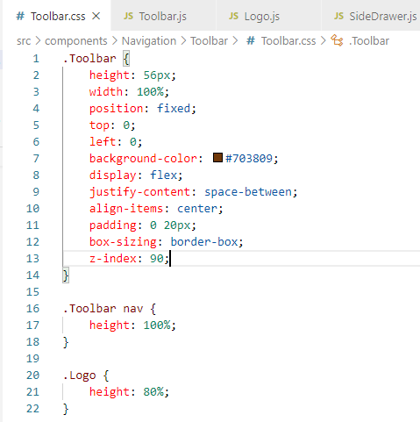
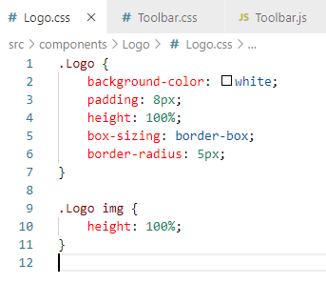
148.1 Add Responsive
https://www.udemy.com/course/react-the-complete-guide-incl-redux/learn/lecture/8125740#notes
Add Responsive

Slide 5
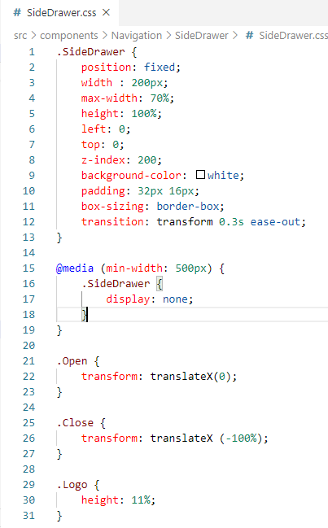
148.1 Add Responsive
https://www.udemy.com/course/react-the-complete-guide-incl-redux/learn/lecture/8125740#notes
Add Responsive

Slide 6
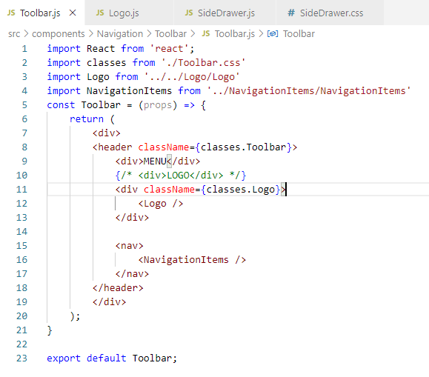
148.1 Add Responsive
https://www.udemy.com/course/react-the-complete-guide-incl-redux/learn/lecture/8125740#notes
Add Responsive

Slide 7
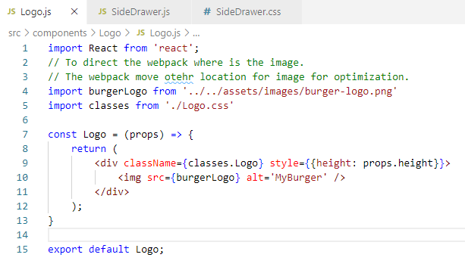
148.1 Add Responsive
https://www.udemy.com/course/react-the-complete-guide-incl-redux/learn/lecture/8125740#notes
Add Responsive

Slide 8
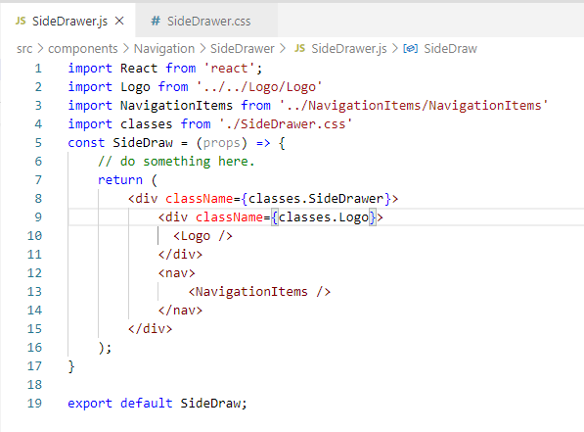
148.1 Add Responsive
https://www.udemy.com/course/react-the-complete-guide-incl-redux/learn/lecture/8125740#notes
Add Responsive

Slide 9
148.2 Verify Navigations

Slide 10
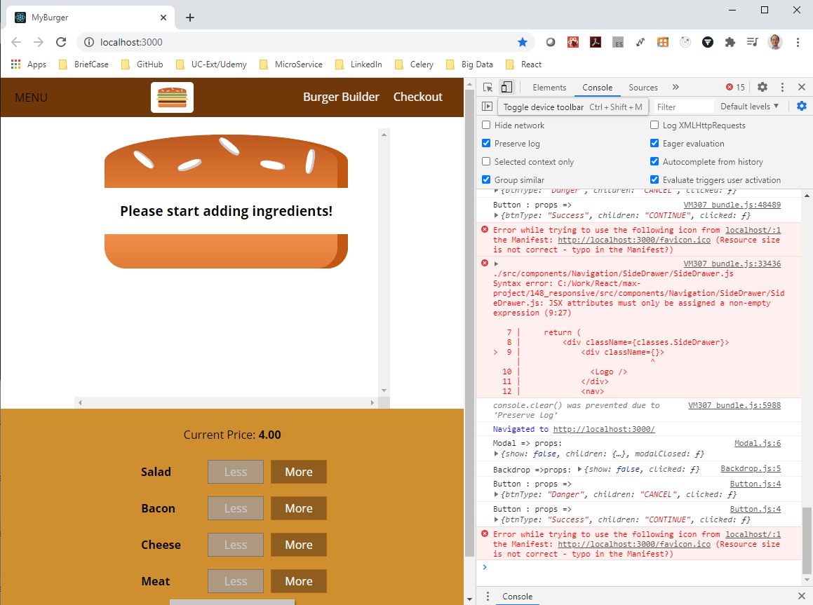
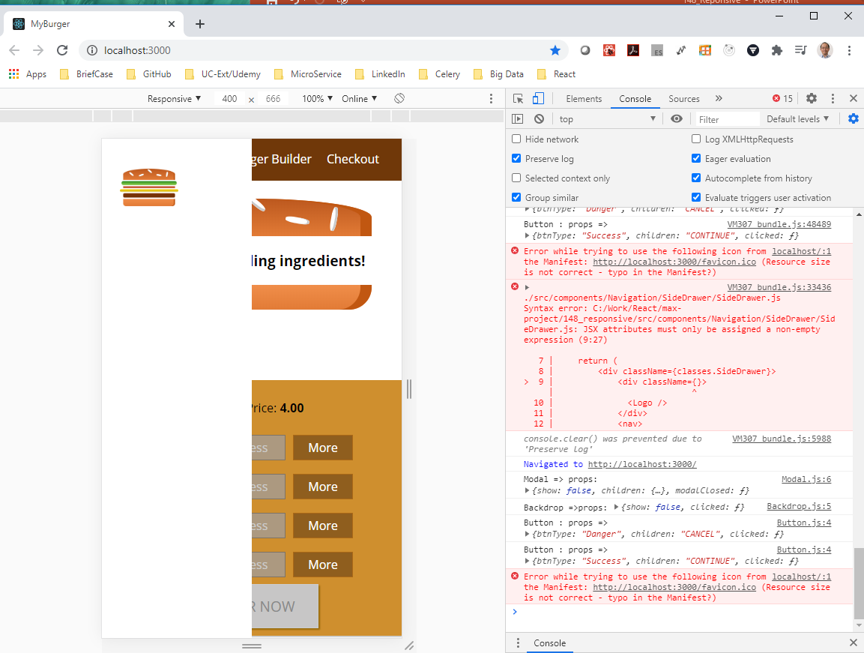
148.2 Verify Responsive
https://www.udemy.com/course/react-the-complete-guide-incl-redux/learn/lecture/8125740#notes
Click the Mobile and regular device to check the Display. It display terrible in mobile device. We will discuss more Responsive.

Slide 11
End of Chapter

