Slide 1

149 More Responsive
Peter H. Chen

Slide 2
149 More Responsive
https://www.udemy.com/course/react-the-complete-guide-incl-redux/learn/lecture/8125746#notes
More Responsive
We adjusted logo to look good in both toolbar and side drawer.
Now we adjusted the navigation.

Slide 3
149.1 Add More Responsive

Slide 4
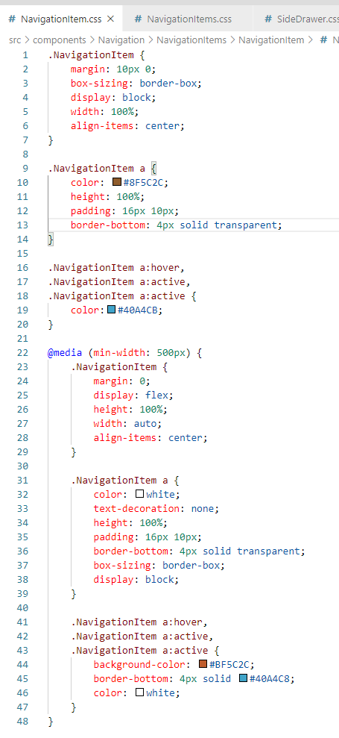
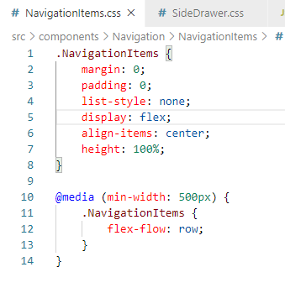
149.1 Add More Responsive
https://www.udemy.com/course/react-the-complete-guide-incl-redux/learn/lecture/8125746#notes
More Responsive

Slide 5
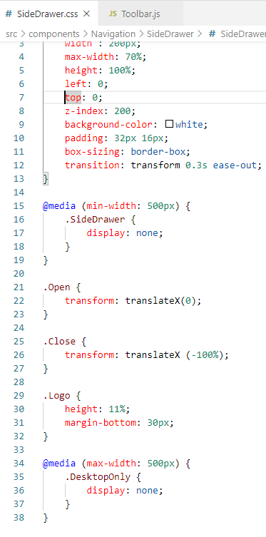
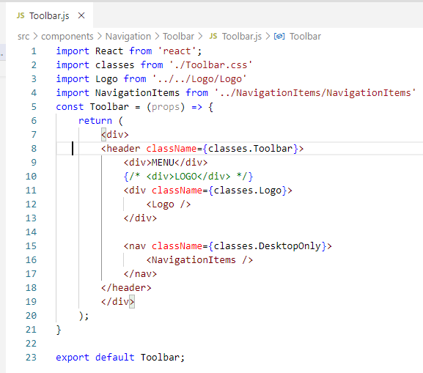
149.1 Add More Responsive
https://www.udemy.com/course/react-the-complete-guide-incl-redux/learn/lecture/8125746#notes
More Responsive

Slide 6
149.2 Verify Navigations

Slide 7
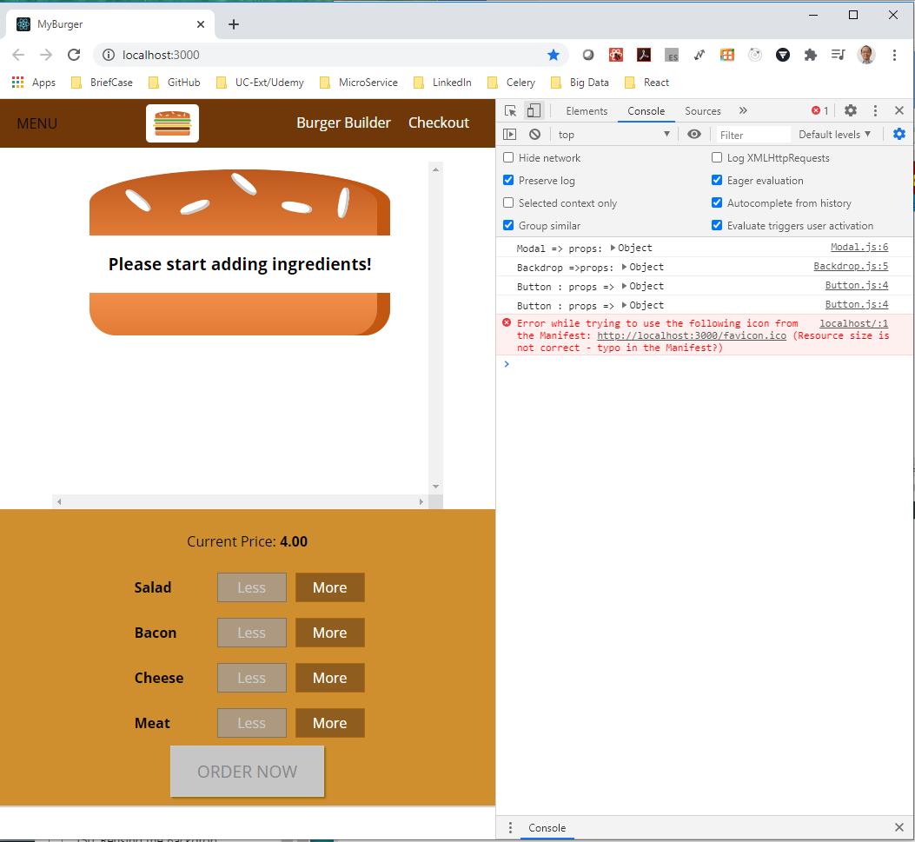
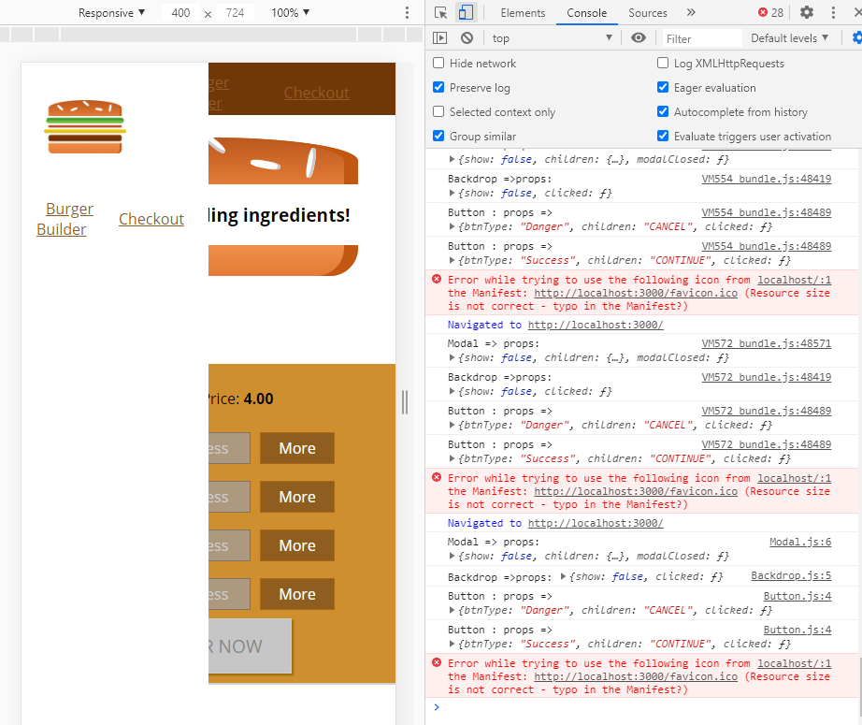
149.3 Verify Navigations
https://www.udemy.com/course/react-the-complete-guide-incl-redux/learn/lecture/8125746#notes
Click the Mobile and regular device to check the Display. It display terrible in mobile device. We fix in next discussion.

Slide 8
End of Chapter

