Slide 1

159 Wrap up
Peter H. Chen

Slide 2
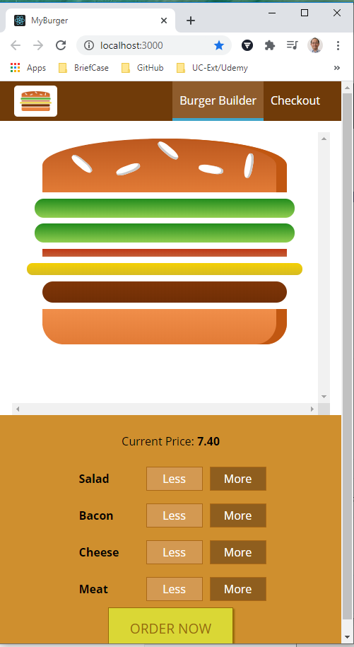
159 Wrap up
https://www.udemy.com/course/react-the-complete-guide-incl-redux/learn/lecture/8125762#notes
Wrap up
We have done the basic implement of the Burger Builder.
How to plan the application
How to split components
How to communicate component each other
Vias props, how to pass method references to components so that a click on the backdrop triggers a method in another component like the layout component.
These are all core concepts of modern React applications.
Be aware of how to communicate, how to structure, how to build the components, and pitfalls of React offers.
Be aware of like auxiliary high order components.
We will discuss more in React next.

Slide 3
End of Chapter

