Slide 1

01 Get Started
Peter H. Chen

Slide 2
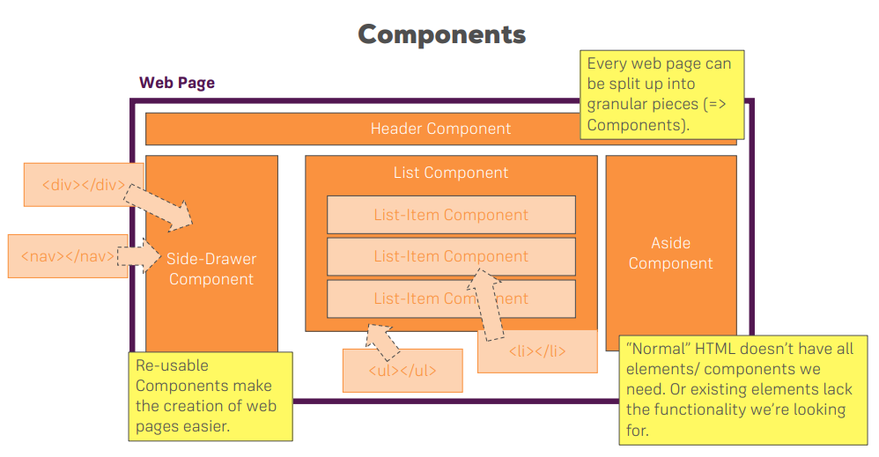
01 Get Started
https://www.udemy.com/course/react-the-complete-guide-incl-redux/learn/lecture/8268490#overview
Get Started
Every Web Page can be split into component pieces.
Components can be re-used.

Slide 3
End of Chapter

