Slide 1

2 ES7
Peter H. Chen

Slide 2
2 ES7
https://www.udemy.com/course/react-the-complete-guide-incl-redux/learn/lecture/8211788#overview
ES 6 and 7
Web site: jsbin.com provides the command and run for JavaScript and ES7.

Slide 3
2.1 let and const

Slide 4
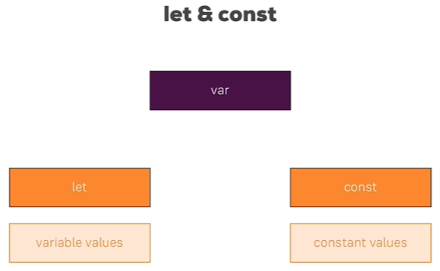
2.1 let and const
https://www.udemy.com/course/react-the-complete-guide-incl-redux/learn/lecture/8211788#overview
Let and const
JavaScript var. ES 6, 7 Uses let and const.

Slide 5
2.2 Arrow Function

Slide 6
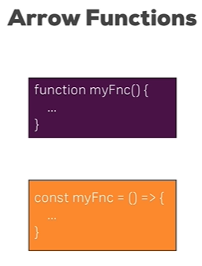


2.2 Arrow Function
https://www.udemy.com/course/react-the-complete-guide-incl-redux/learn/lecture/8211788#overview
Arrow Function:
Use jsbin.com to run ES7.

Slide 7
2.3 Import and Export

Slide 8
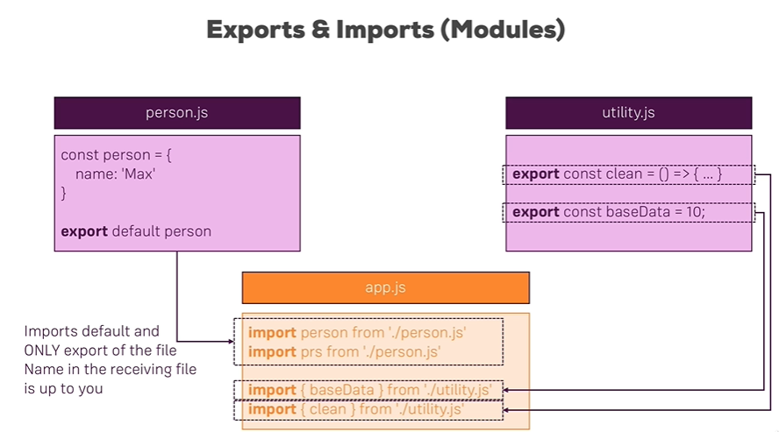
2.3 Import and Export
https://www.udemy.com/course/react-the-complete-guide-incl-redux/learn/lecture/8211788#overview
Import and Export

Slide 9
2.4 Class

Slide 10
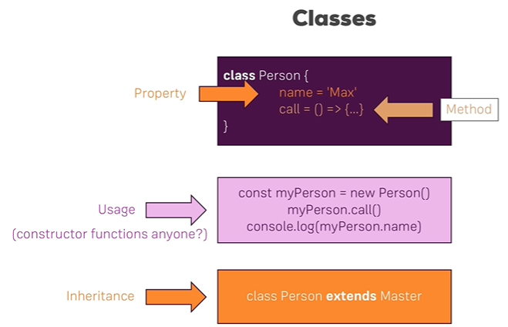
2.4 Class
https://www.udemy.com/course/react-the-complete-guide-incl-redux/learn/lecture/8211788#overview
class

Slide 11
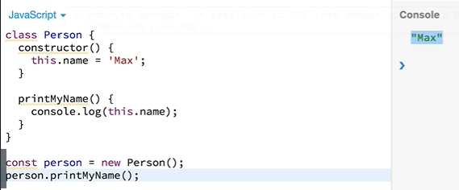
2.4 Class
https://www.udemy.com/course/react-the-complete-guide-incl-redux/learn/lecture/8211788#overview
class

Slide 12
2.5 Attribute, Method, and Inheritance

Slide 13
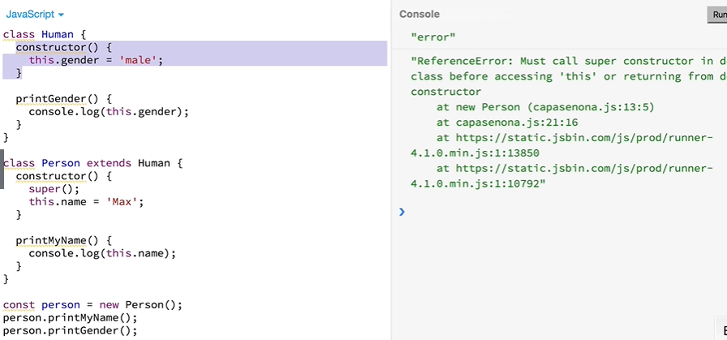
2.5 Attribute, Method, and Inheritance
https://www.udemy.com/course/react-the-complete-guide-incl-redux/learn/lecture/8211788#overview
Class: Inheritance with extends and must have super() to execute the parent’s constructor.

Slide 14
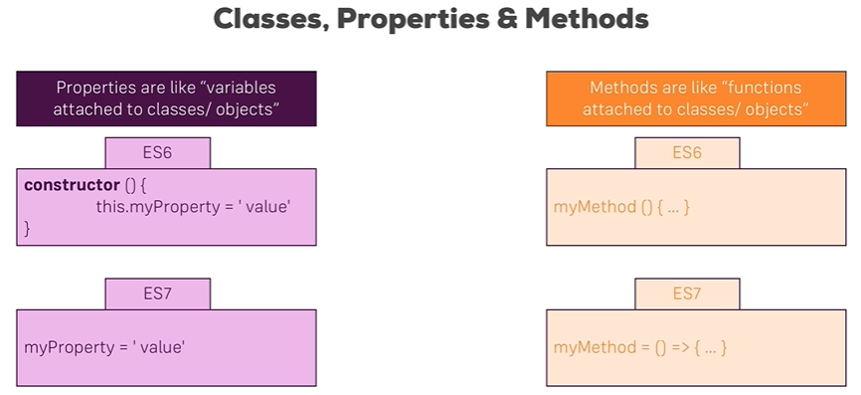
2.5 Attribute, Method, and Inheritance
https://www.udemy.com/course/react-the-complete-guide-incl-redux/learn/lecture/8211788#overview
Class properties and method

Slide 15
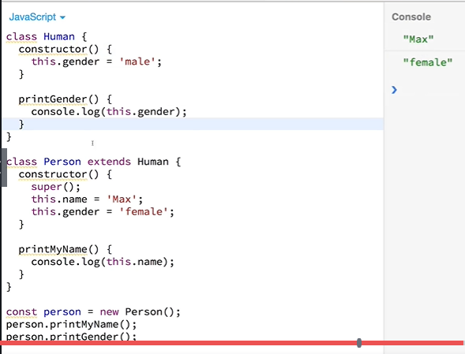
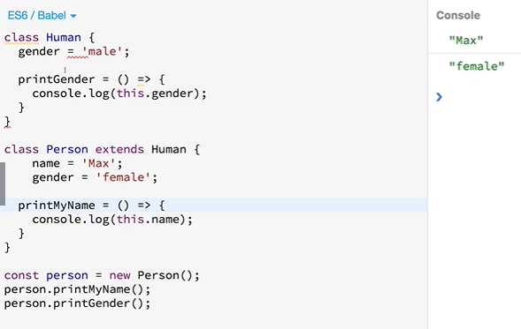
2.5 Attribute, Method, and Inheritance
https://www.udemy.com/course/react-the-complete-guide-incl-redux/learn/lecture/8211788#overview
Class properties and method: JavaScript uses ‘this’ keyword.
ES 7 does not use constructor and ‘this’ keyword.
JavaScript
ES6

Slide 16
2.6 Spread and Rest Operator

Slide 17
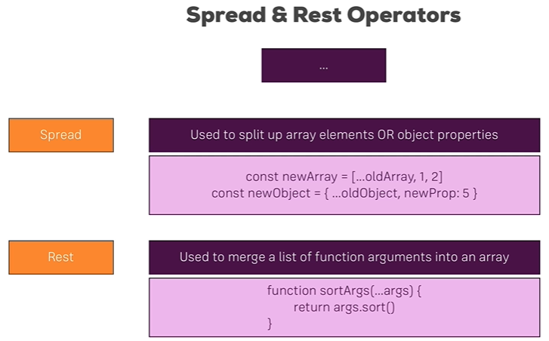
2.6 Spread and Rest Operator
https://www.udemy.com/course/react-the-complete-guide-incl-redux/learn/lecture/8211788#overview
Spread and Rest Operator: …

Slide 18

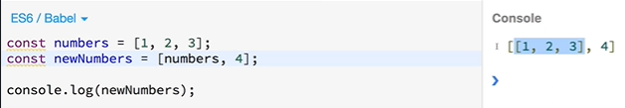
2.6 Spread and Rest Operator
https://www.udemy.com/course/react-the-complete-guide-incl-redux/learn/lecture/8211788#overview
Spread Operator: Separate array

Slide 19
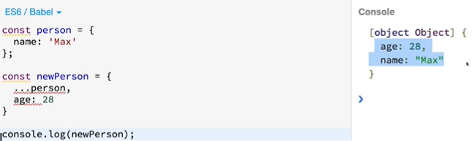
2.6 Spread and Rest Operator
https://www.udemy.com/course/react-the-complete-guide-incl-redux/learn/lecture/8211788#overview
Spread Operator: Separate Object

Slide 20
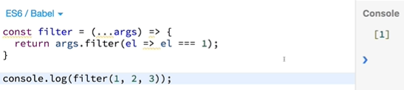
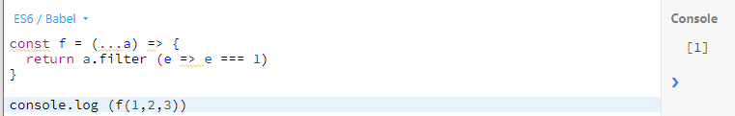
2.6 Spread and Rest Operator
https://www.udemy.com/course/react-the-complete-guide-incl-redux/learn/lecture/8211788#overview
Rest Operator: Separate argument array

Slide 21
2.7 Destructuring

Slide 22
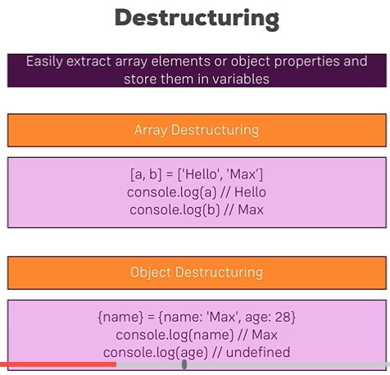
2.7 Destructuring
https://www.udemy.com/course/react-the-complete-guide-incl-redux/learn/lecture/8211788#overview
Destructure an array or object into variables.
Object only pull the first element only. Second element is undefined.

Slide 23
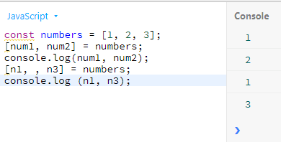
2.7 Destructuring
https://www.udemy.com/course/react-the-complete-guide-incl-redux/learn/lecture/8211788#overview
Destructure array:

Slide 24
2.8 Reference and Primitive Type

Slide 25
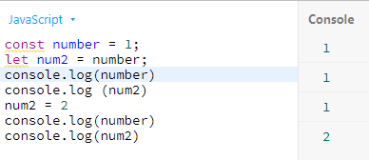
2.8 Reference and Primitive Type
https://www.udemy.com/course/react-the-complete-guide-incl-redux/learn/lecture/8211788#overview
Primitive Type:
Copy primitive copies into separated memory space and value.

Slide 26
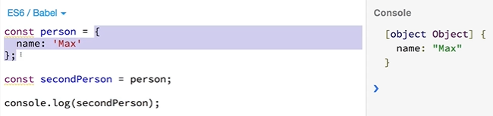
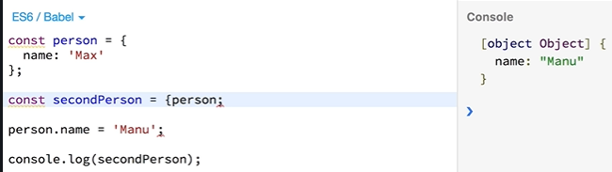
2.8 Reference and Primitive Type
https://www.udemy.com/course/react-the-complete-guide-incl-redux/learn/lecture/8211788#overview
Array or object:
Copy the reference (pointer). The value is associate with pointer.

Slide 27
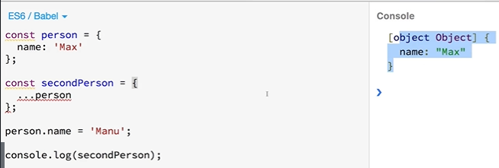
2.8 Reference and Primitive Type
https://www.udemy.com/course/react-the-complete-guide-incl-redux/learn/lecture/8211788#overview
Array or object:
How to change the content of array or object of the person only? The second person keep the same content without affect by the assignment.
Use spread operator. This is the separate real copy with separate memory address.

Slide 28
2.9 Array Function

Slide 29
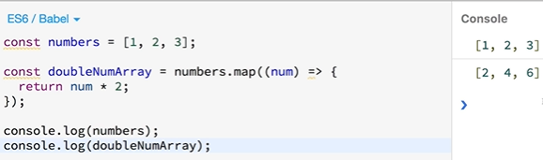
2.9 Array Function
https://www.udemy.com/course/react-the-complete-guide-incl-redux/learn/lecture/8211788#overview
Array Function map, filter, reduce: take each individual element out of the array.

Slide 30
2.1 Quiz

Slide 31
2.1 Quiz
https://www.udemy.com/course/react-the-complete-guide-incl-redux/learn/lecture/8211788#overview
1. What web site give the JavaScript, ES6 compilation and run.
Ans: jsbin.com
2. What is the equivalent of JavaScript var in ES 7?
Ans: let and const
3. What is simplified arrow function of function multiply(num) { return num * 2 }?
Ans: multiple = (num) => num * 2;
4. What is import synatx?
Ans: import module from file or import { function } from file.
5. What is syntax for object and Class?
Ans: const obj = new class-name();
6. Does ES7 uses constructor and ‘this’ keyword in constructor?
Ans: ES 7 does not use constructor and ‘this’ keyword inside.
7. What is spread and rest operator?
Ans: … can be spread or rest operator. Separate array (object) into separate elements.
8. What is Destruction?
Ans: Extract out single element out of array or object into variables.

Slide 32
2.1 Quiz
https://www.udemy.com/course/react-the-complete-guide-incl-redux/learn/lecture/8211788#overview
9. What is difference copy primitive values and copy array/object?
Ans:
1) primitive copy in separate memory address.
2) array/object copy the reference (same address). Use spread operator if you want to make the real copy (separate address and value).
10. What is array functions do?
Ans: take each element out of array and do the operation, such a, map, filter, reduce, and etc.

Slide 33
End of Chapter

