Slide 1

188 SPA
Peter H. Chen

Slide 2
188 SPA
https://www.udemy.com/course/react-the-complete-guide-incl-redux/learn/lecture/8138534#notes
Routing: Build Single-Page-Application
Most applications have more than one pages.
They have a users page, a post page, an account page, and etc.
Why multiple pages in a Single Page application?
How does that work together?
In a single Page application, or a single HTML file. We still want to provide the user with a normal web using experience.
We want to show the user different pages for different URLs.

Slide 3
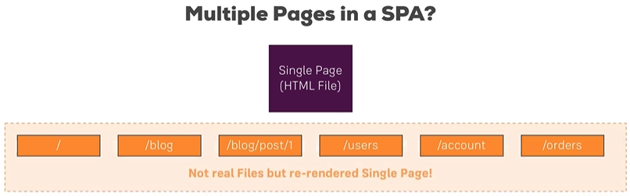
188 SPA
https://www.udemy.com/course/react-the-complete-guide-incl-redux/learn/lecture/8138534#notes
The trick is tat we do not have actually have multiple HTML files, but we instead, we use JavaScript to render different pages for different paths.
We do not have different files but simply re-render parts of that single page or entire single page depending on which path the user navigated to in our application.
That is what routing is about, parsing this path, so the path after our domain and showing the appropriate JSX or component code in our app.

Slide 4
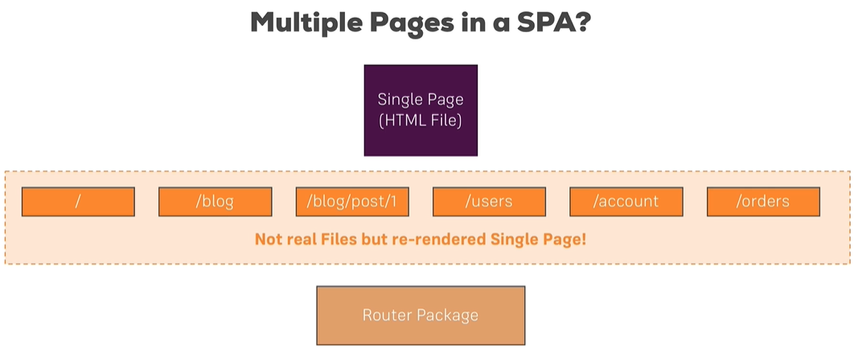
188 SPA
https://www.udemy.com/course/react-the-complete-guide-incl-redux/learn/lecture/8138534#notes
We are going to use a routing package so that we do not have to parse that path on our own which is a big task.
The router package has a couple of tasks.

Slide 5
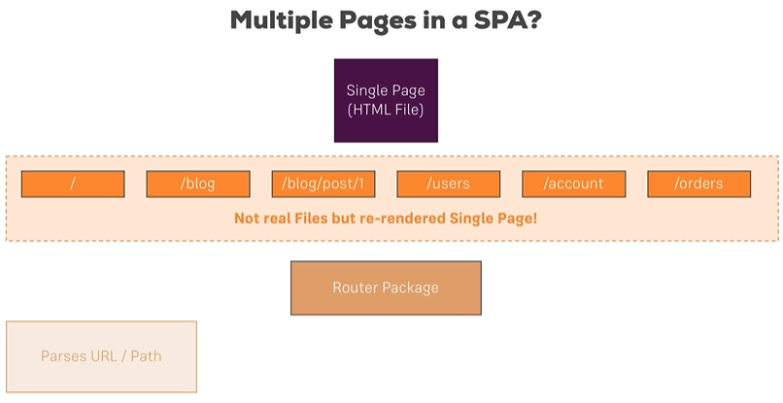
188 SPA
https://www.udemy.com/course/react-the-complete-guide-incl-redux/learn/lecture/8138534#notes
First of all, it has to parse the URL path. We are have to configure different paths in our application which we support.

Slide 6
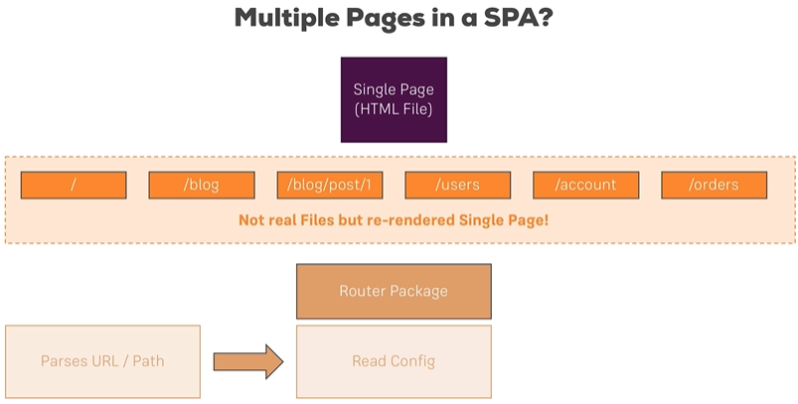
188 SPA
https://www.udemy.com/course/react-the-complete-guide-incl-redux/learn/lecture/8138534#notes
Second, the router package can then read our configuration so that it knows which paths are supported and what should happen when the user visits one of these paths.

Slide 7
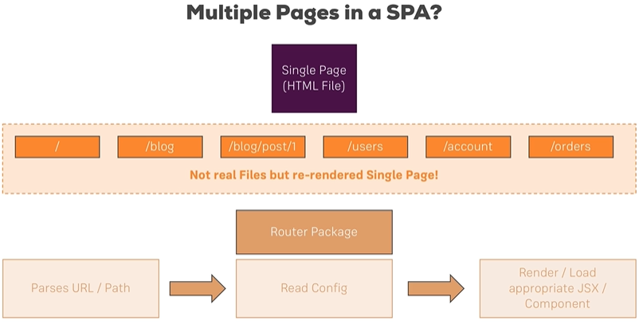
188 SPA
https://www.udemy.com/course/react-the-complete-guide-incl-redux/learn/lecture/8138534#notes
Third step, it will then render or load the appropriate JSX or component code depending on which path the user visited.

Slide 8
188 SPA
https://www.udemy.com/course/react-the-complete-guide-incl-redux/learn/lecture/8138534#notes
This is the idea behind outing, load different code, conditional JSX, or component code for different paths.
We use a routing package so that we do not have to determine which path the user is on our own.
We will discuss the router package the feature and supports to implement multiple pages in our Single Page Application.

Slide 9
End of Chapter

