Slide 1

189 Setup Link
Peter H. Chen

Slide 2
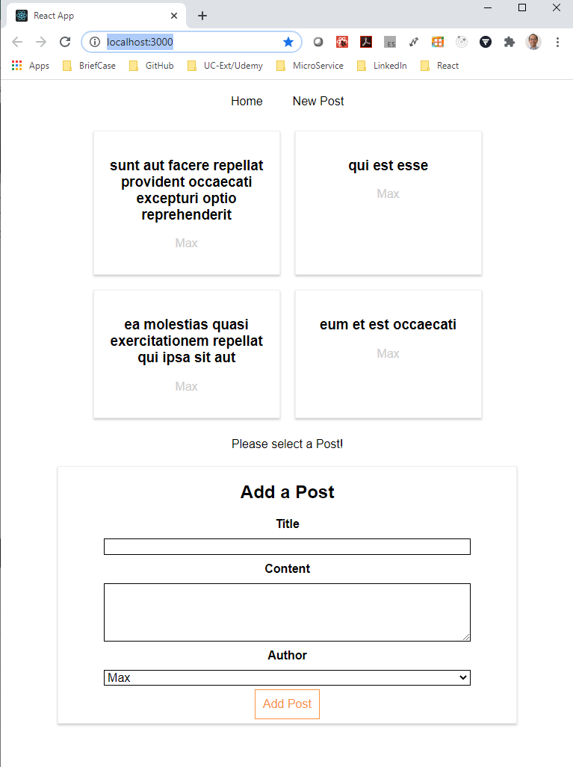
189 Setup Link
https://www.udemy.com/course/react-the-complete-guide-incl-redux/learn/lecture/8138538#notes
Setup Link
We use the blog application for routing application.
We can select the post and we cane create a new post.
We will add the link on the top and load different pages with route.

Slide 3
189.1 Add Link
Peter H. Chen

Slide 4
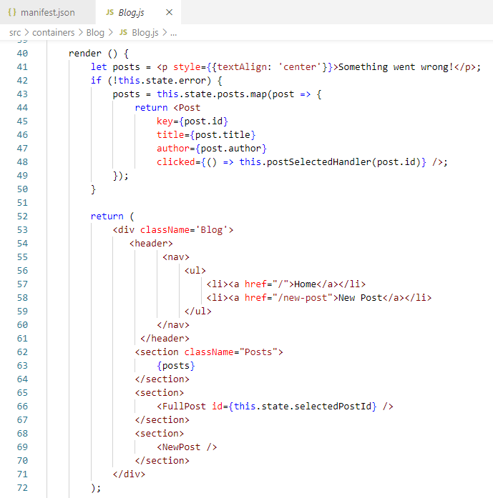
189.1 Add Link
https://www.udemy.com/course/react-the-complete-guide-incl-redux/learn/lecture/8138538#notes
Add Link
In the Blog.js, we add the link.

Slide 5
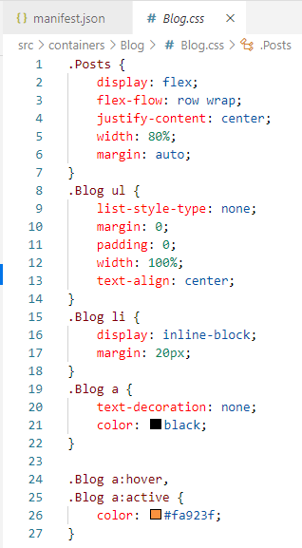
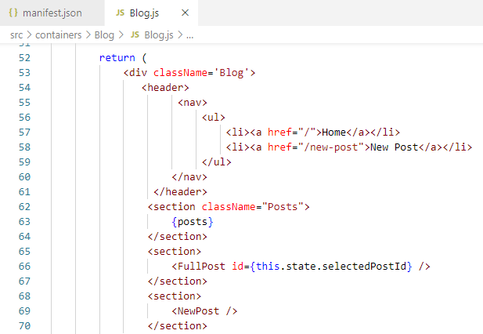
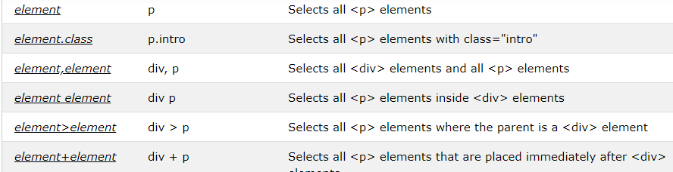
189.1 Add Link
https://www.udemy.com/course/react-the-complete-guide-incl-redux/learn/lecture/8138538#notes
Add Link
In Blog.css, add the Blog class.

Slide 6
189.2 Verify

Slide 7
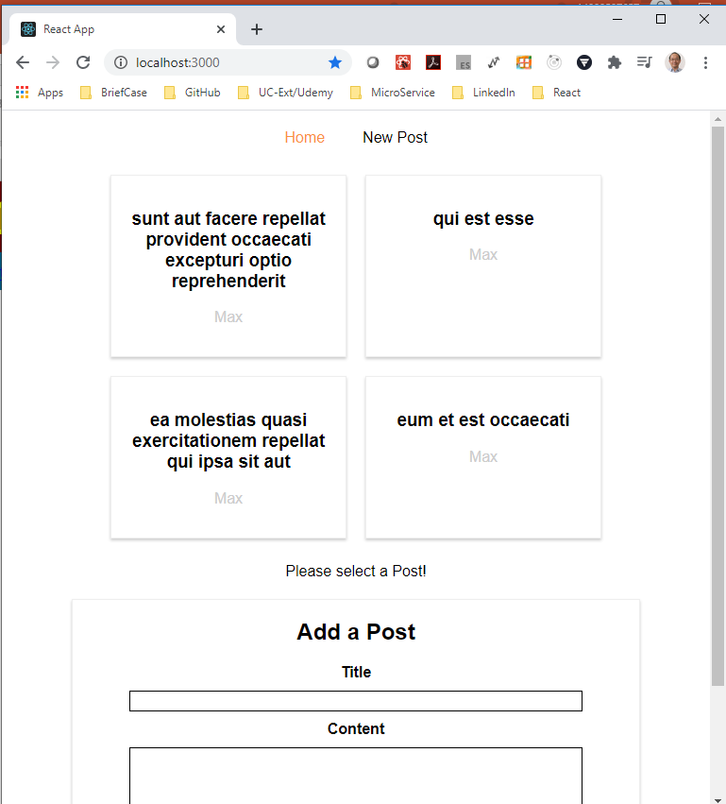
189.2 Verify
https://www.udemy.com/course/react-the-complete-guide-incl-redux/learn/lecture/8138538#notes
Verify Link

Slide 8
End of Chapter

