Slide 1

190 Setup Router Package
Peter H. Chen

Slide 2
190 Setup Router Package
https://www.udemy.com/course/react-the-complete-guide-incl-redux/learn/lecture/8138540#notes
Setup Router Package
> npm install react-router react-router-dom
The the packages react-router and react-router-dom are not created by Facebook.

Slide 3
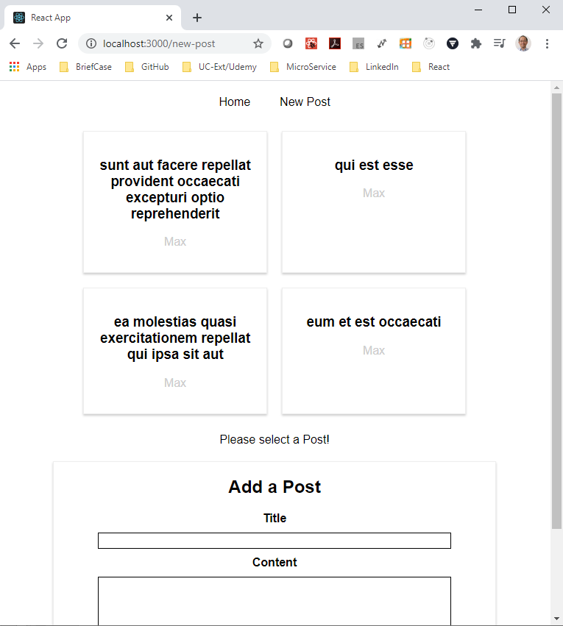
190 Setup Router Package
https://www.udemy.com/course/react-the-complete-guide-incl-redux/learn/lecture/8138540#notes
Setup Router Package
> npm start
Verify the packages are fine for our application.
Now, we want to start using the router package.

Slide 4
190.1 Add Route

Slide 5
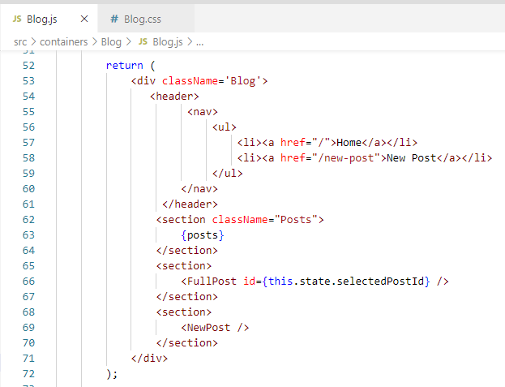
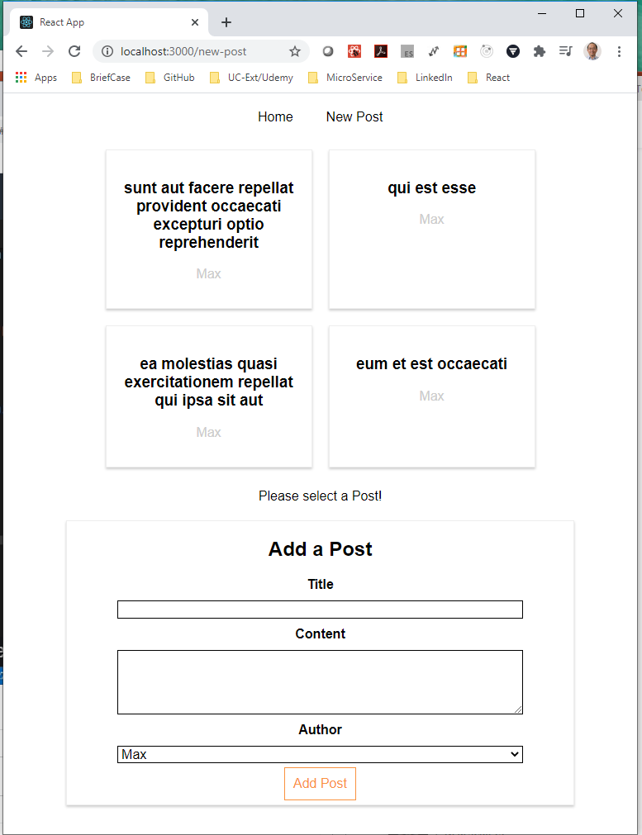
190.1 Add Route
https://www.udemy.com/course/react-the-complete-guide-incl-redux/learn/lecture/8138540#notes
Add Route
In the Blog container, we have link, posts, FullPost, and NewPost.

Slide 6
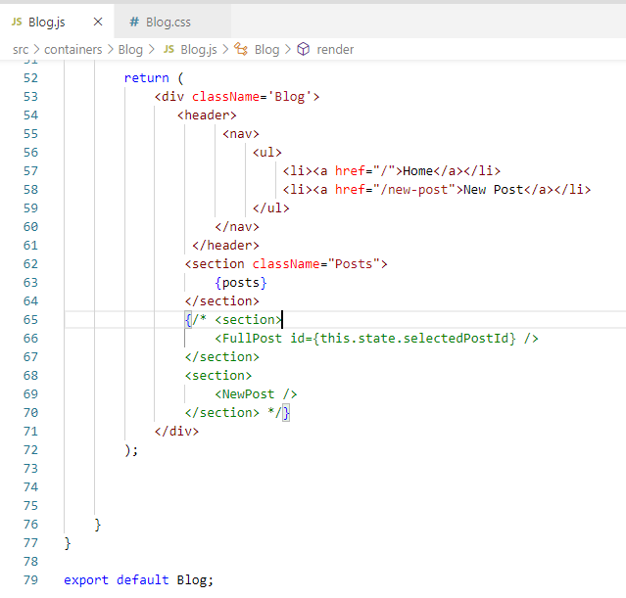
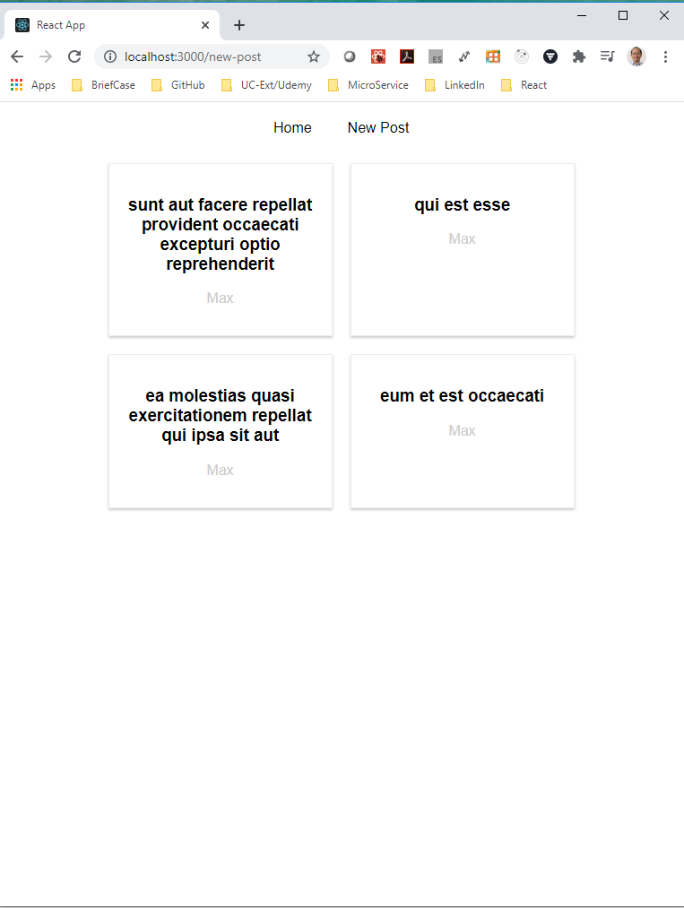
190.1 Add Route
https://www.udemy.com/course/react-the-complete-guide-incl-redux/learn/lecture/8138540#notes
Add Route
In the Blog container, we remove FullPost and NewPost.

Slide 7
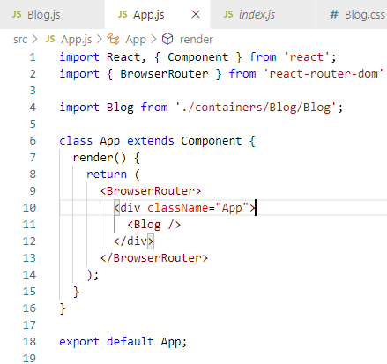
190.1 Add Route
https://www.udemy.com/course/react-the-complete-guide-incl-redux/learn/lecture/8138540#notes
Add Route
We do the route in index.js or App.js. In the App.js.
> import { BrowserRouter } from ‘react-router-dom’
<BrowserRouter>
<div className=“App”>
<Blog />
</div>
</BrowserRouter>

Slide 8
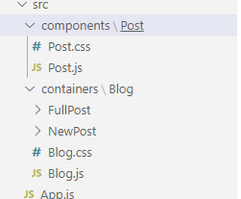
190.1 Add Route
https://www.udemy.com/course/react-the-complete-guide-incl-redux/learn/lecture/8138540#notes
Add Route
Now, we can use the routing features in our application.
We wrap the Blog component.
Any subcomponents are embedded in Blog components.
Now in the Blog component, we want to have the routing feature in the {posts} section.
Move the FullPost and NewPost folder from the component\Post into the Blog folder.

Slide 9
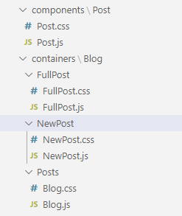
190.1 Add Route
https://www.udemy.com/course/react-the-complete-guide-incl-redux/learn/lecture/8138540#notes
Add Route
Now, we can use the routing features in our application.
We wrap the Blog component.
Any subcomponents are embedded in Blog components.
Now in the Blog component, we want to have the routing feature in the {posts} section.
Move the FullPost and NewPost folder from the component\Post into the Blog folder.

Slide 10
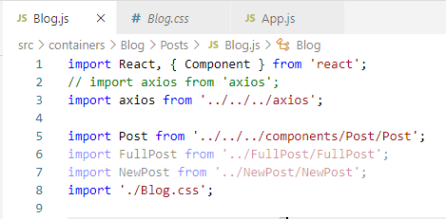
190.1 Add Route
https://www.udemy.com/course/react-the-complete-guide-incl-redux/learn/lecture/8138540#notes
Add Route
In Blog.js, change the import paths.

Slide 11
End of Chapter

