Slide 1

192 Prepare Routing
Peter H. Chen

Slide 2
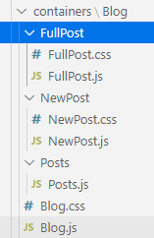
192 Prepare Routing
https://www.udemy.com/course/react-the-complete-guide-incl-redux/learn/lecture/8138542#notes
Prepare Routing
In the previous discussion, we setup FullPost, NewPost, and Posts under the Blog folder.

Slide 3
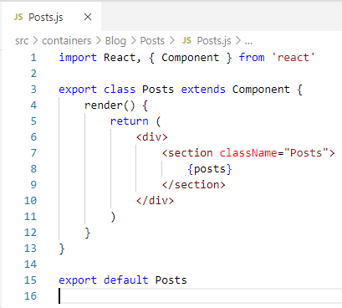
192 Prepare Routing
https://www.udemy.com/course/react-the-complete-guide-incl-redux/learn/lecture/8138542#notes
Prepare Routing
In Posts.js, type ‘rce’ (React Class Component ES7).

Slide 4
192 Prepare Routing
https://www.udemy.com/course/react-the-complete-guide-incl-redux/learn/lecture/8138542#notes
Prepare Routing
In Posts.js, type ‘rce’ (React Class Component ES7).

Slide 5
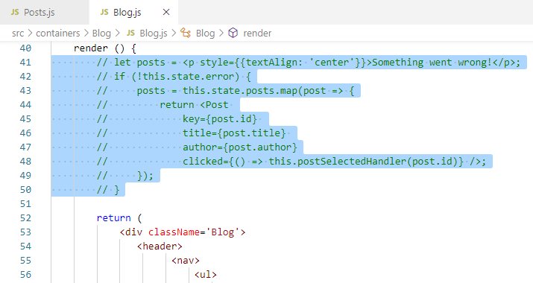
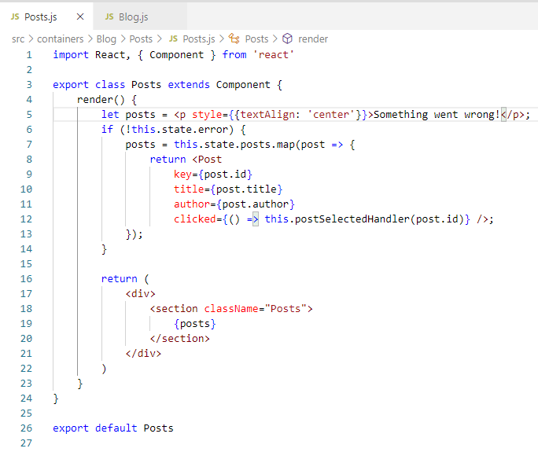
192 Prepare Routing
https://www.udemy.com/course/react-the-complete-guide-incl-redux/learn/lecture/8138542#notes
Prepare Routing
The posts is defined in Blog.js. Move posts to posts.js.

Slide 6
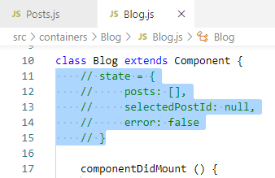
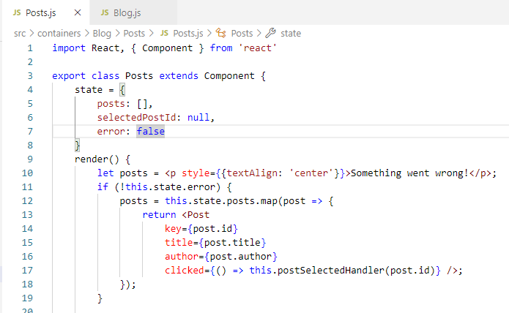
192 Prepare Routing
https://www.udemy.com/course/react-the-complete-guide-incl-redux/learn/lecture/8138542#notes
Prepare Routing
We need to move state from Blog.js to the post.js

Slide 7
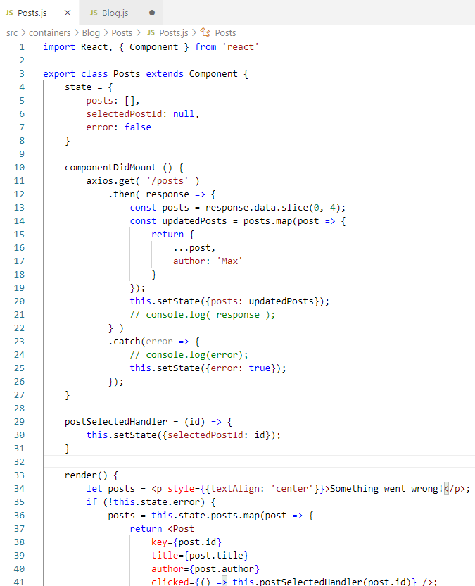
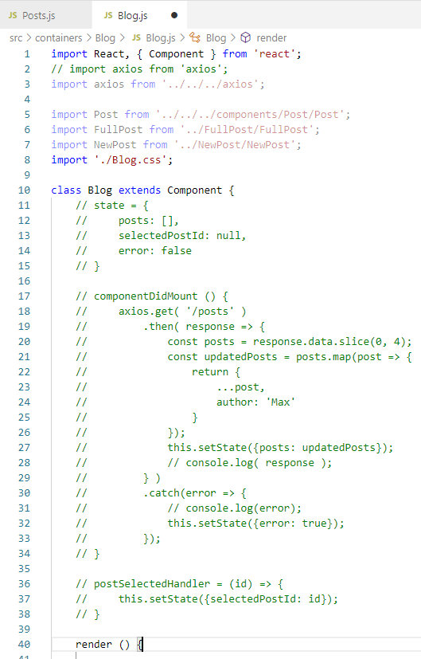
192 Prepare Routing
https://www.udemy.com/course/react-the-complete-guide-incl-redux/learn/lecture/8138542#notes
Prepare Routing
Move the handler from Blog.js to the Posts.js.

Slide 8
192.1 Create Posts Component

Slide 9
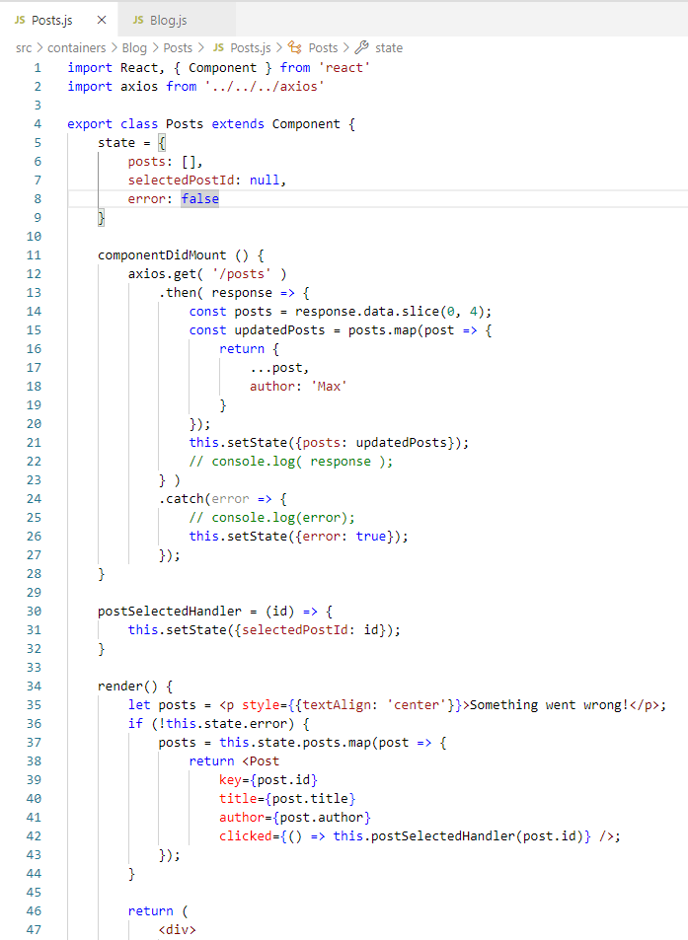
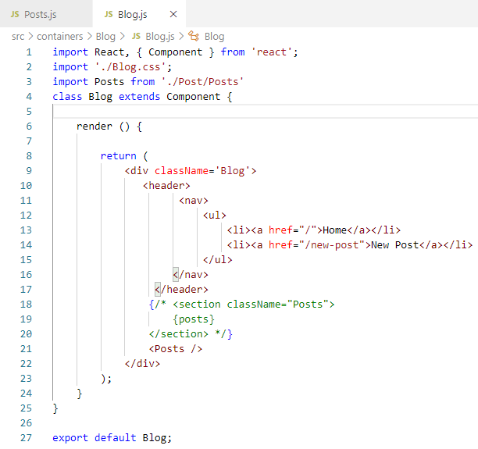
192.1 Create Posts Component
https://www.udemy.com/course/react-the-complete-guide-incl-redux/learn/lecture/8138542#notes
Create Posts Component
In the Blog.js, import Posts Component.

Slide 10
End of Chapter

