Slide 1

194 Component Route
Peter H. Chen

Slide 2
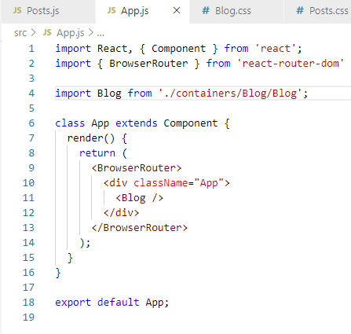
194 Component Route
https://www.udemy.com/course/react-the-complete-guide-incl-redux/learn/lecture/8138544#notes
Component Route
In the previous discussion, we have move the posts into the independent component.
We want to load the posts component dynamically depending on the path we have in the URL existed or display nothing if not existed.
In the App.js, we have <BrowserRouter> for <Blog /> component.

Slide 3
194.1 Load Different Pages

Slide 4
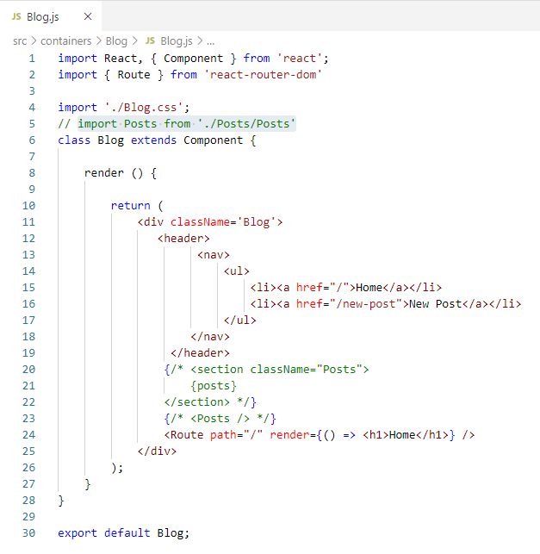
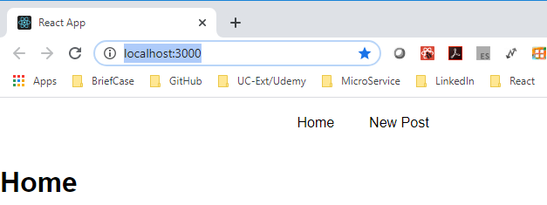
194.1 Load Different Pages
https://www.udemy.com/course/react-the-complete-guide-incl-redux/learn/lecture/8138544#notes
Load Different Pages
In the Blog.js, we wan to load different pages.
<Route path =“/” render = { () => < h1> Home </h1> } />

Slide 5
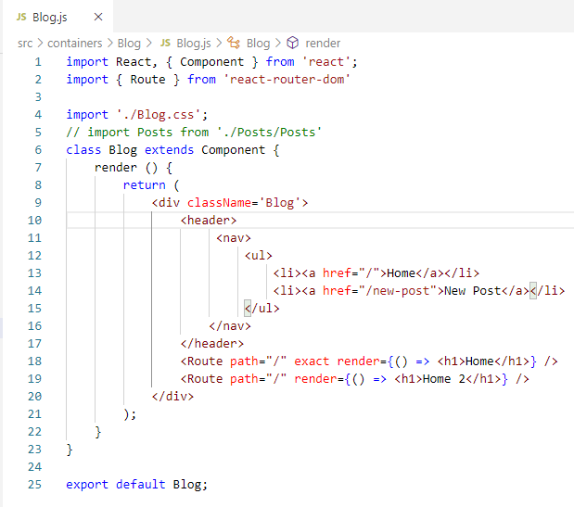
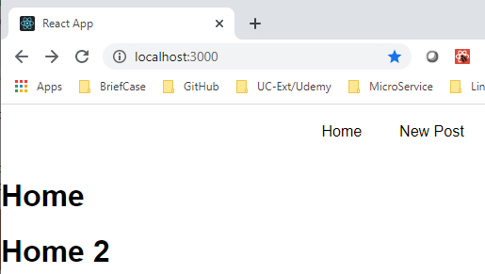
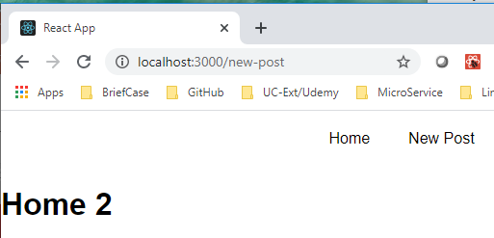
194.1 Load Different Pages
https://www.udemy.com/course/react-the-complete-guide-incl-redux/learn/lecture/8138544#notes
Load Different Pages
If we remove the exact in the second path, and click “New Post”
<Route path =“/” exact render = { () => < h1> Home </h1> } />
<Route path =“/” render = { () => < h1> Home 2 </h1> } />

Slide 6
194.1 Load Different Pages
https://www.udemy.com/course/react-the-complete-guide-incl-redux/learn/lecture/8138544#notes
Load Different Pages
We will start the component route in the next discussion.

Slide 7
End of Chapter

