Slide 1

195 Switch Page
Peter H. Chen

Slide 2
195 Switch Page
https://www.udemy.com/course/react-the-complete-guide-incl-redux/learn/lecture/8138550#notes
Switch Page
We add the switch page for the Route Package.

Slide 3
195.1 Load Different Pages
Peter H. Chen

Slide 4
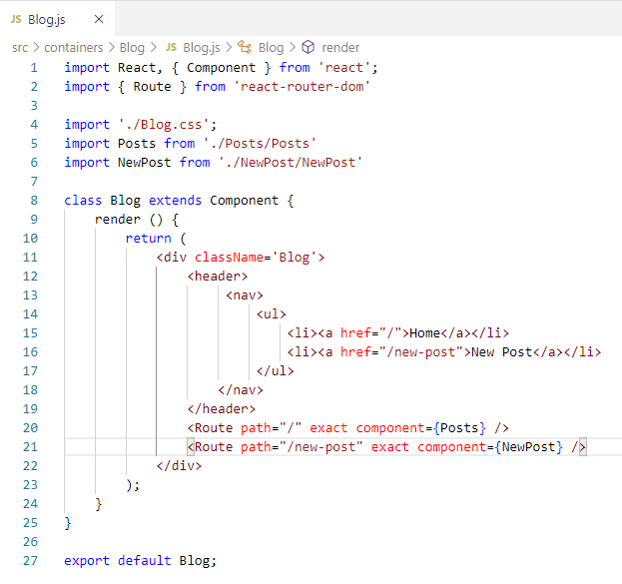
195.1 Load Different Pages
https://www.udemy.com/course/react-the-complete-guide-incl-redux/learn/lecture/8138550#notes
Load Different Pages
In the Blog.js, we wan to load different pages.
<Route path =“/” exact component = { Posts} />
<Route path =“/new-post” exact component = { NewPost} />

Slide 5
195.2 Verify

Slide 6
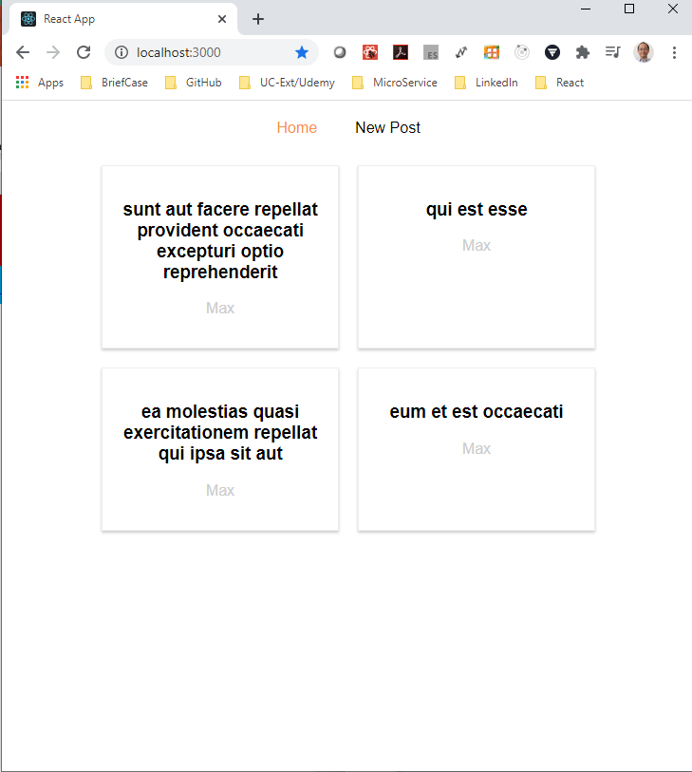
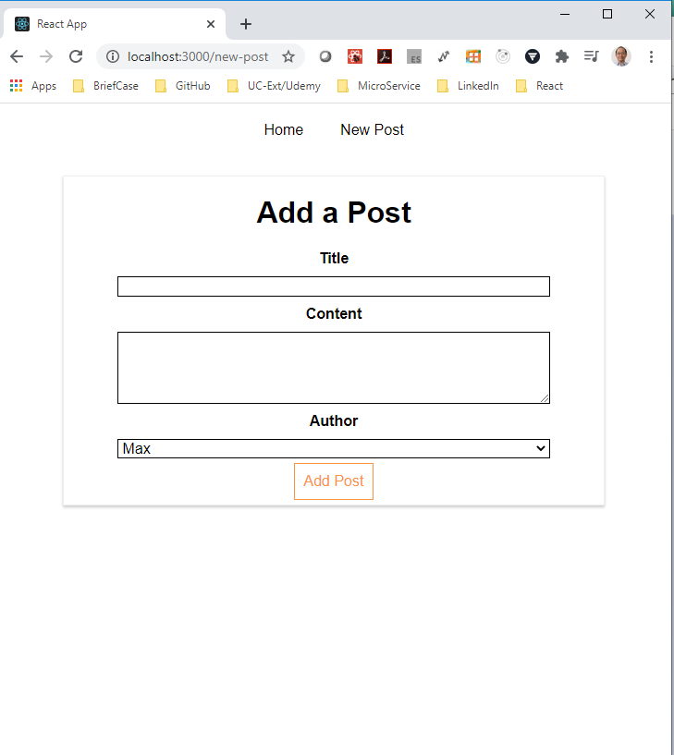
195.2 Verify
https://www.udemy.com/course/react-the-complete-guide-incl-redux/learn/lecture/8138550#notes
Verify
Click “Home” button for the home page.
Click “New Post” button for the “New Post” Page.

Slide 7
195.2 Verify
https://www.udemy.com/course/react-the-complete-guide-incl-redux/learn/lecture/8138550#notes
Verify
Right now, the page is reloaded.
We need the react router partially re-render the DOM.
We will discuss next how to primally update the DOM without re-render the entire page.

Slide 8
End of Chapter

